Slide 1
Automated XNAT Testing with Selenium and JIRA
Charlie Moore, June 7, 2016

Slide 2
Outline
Brief Introduction to Selenium
XNAT-themed tests based around Selenium and testNG:
CNDA Pipeline Tests
Brief overview of test integration with JIRA and Zephyr

Slide 3
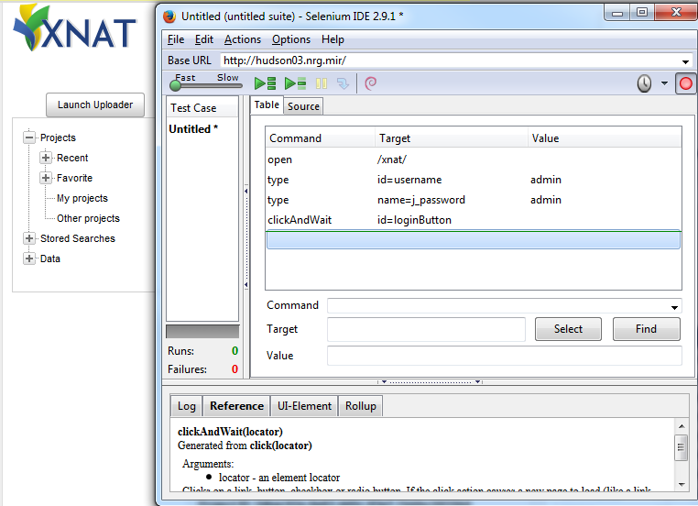
Getting Set up with Selenium
Selenium “IDE”
Pros:
Easy
Recording
Lightweight
Cons:
Scalability
Frailty
(Un)portability
Lightweight

Slide 4
Getting Set up with Selenium
Selenium WebDriver
Robust
Multiplatform/browser
Maintainable
Available at:
http://www.seleniumhq.org/download/, or
Java library available with maven:
<dependency> <groupId>org.seleniumhq.selenium</groupId> <artifactId>selenium-java</artifactId> <version>2.53.0</version> </dependency>

Slide 5
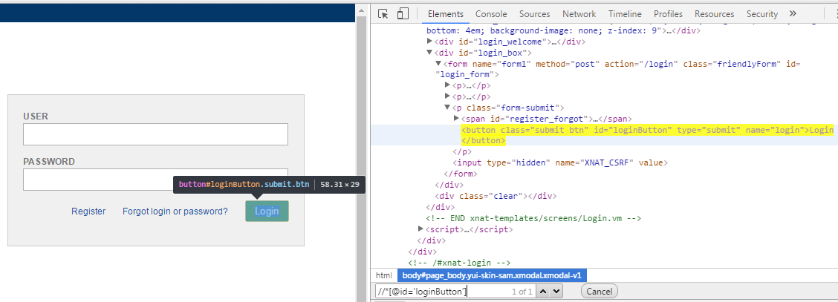
Getting Started with Selenium
Identifying elements of interest:
Gold standard: element ids
Plan B: More advanced locating strategies like XPath
Working with WebElements:
Predefined methods for clicks, filling fields, etc.
driver.findElement(By.id("loginButton")).click();

Slide 6
CNDA Selenium Pipeline Tests
Base NRG Selenium Package:
Source of the engine to actually run the tests.
Extra Crispy 1.7 version: https://bitbucket.org/xnatdev/nrg_selenium
Legacy 1.6 version: https://bitbucket.org/xnatdev/nrg_selenium_1_6
CNDA pipeline tests use 1.6 since CNDA is running XNAT 1.6
CNDA Pipeline Test Package:
Contains specific CNDA pipeline tests.
Available at: https://bitbucket.org/xnatdev/cnda_selenium_pipeline_tests

Slide 7
Pipeline Test Schematic (testNG annotations)
@BeforeSuite:
Check to ensure that the selenium user account is setup correctly on CNDA
@Test phase:
Launch all pipelines, each launch corresponding to 1 @Test
For each pipeline that passed the launch phase, run various customized checks on the session to ensure correct pipeline execution. The checks for each session correspond to 1 @Test and include:
Creation of assessors
Files created under parent session resources/scans, files created under assessor
Values displayed in created assessors, checked to match specified criteria such as exact equality, within 1% error, etc.

Slide 8
Pipeline Launch Test
Entire test can be constructed as a List of simple elements describing basic core operations (click, fill text, select dropdown option, etc.)
@Test() public void testLaunchFS_PUP() { config.add(new TestStepElement(By.id("start"), XNATLocators.BUTTON_ADVANCE)); config.add(new SelectElement(By.name("pet_scan_id"), "5: DIAN PIB 336mtx (AC)")); config.add(new TestStepElement(By.id("start"), XNATLocators.BUTTON_ADVANCE)); config.add(new ClickElement(By.xpath("//input[@value='freesurfer']"))); config.add(new TestStepElement(By.id("start"), XNATLocators.BUTTON_ADVANCE)); config.add(BUTTON_ADVANCE_CLICK_ELEMENT); config.add(new TestStepElement(By.id("start"), XNATLocators.BUTTON_ADVANCE)); config.add(new ClickElement(By.xpath("//input[@data-mrlabel='PUP_FS_MR']"))); config.add(new TestStepElement(By.id("start"), XNATLocators.BUTTON_ADVANCE)); config.add(BUTTON_ADVANCE_CLICK_ELEMENT); config.add(new TestStepElement(By.id("start"), XNATLocators.BUTTON_ADVANCE)); config.add(new FillElement(By.name("refroistr"), "Cerebellum-Cortex")); config.add(new TestStepElement(By.id("start"), XNATLocators.BUTTON_ADVANCE)); config.add(BUTTON_ADVANCE_CLICK_ELEMENT); config.add(new TestStepElement(By.id("start"), XNATLocators.BUTTON_ADVANCE)); config.add(new SimpleClickElement(XNATLocators.BUTTON_ADVANCE)); config.add(new AlertElement("Build pipeline with these parameters?")); config.add(new TestStepElement(By.xpath("//*[contains(text(), 'The build process was successfully launched')]"), By.xpath("//td[@valign='bottom']"))); config.add(new SimpleClickElement(By.xpath("//input[@value='CLOSE']"))); performPipelineTest(PUP_FS_SESSION, "PETUnifiedPipeline", PUP_HISTORY_NAME); }

Slide 9
Pipeline Check Test
Standardized steps pass through checkPipelineTest method. Customized operations are added after checkPipelineTest() method is called.
@Test() public void testCheckFS_PUP() { checkPipelineTest(PUP_FS_SESSION, Collections.singleton("PUP Timecourse"), null, 600, 60 * 60 * 4, PUP_HISTORY_NAME); seleniumUtils.exceptionSafeClick(By.linkText("PUP Timecourse")); captureStep(XNATLocators.H2_TAG, XNATLocators.DELETE_LINK); compareTable(importValuesFromCSV("PUP_FS_values.csv", PUP_FS_SESSION), "FS PUP Summary values", XNATLocators.SHORT_SUMMARY_TABLE, XNATLocators.QC_RESULTS_TABLE); driver.findElement(By.linkText("View Full Results")).click(); seleniumUtils.captureTable(FULL_TABLE, 16); compareTable(importValuesFromCSV("PUP_FS_values_page_2.csv", PUP_FS_SESSION), "FS PUP Full values"); logLogout(); checkVerificationErrors(); }

Slide 10
Now what?
Great, I have these Selenium tests, but…
What happens when something goes wrong?
Alternatively, what if I want a record of my tests?
Both concerns are alieviated by integrating Selenium tests with JIRA (more specifically, the Zephyr and ZAPI JIRA plugins).
Provided by nrg_selenium packages mentioned earlier

Slide 11
JIRA Integration Schematic (testNG annotations)
@BeforeSuite phase:
Create a new Test Cycle under the specified JIRA project and version.
Add an execution for each test to be run under this cycle.
@Test phase:
As each @Test begins, corresponding execution is updated from unexecuted to WIP (Work in Progress)
Steps are updated in JIRA as @Test reaches key points.
Upon successful @Test completion or failure, corresponding execution is updated appropriately.

Slide 12
Final Product
A portion of a test execution in JIRA:

Slide 13
Wrapping Up
List of all links in presentation:
http://www.seleniumhq.org/download/
https://bitbucket.org/xnatdev/nrg_selenium
https://bitbucket.org/xnatdev/nrg_selenium_1_6
https://bitbucket.org/xnatdev/cnda_selenium_pipeline_tests
Questions?
You can also email me later: moore.c@wustl.edu

