Slide 2
XNAT in Cancer, Diagnosis, Therapy and Research
Simon Doran
Cancer Research UK Cancer Imaging Centre
Institute of Cancer Research
London, UK

Slide 3
Acknowledgements
  Imaging Centre
  James d’Arcy Rafal Panek Liam Welsh
  Matt Orton Jess Winfield Fenna Kwaks
  Matt Blackledge David Collins
  ICR IT staff
  Tolis Sisiaridis Steve Cox Mark Allen
  Jon Lockley David Silva Peter Thompson
  Ian Giddings Flavio Zanchi Terry Woolfries
  RT Physics Knowledge Hub
  Dualta McQuaid Bissan Al-Lazikani Anguraj Sadanandam
  Alex Dunlop Carmen Rodriguez-Gonzalvez Sheng Yu
  Simeon Nill Verónica García-Pérez
  UCL All the patients whose data we used.
  Ben Yvernault

Slide 4
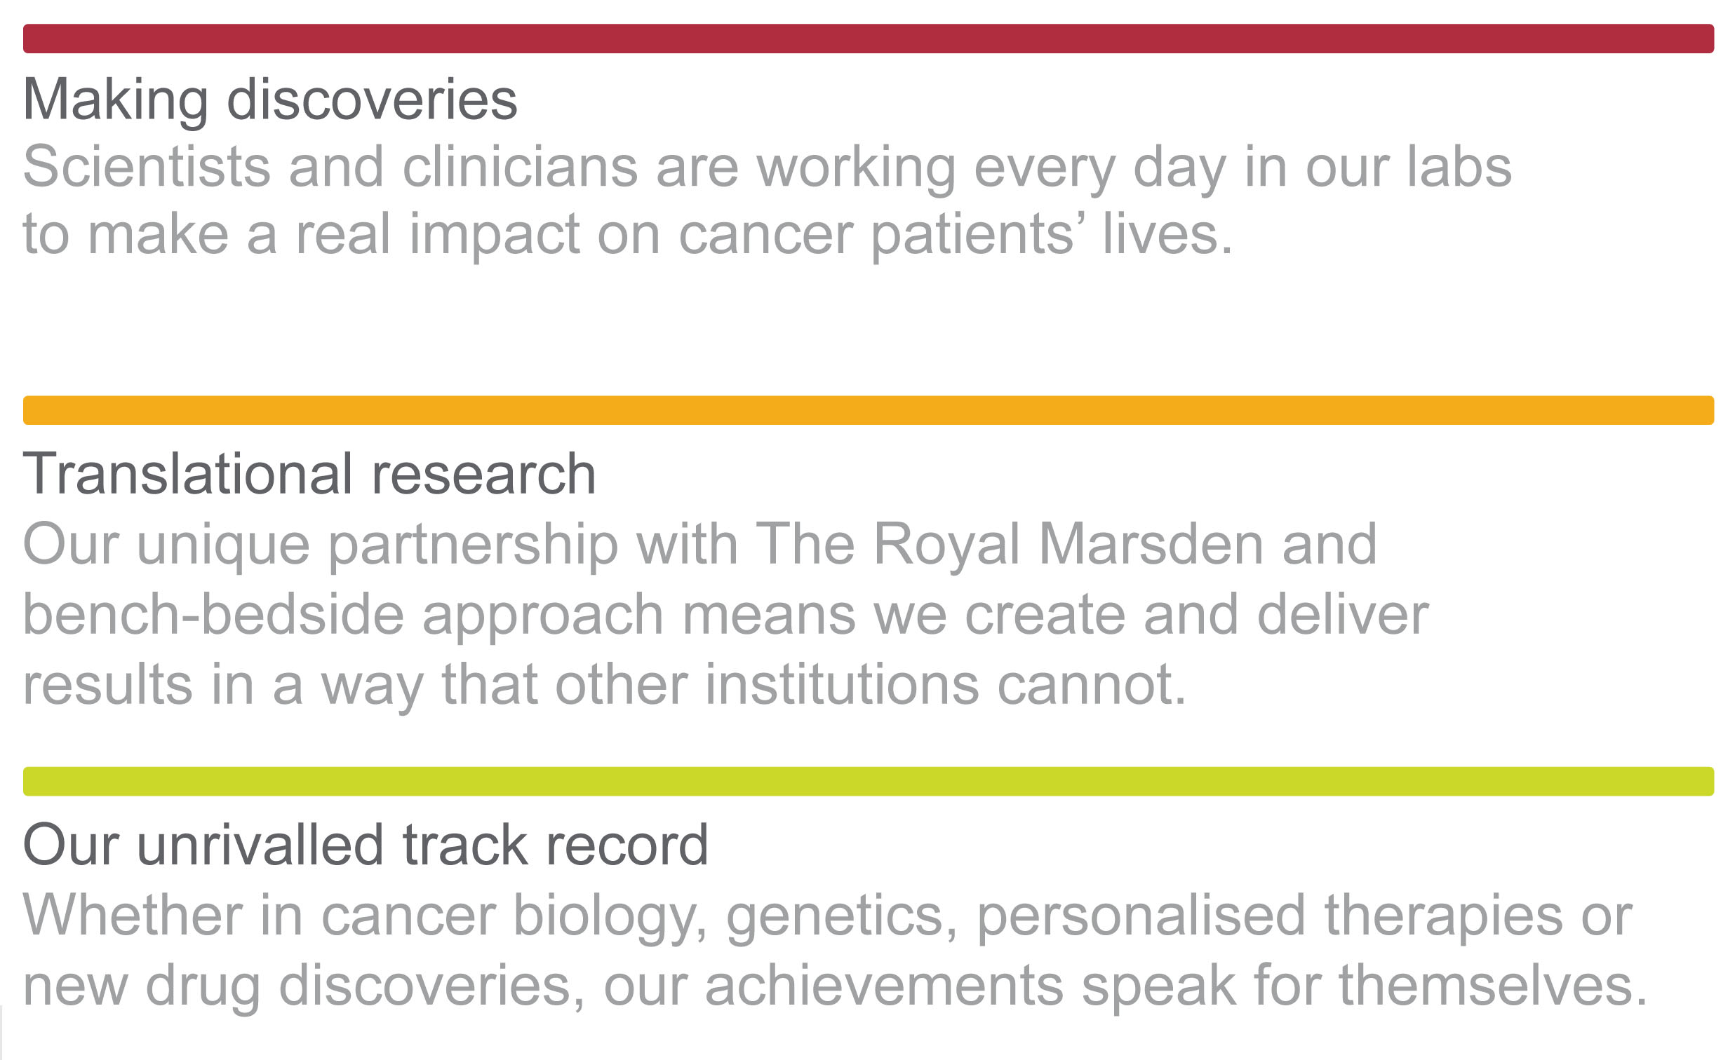
Talk outline
1 Context: XNAT at the ICR
2 Big Data at the ICR
3 Schema extensions

Slide 5
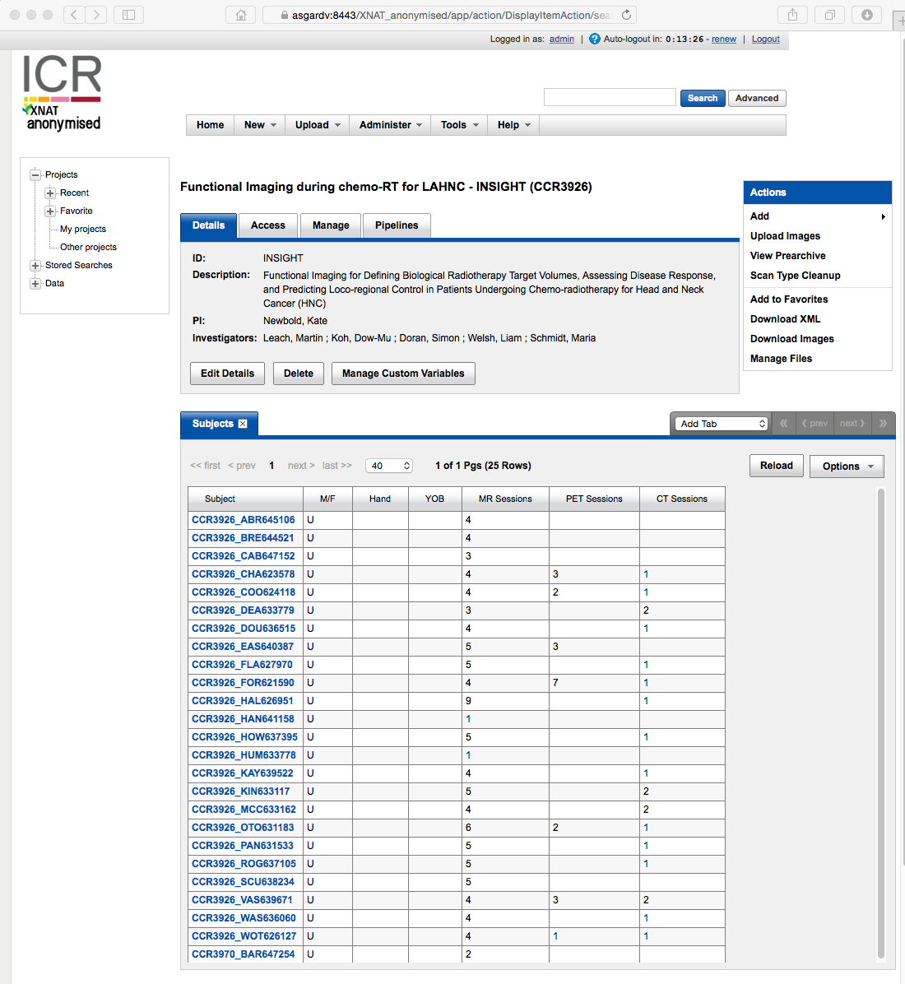
1
  Context:
  XNAT at the ICR

Slide 6
XNAT production installations at ICR
  eXtensible Neuroimaging Archive Toolkit (XNAT)
XNAT_identifiable
  XNAT 1.6 installation (capacity 200 TB)
  77 projects, 9228 imaging sessions
  Dell server (RHEL 6) with geo-dispersed Lattus™ storage based from Quantum
  Sits behind clinical firewall, but used for research, not primary patient care
  Contains completely unanonymised data, uploaded via direct DICOM push from scanners or clinical PACS
  XNAT_anonymised
  Medium-scale (~16 TB) XNAT 1.6.5 installation
  108 projects, 3700 imaging sessions
  Live-mirrored Dell R730 servers on two sites
  High-availability technology
  XNAT_CRUK
  Multi-centre clinical trials
  Prototype for UK national cancer imaging data repository

Slide 7

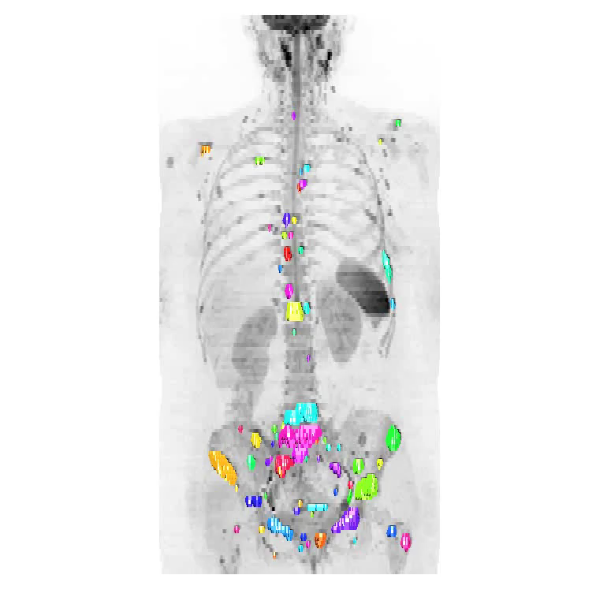




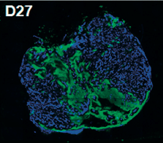
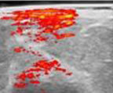
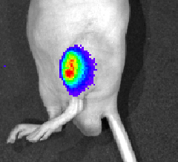


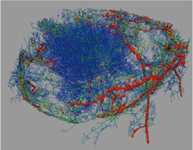
This is my day job; by night I’m really a physicist!
MRIS
CT
PET
SPECT
US
Repository for multi-centre trials
Process
DICOM modalities
Microscopy
whole-slide
confocal
time-lapse
Optical CT
absorption
emission
FLIM/FRET
OCT
IVIS
Photoacoustic
Elastography
Spectral CZT
micro x-ray CT
MALDI
genomic
Register results back in database with provenance.
Import images with complete metadata regardless of origin
Whole-cohort processing pipelines
3-D interaction with registered multimodality data
Oontology, controlled vocabulary and content-based image search
Automatic segmentation
Modelling
multi-parametric
spatial / statistical
hierarchical
(lesion, lesion class,
timepoint, patient, cohort)
non-DICOM modalities
Notes:
First panel: MRI, CT, PET are now being stored routinely in the database. XNAT can load all the other modalities, too, but we are not yet taking advantage of any additional metadata in the DICOM files.
Second panel: Data files of all these types can be stored in the database, but it is a part of the Knowledge Hub task to use all the metadata. We have established the principles, but now the task is just to step through the modalities one by one and do the coding. To the best of my knowledge all the displayed data will come from the CCI. However, I have not yet seen any evidence of data from OCT, multi-spectral CZT or MALDI We already have absorption optical CT data. Part of my student’s PhD project is to develop emission optical CT. FLIM/FRET is a much later development, potentially with an Imperial Collaboration if the ICR-Imperial hook-up takes off.
Third panel: We have demonstrated the linkage between XNAT and in-house packages. It works, but, again it is just a question of staff time to implement. 3-D interaction is a big theme for the next 5-year programme.
Fourth panel: video shows whole-body apparent diffusion coefficient MRI image. Individual lesions have been selected by a semi-automatic algorithm.
Fifth panel: Registering the results back in the database with provenance is important from an informatics point of view. We can already do it with output from some in-house software. We currently have semi-automatic segmentation, making this completely automatic is an aspiration and a little speculative. It is worth stressing that this example epitomises the value of the informatics system. For whole-body MRI diffusion-weighted imaging, we will be registering several hundred ROI’s per scan, each with individual mean, median, mode and histogram statistics. We will then be performing our hierarchical modelling.

Slide 8
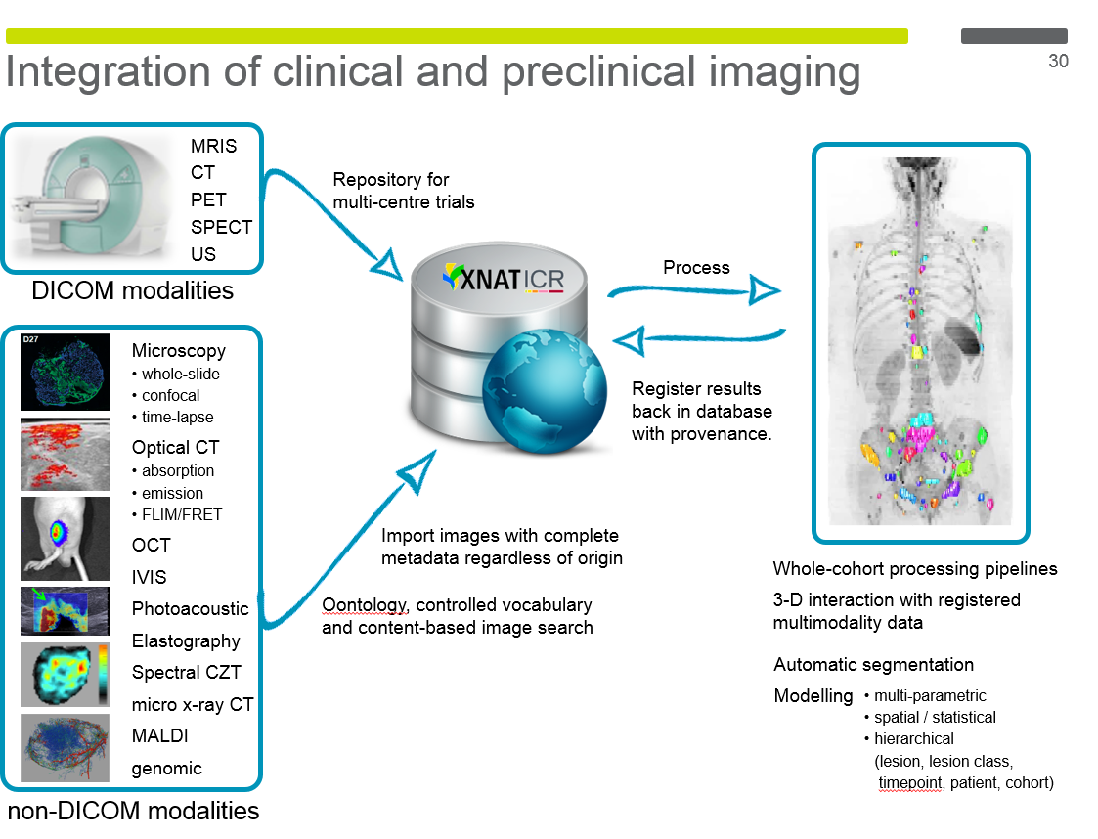
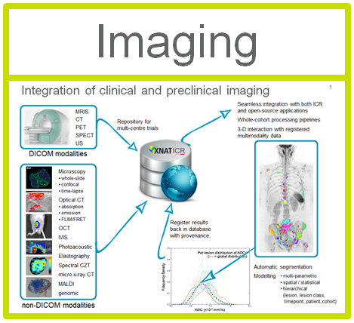
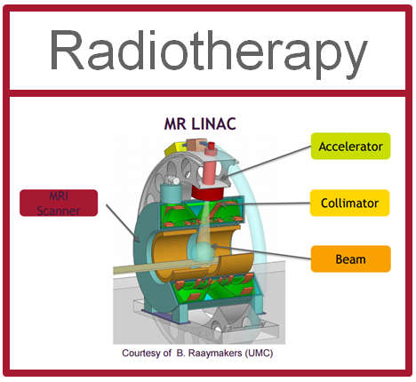
Division of Radiotherapy and Imaging

Slide 9
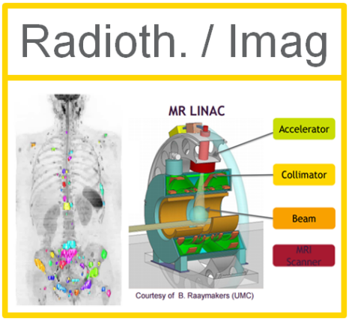
Division of Radiotherapy and Imaging

Slide 10
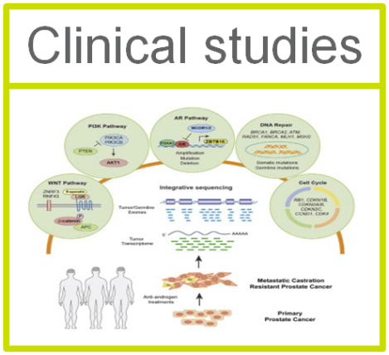
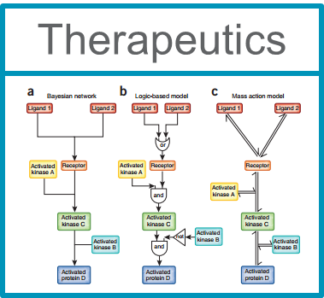


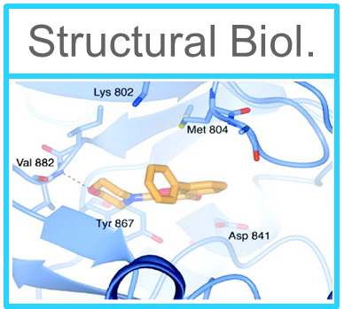
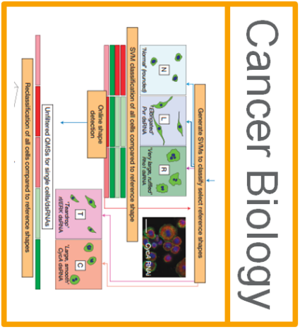
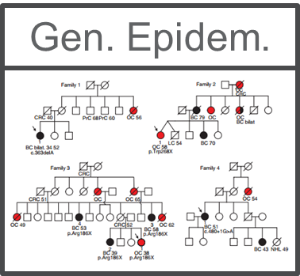
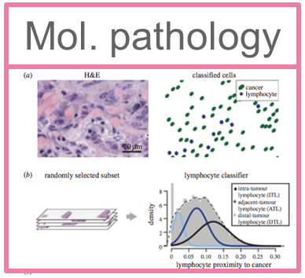
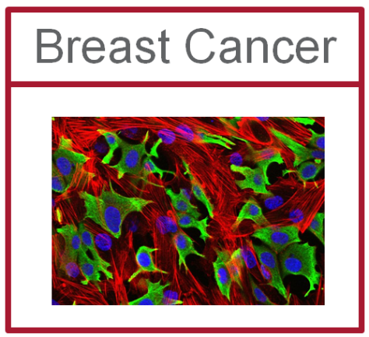
The Institute of Cancer Research

Slide 11
The Institute of Cancer Research
  Research Institute
  UK Higher Education Institute
  College of the University of London
  Top in RAE2008 and REF2014
  Registered charity
  Europe’s largest comprehensive
  cancer care centre
  In conjunction with the Royal
  Marsden Hospital

Slide 12
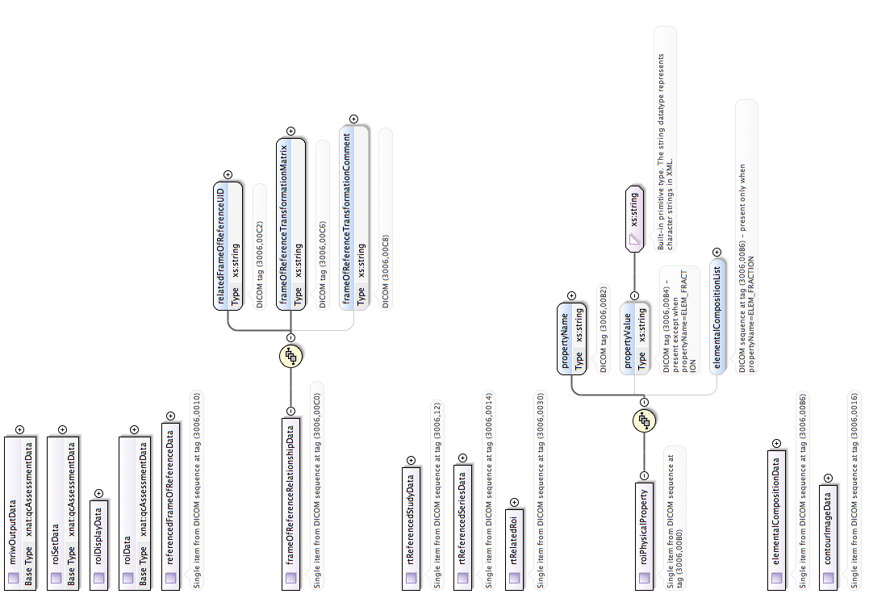
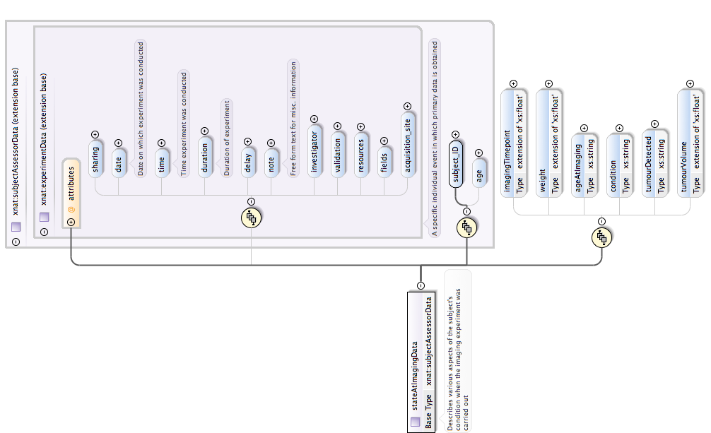
2
  Big Data and the Knowledge Hub

Slide 13
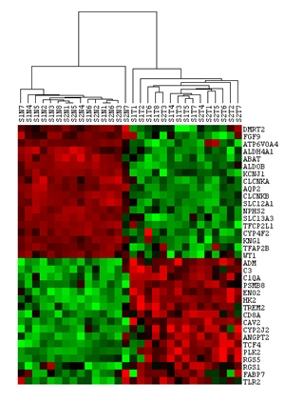
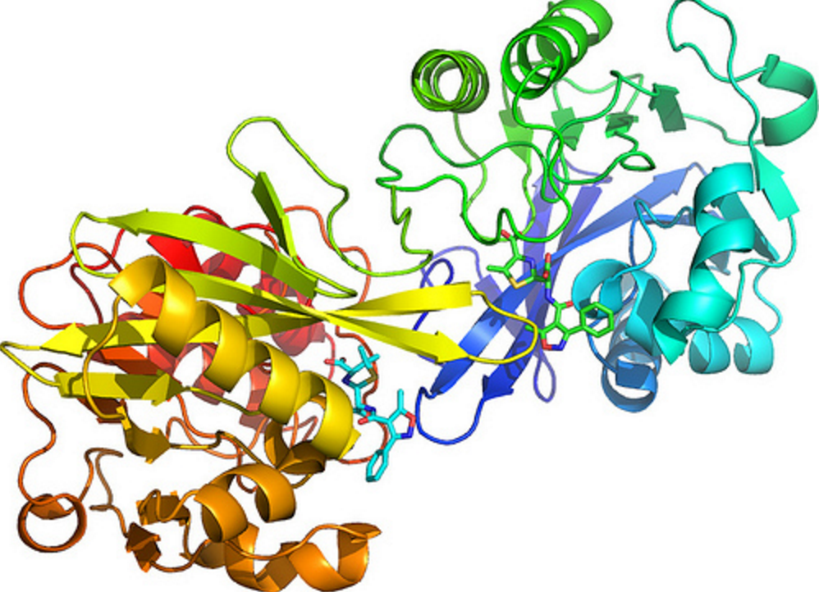
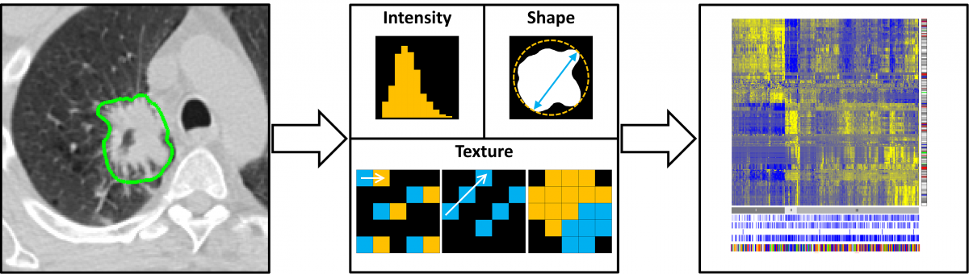
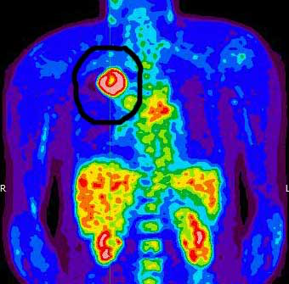
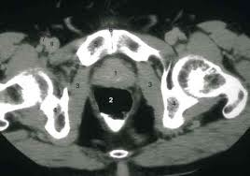

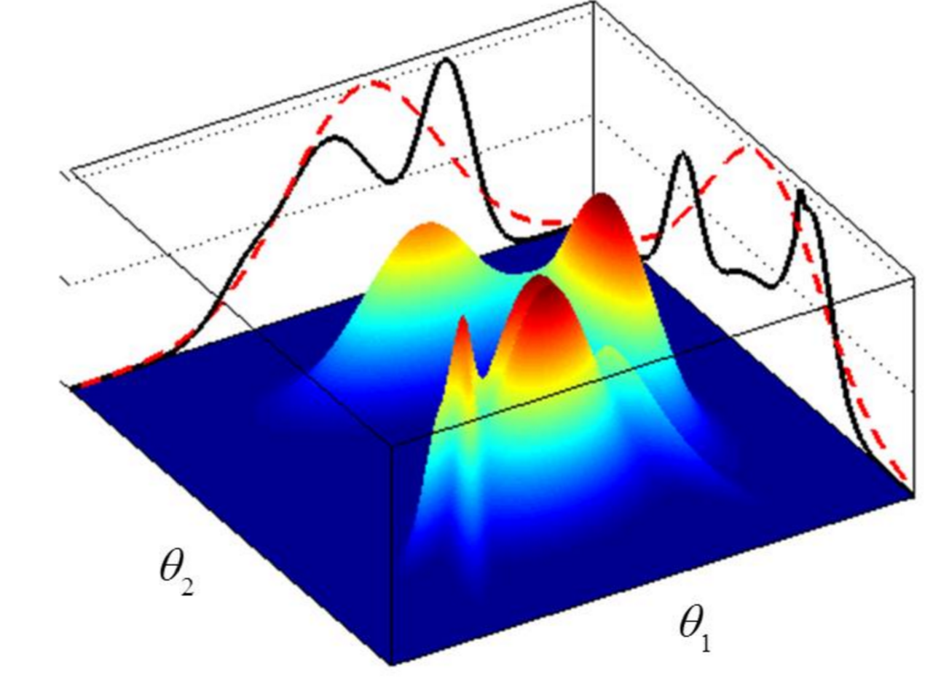


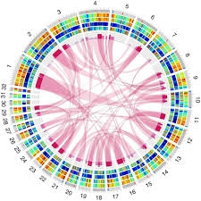
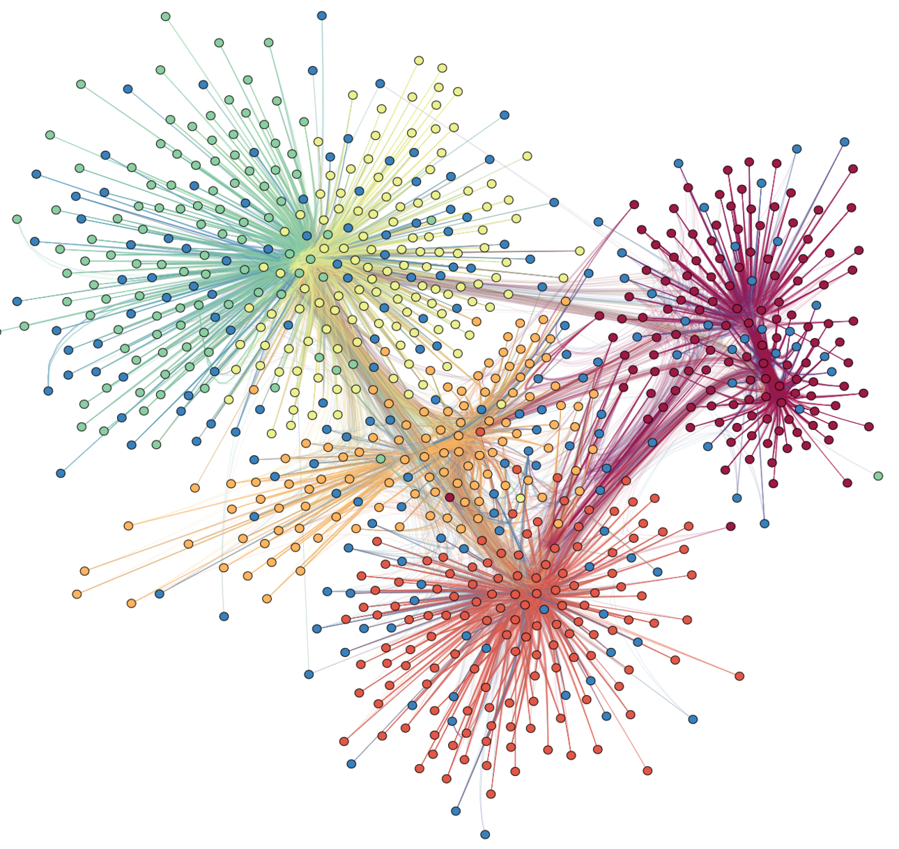
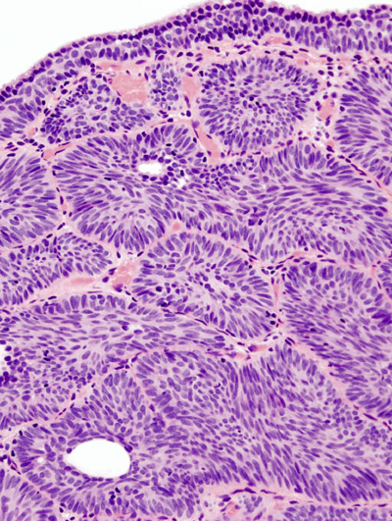
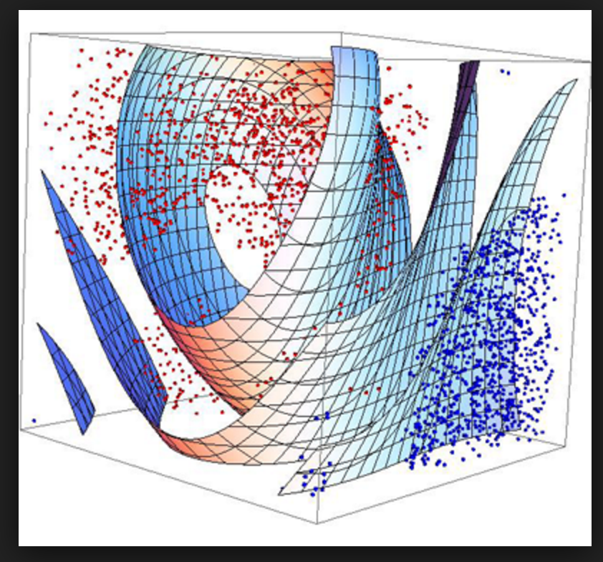

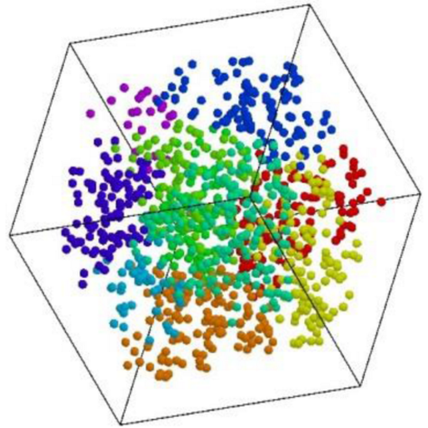
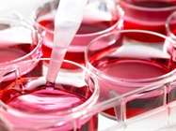
Big Data at ICR
Slide courtesy of Carmen Rodriguez-Gonzalvez
ICR currently dealing with data holdings of ~2 PB with capacity for 6 PB by Q4.
Of this, probably less than 50 TB are imaging data from clinical modalities!
Collect Data
Abstract
The Knowledge Hub:
Research group to interpret & mine a diversity of data
Model
Link
Predict
Personalised
Therapies
Synergism …
Hypothesis
Novel drug
targets
&

Slide 14
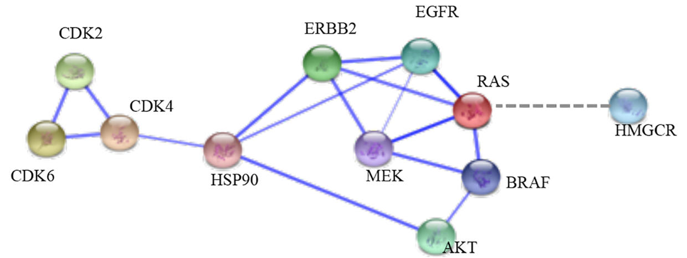
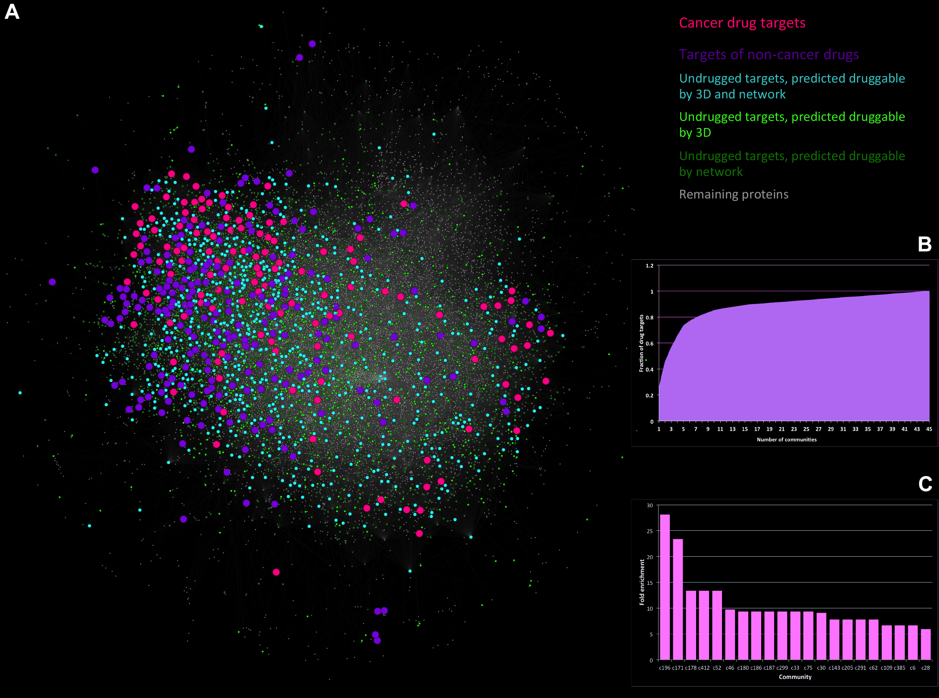
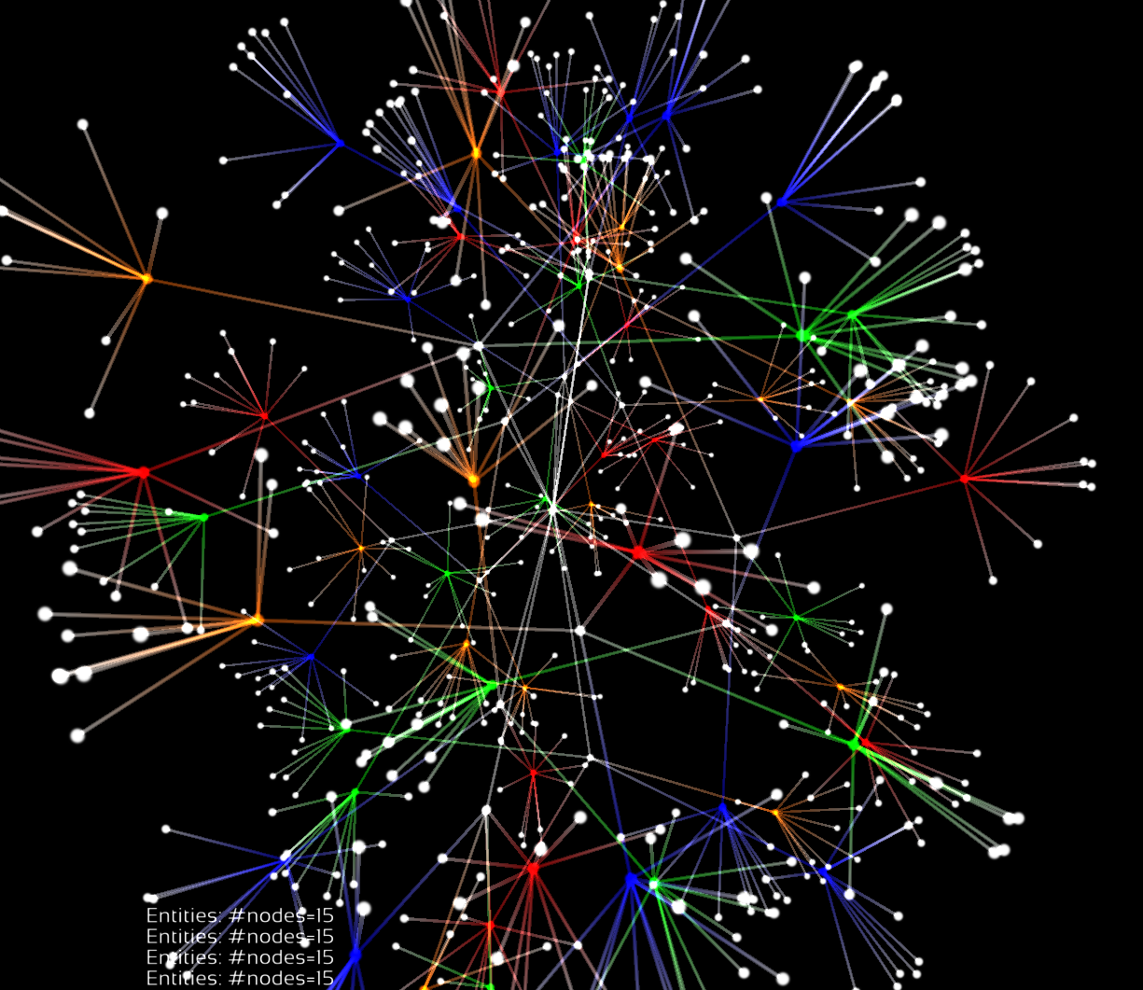
Academic methodologies from social media?
The Knowledge Hub is a large, noSQL database, incorporating ontologies, represented in RDF.
Aims to work cooperatively with ICR’s existing databases
XNAT
Hospital electronic patient record
CanSAR: drug discovery database written at ICR > 50,000 independent users (Google Analytics)
Cell bank data … and many more
Slide courtesy of Sheng Yu
Images fromDistinctive Behaviors of Druggable Proteins in Cellular Networks, PLoS One, Dec. 2015.
Costas Mitsopoulos, Amanda C. Schierz, Paul Workman, Bissan Al-Lazikani

Slide 15
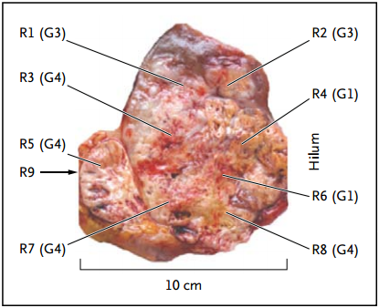
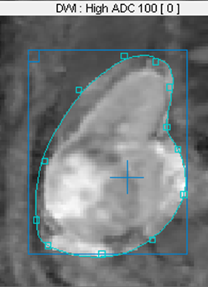
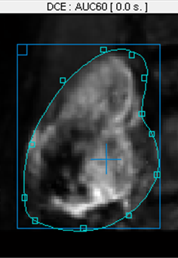
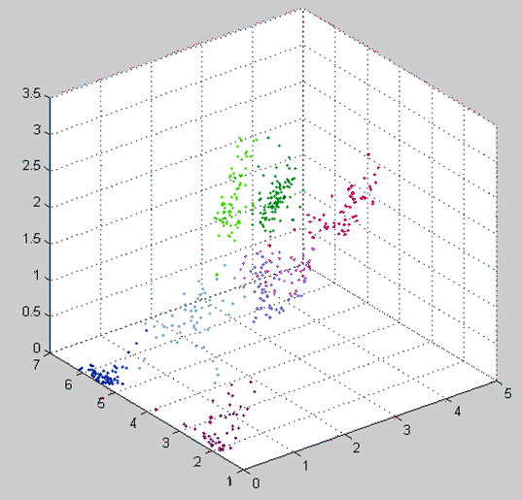

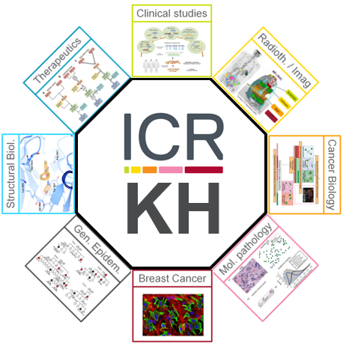
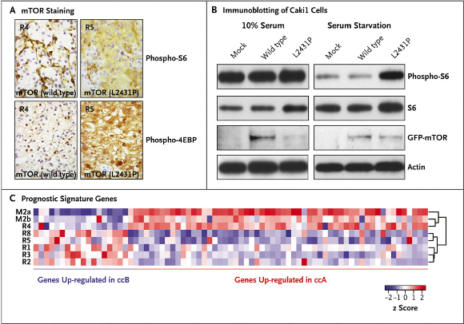
Integration of imaging and genomics
INVASIVE
NON-INVASIVE
DWI
DCE
Existing Imaging Centre work on same patients
[Gd]_{eq}
Imaging pre- and post drug treatment
ADC
AUC60
Hypothesis: A new paradigm of personalised treatment can be enabled by the Knowledge Hub.
Use Knowledge Hub to identify regions of viable, drug-resistant tumour from multi-functional imaging data.
Use results to obtain image-guided biopsy.
Use Knowledge Hub to find closest match to patient tissue in cell and tissue banks, 2D / 3D tumour model database.
Culture patient cells with different drug combinations suggested by Knowledge Hub to find most efficacious, personalised therapy.
Gerlinger et al. NEJM 2012
(2800+ citations)
Notes:
Drug trial of Everolimus on metastatic renal cell carcinoma patients.
Initial panel: Assume everyone aware of Marco Gerlinger’s NEJM paper.
People might not know that in parallel with the genomics element of the invasive sampling, multi-functional imaging was conducted pre- and 28-days post neoadjuvant therapy.
Second panel: In existing work at the CRUK Cancer Imaging Centre, we performed spatial registration on T1-weighted, T2-weighted, Dynamic Contrast-Enhanced MRI and Diffusion-Weighted MRI and then performed multiparametric analysis on the resulting data.
Three parameters used to classify regions, with radiologist prior experience used for initial parameter estimates. Variety of different classification algorithms give similar results. Classes examined: healthy medulla, healthy cortex, viable tumour, necrosis, fibrosis, plus two “mixture classes”.
Panel 3: Illustrated is how the Knowledge Hub could use these types of data to provide a genuine implementation of personalised therapy for patients.

Slide 16
3
  Schema extensions

Slide 17
What attracted me to XNAT?
  It’s eXtensible!
  It’s eXtensible!

Slide 18
What attracted me to XNAT?
  Making the best use of extensibility
  For me, the most exciting aspect is that the schema is extensible.
  But, we need to put in some work to upload data and be able to search it.
  Here’s a common pattern:
  Upload some DICOMs and create a session.
  Create some resource folders under the session.
  Upload non-DICOM data files.
  Question: How do you search on what you have uploaded?

Slide 19
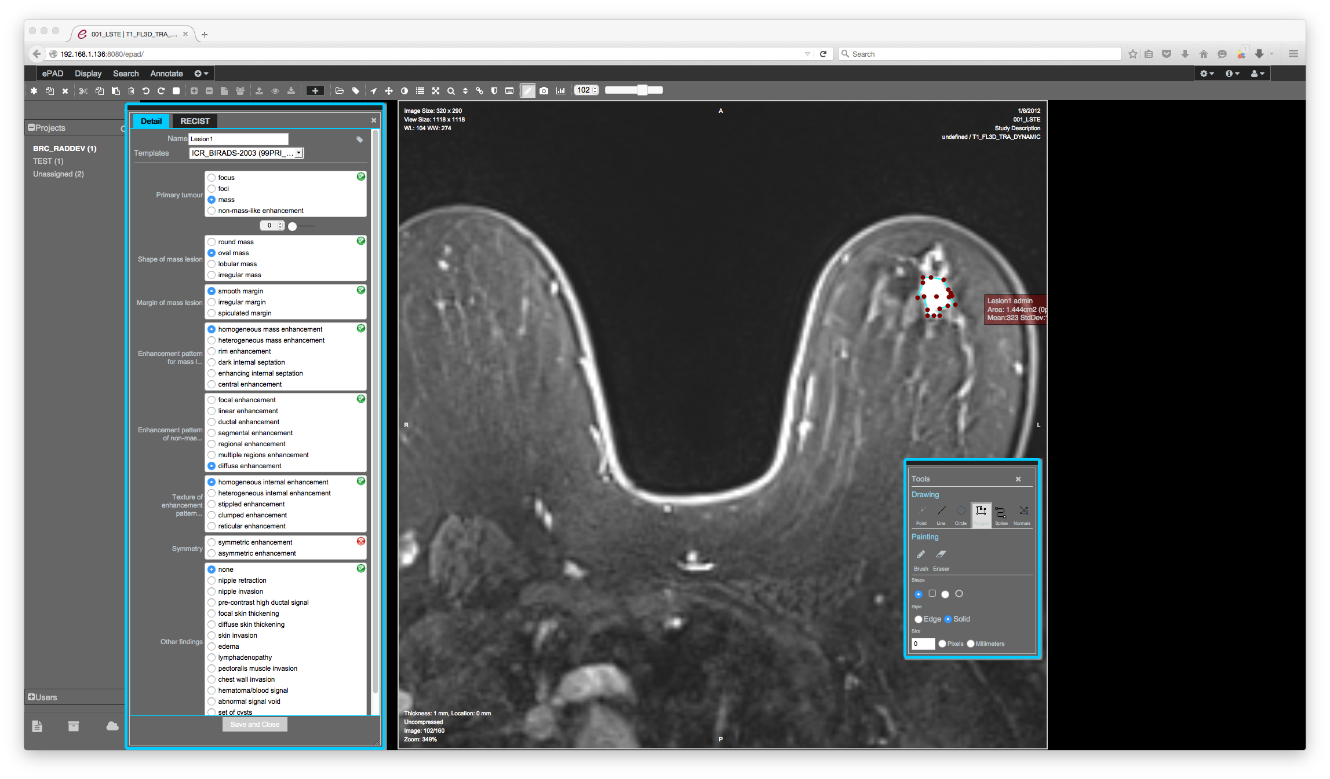
Example 1: Image annotation

Slide 20
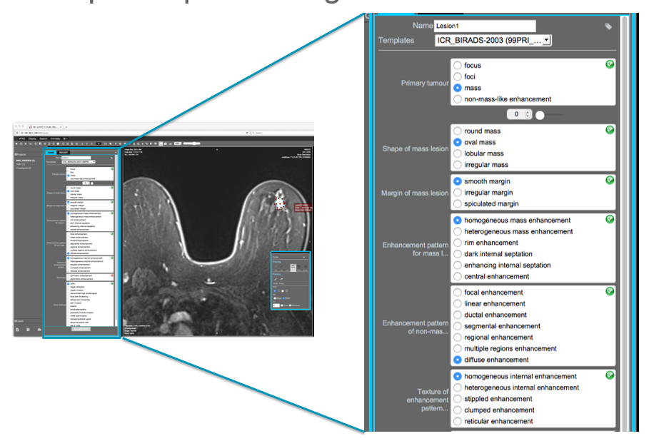
Example 1: Image annotation

Slide 21
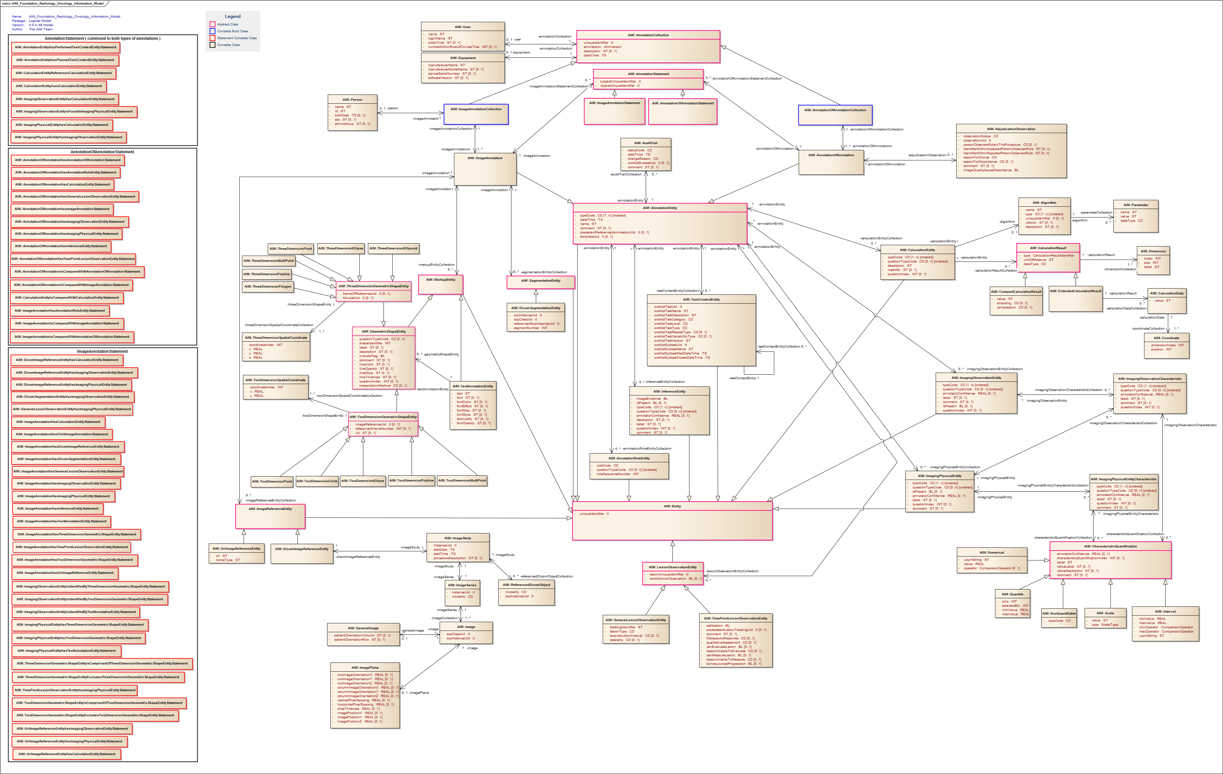
Example 1: Image annotation
  The AIM UML diagram

Slide 22
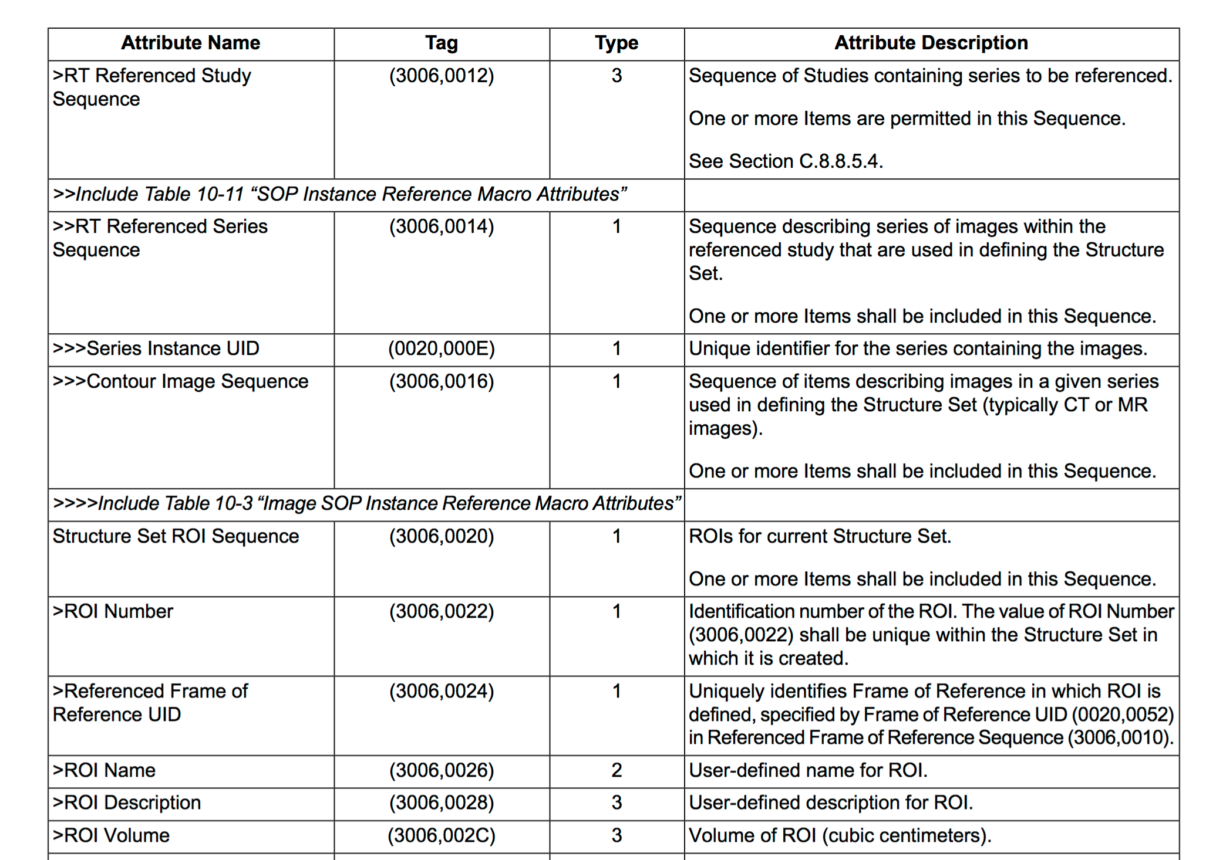
Example 2: DICOM RT-STRUCT file

Slide 23
Now here’s my search question
  All the information is in XNAT, but how do I get it?
  “Get me a visualisation of the radiotherapy planning treatment volume (PTV) for all patients with an enhancing tumour > 2 cm in diameter.”
  Where are the data?
  Enhancement description and tumour diameter buried in large AIM XML file
  ROI definitions in RT-STRUCT files
  Image data (on which to overlay ROIs) in existing ctSession
  Problem: XNAT doesn’t know anything* about the contents of
  the new resources
  Answer: Create custom XNAT assessors for each datatype uploaded
  and parse the metadata from the sources on ingestion.
  * Except for what is in the tags.

Slide 24
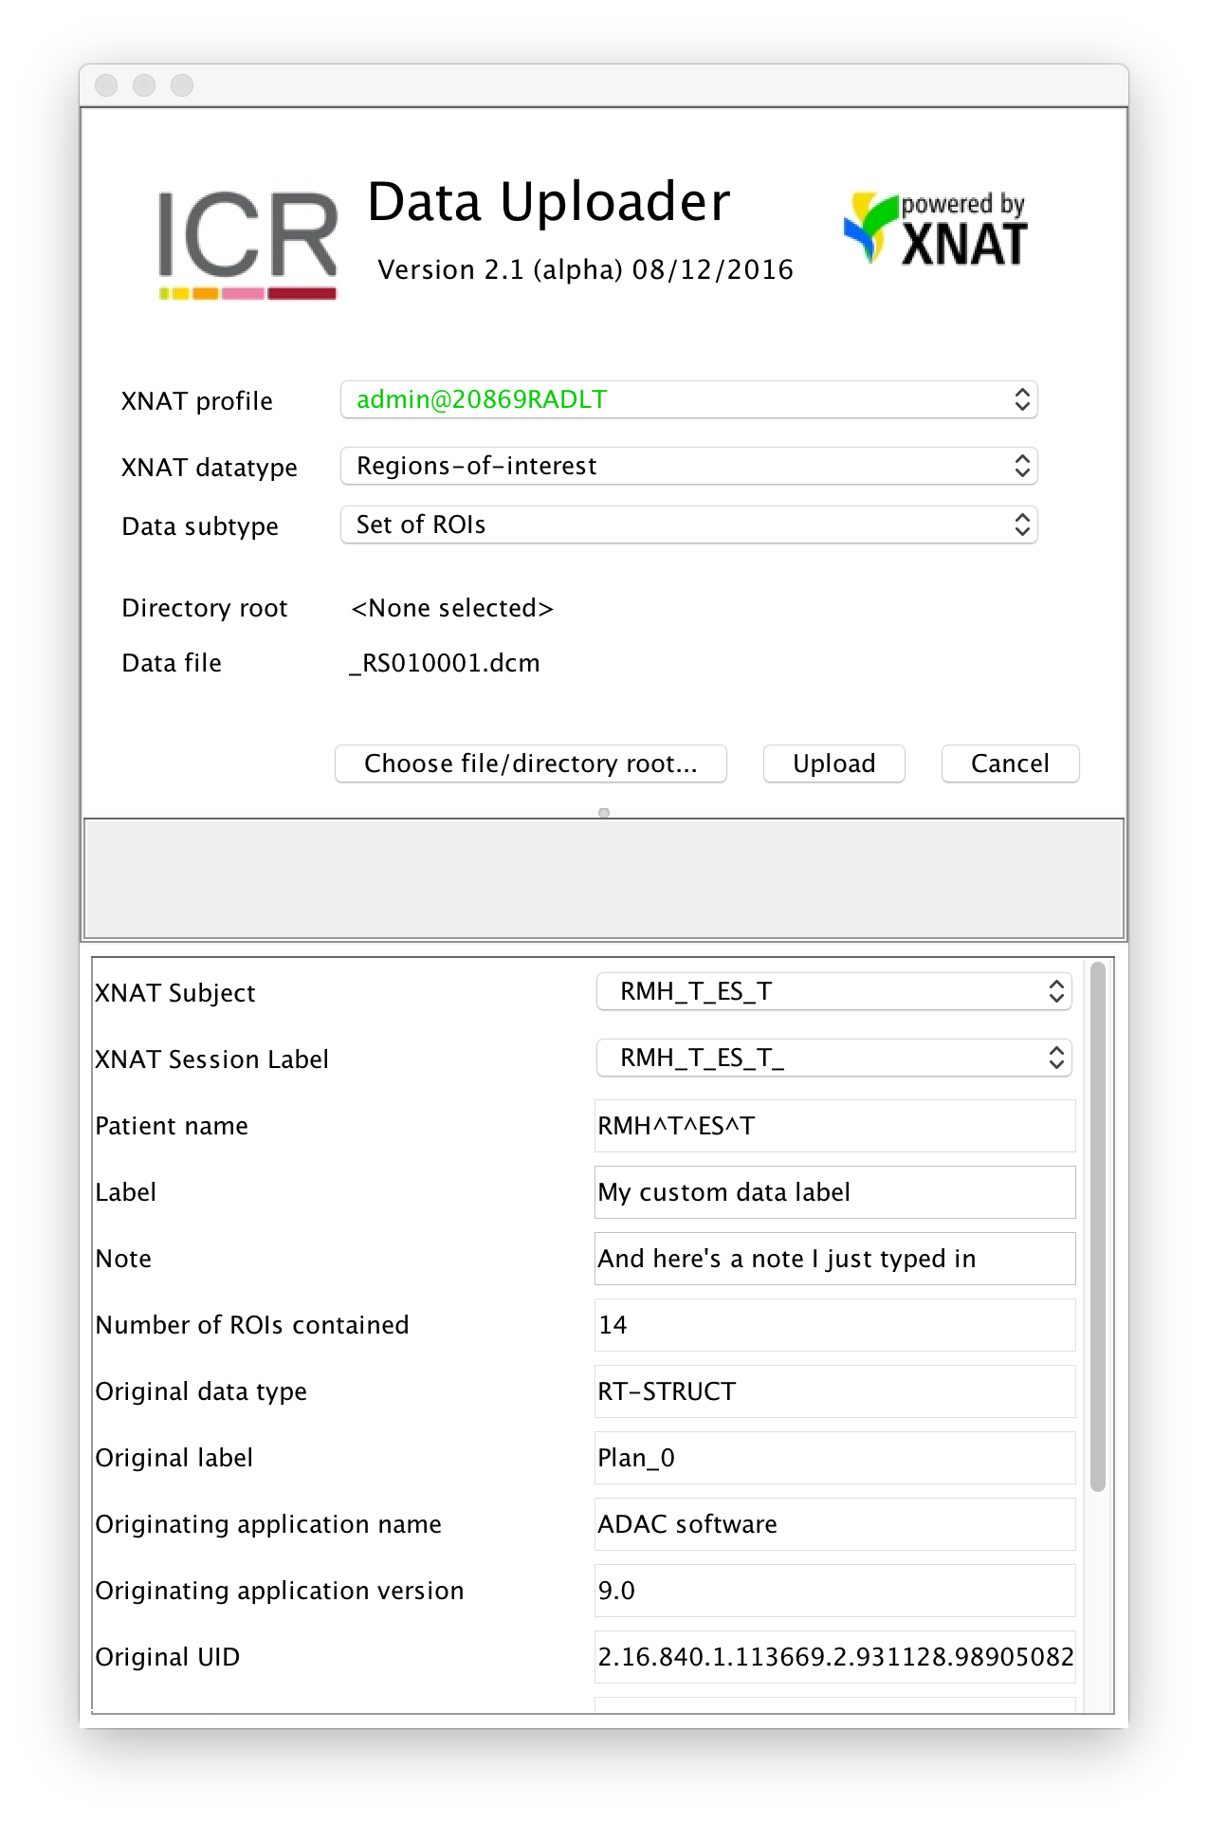
XNAT Data Uploader
  Getting application data into XNAT
  Upload arbitrary datatype into repository.
  Both a GUI and a framework.
  Developers can incorporate Java to provide any desired validation of input files.
  Developer hooks to allow arbitrary extraction of metadata from incoming data
  Facility to allow user to supply any of schema metadata on upload
  Upload a single file or descend directory structure recursively.
  Cascade upload of multiple assessors.

Slide 25
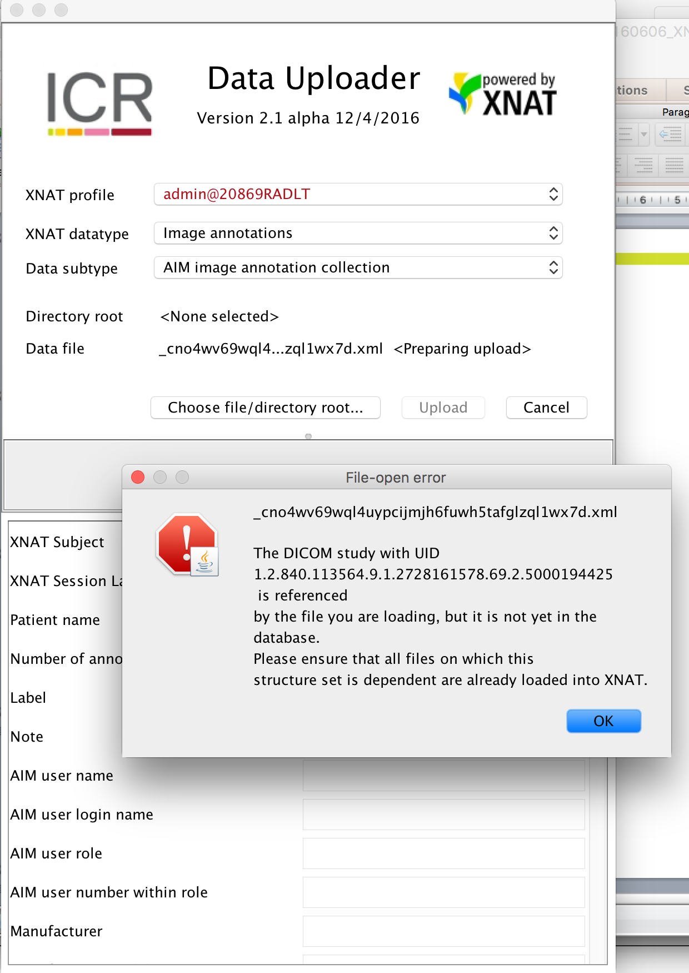
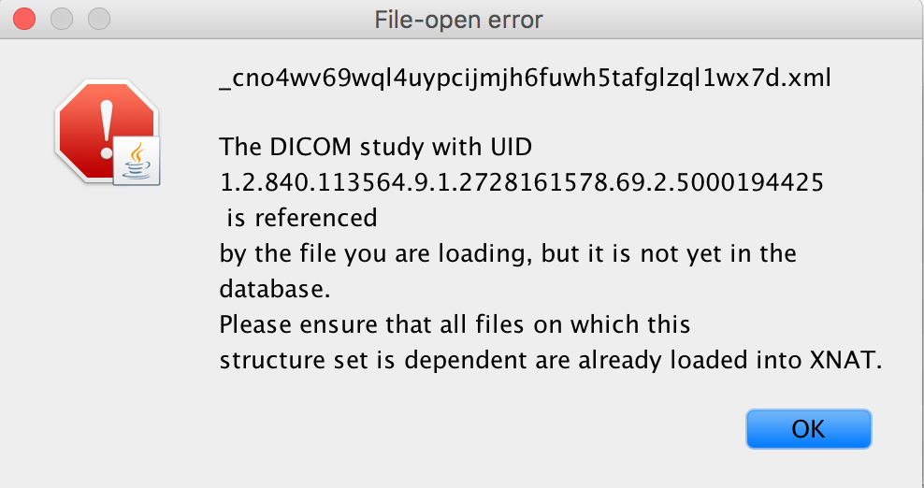
Enforce custom validation of upload

Slide 26
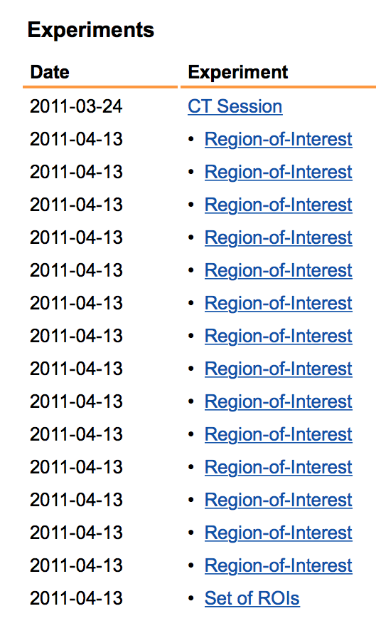
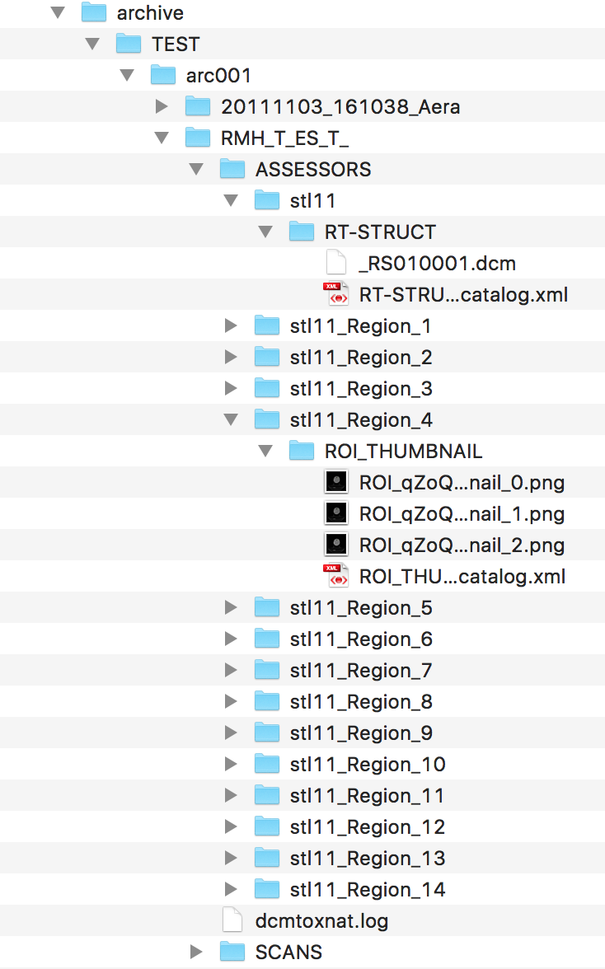

Cascade assessor and resource creation
What happens when you upload an RT-STRUCT?

Slide 27

XNAT DataChooser
  Getting data out of XNAT into applications
  Client-side GUI for selecting XNAT data
  Drop-in, single function call replacement for File → Open + full Java API
  Extensible, virtual directory framework for non-image datatypes

Slide 28

Preclinical XNAT
New challenges
28
  Schema extension to add new complexType extending xnat:abstractDemographicData
  Communication with LabTracks colony management system to pull nightly data into XNAT.
  New non-DICOM scan types.

Slide 29

New browsing tools
Polyscope: a viewer for microscopy data
29
Polyscope viewer developed by the Yuan Lab, ICR
This version courtesy Andreas Heindl

Slide 30

XNAT Developments
Statistics and hierarchical classification
30
Data courtesy of Matt Blackledge
Level
Unit
1
2
3
4
5
6
7
8
9
Image voxel
Segmented lesion
Lesion class (e.g., “aggressive”)
Whole patient (all lesions)
Single patient all timepoints
Patient cohort
Trial centre
All centres, single trial
All trials

