Slide 1
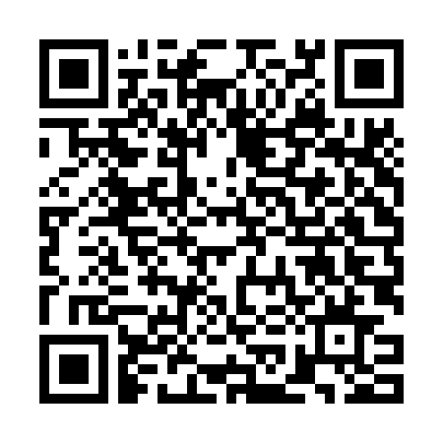
Follow along with this presentation:
Visits & Protocols Plugin
Justin Cleveland, June 9, 2016
Notes:
40 slides, lots of caffeine and 15 minutes means I’m going to go fast! There are a few more QR codes in the presentation to help you quickly get to this stuff. So you might want to get your Google Goggles app or code scanner apps on your devices out if you think you’ll be interesting in trying this plugin out!

Slide 2
What will the Visits & Protocols plugin do for you?
Adds visit scheduling and experiment/session tracking features to core XNAT for longitudinal studies
Allows research coordinators greater ability to:
Track project protocol requirements
Monitor missed visits / deviations
Catch missed experiments
Visualize project progress reports
Currently an early alpha phase release for XNAT 1.7
But available as a Beta Module for XNAT 1.6.5
Notes:
The Visits & Protocols plugin is a tool that adds subject visit scheduling and experiment tracking

Slide 3
Outline
Where to get it?
How to install it?
How to use it:
Brief Introduction to the new Protocol Manager/Editor
Project association
A look at the Subject Visit Completion Status project dashboard
Managing visits under your protocol
Protocol version control

Slide 4
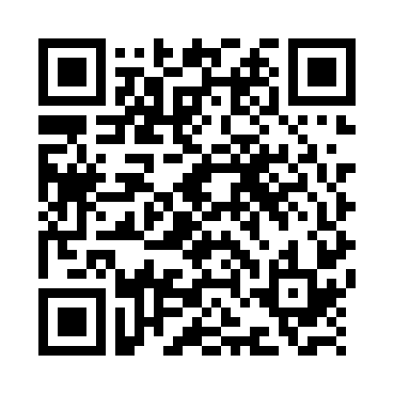
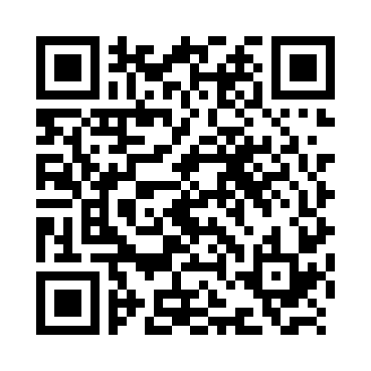
Downloading the Module/Plugin…
http://marketplace.xnat.org/plugin/visits-protocols-plugin-alpha-xnat-1-7/
…or, for a little more stable module version for XNAT 1.6.5…
http://marketplace.xnat.org/plugin/visits-protocols-module-beta-xnat-1-6-5/
1.6.5 Module:
1.7 Plugin:
...don’t expect much from this one yet. Protocol Manager works, but it’s visits functionality is a work in progress.

Slide 5
Downloading the Module/Plugin…

Slide 6
How to install it
XNAT 1.7
Drop the plugin’s “.jar” file in your <home>/plugins folder
Restart Tomcat
XNAT 1.6.5
Drop the module’s “.jar” file in the xdat.modules.location defined in your build.properties file
Rebuild XNAT (bin/update.sh -Ddeploy=true)
Restart Tomcat

Slide 7
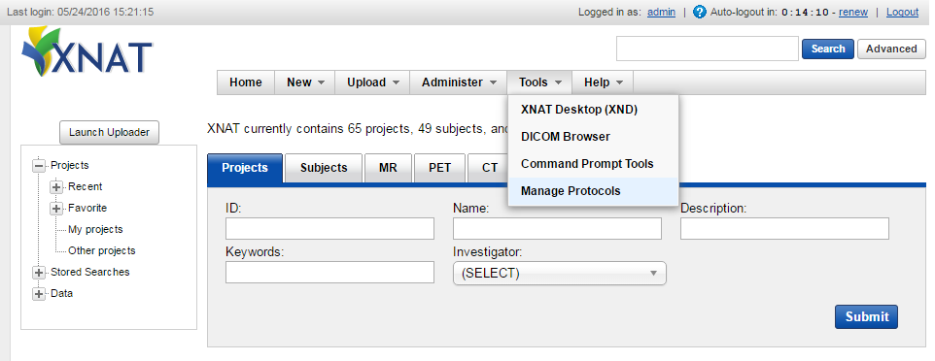
Getting started with the Protocol Manager
From the menu bar click Tools > Manage Protocols

Slide 8
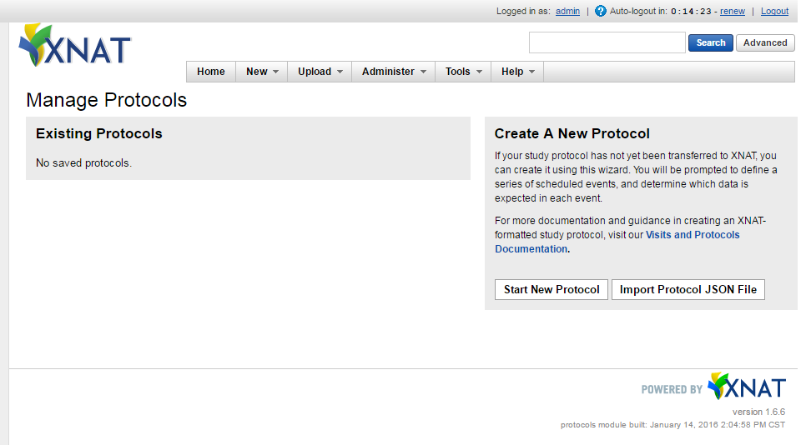
Introduction to the Protocol Manager
Import an existing JSON protocol definition file
…or, create a new one

Slide 9
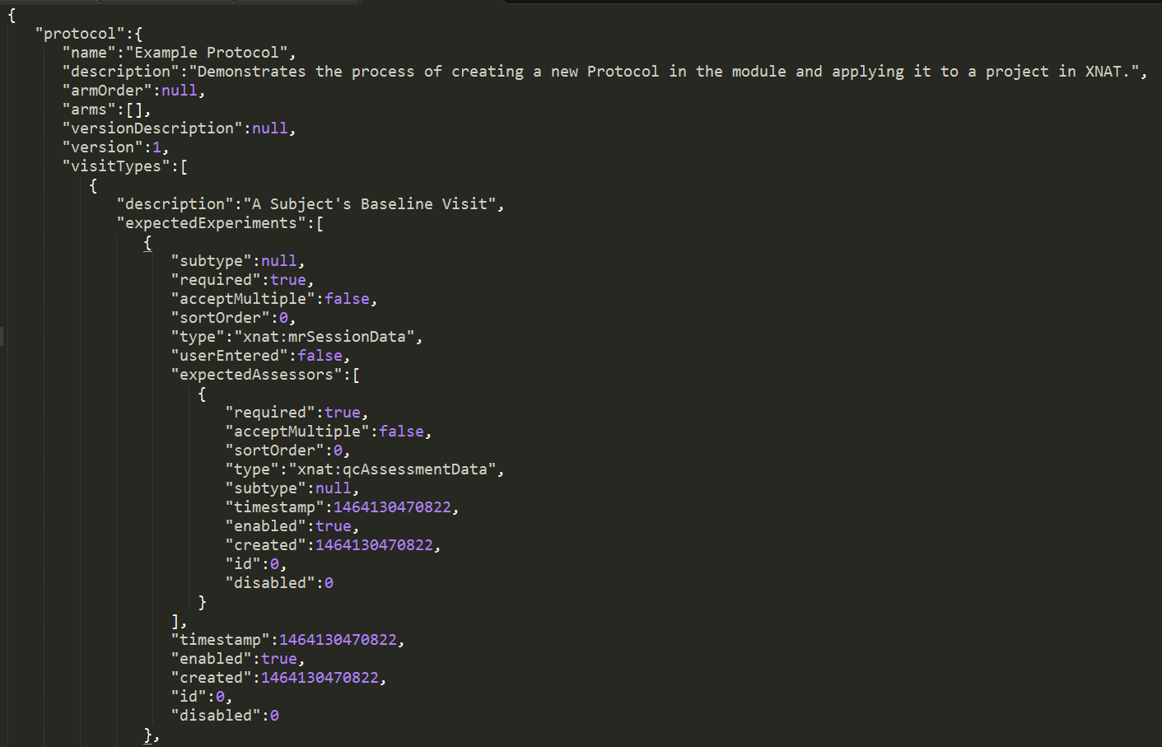
Introduction to the Protocol Manager
Example of an exported JSON protocol file

Slide 10
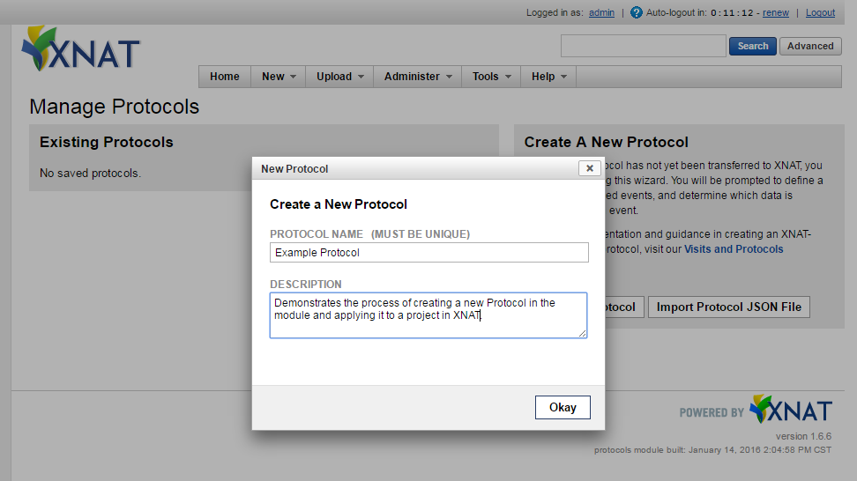
Introduction to the Protocol Manager
Give it a name and an optional description

Slide 11
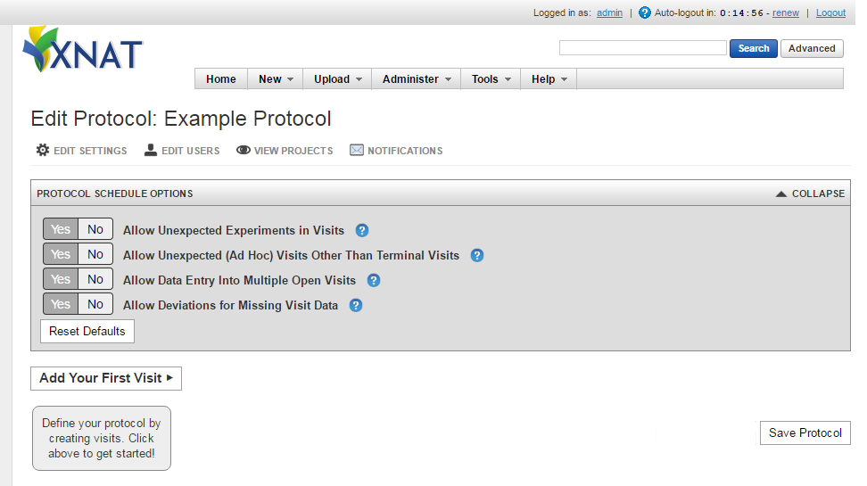
Introduction to the Protocol Editor
Start by adding your first visit to the protocol

Slide 12
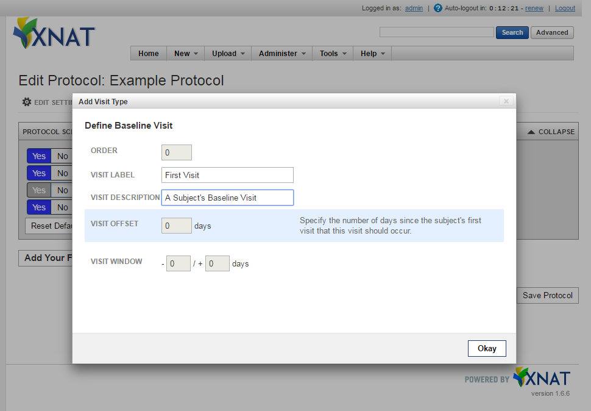
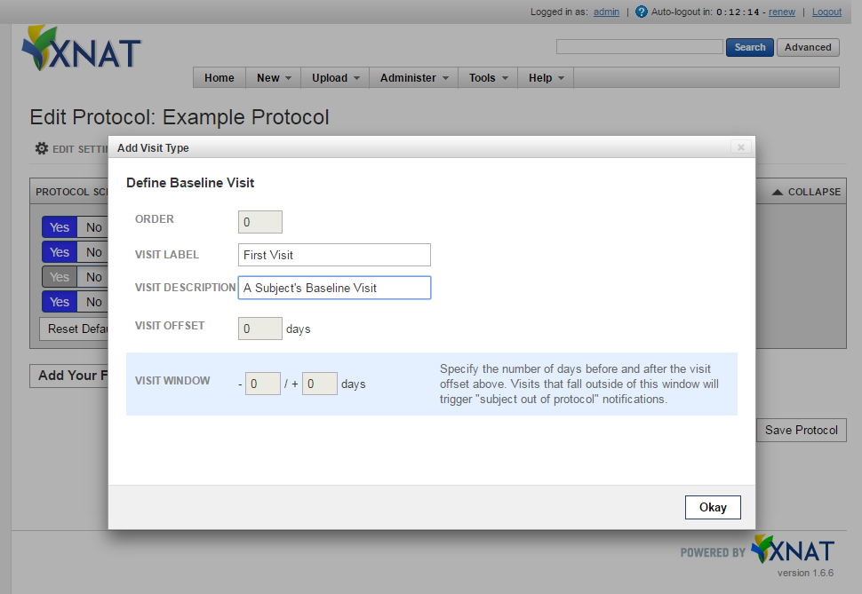
Introduction to the Protocol Editor
Describe a subject’s first visit

Slide 13
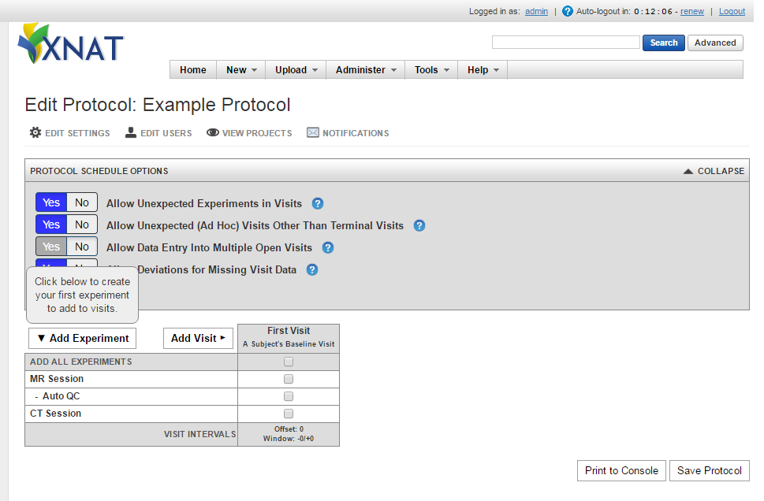
Introduction to the Protocol Editor
We’ll throw in a couple common experiments types for free to get you started…

Slide 14
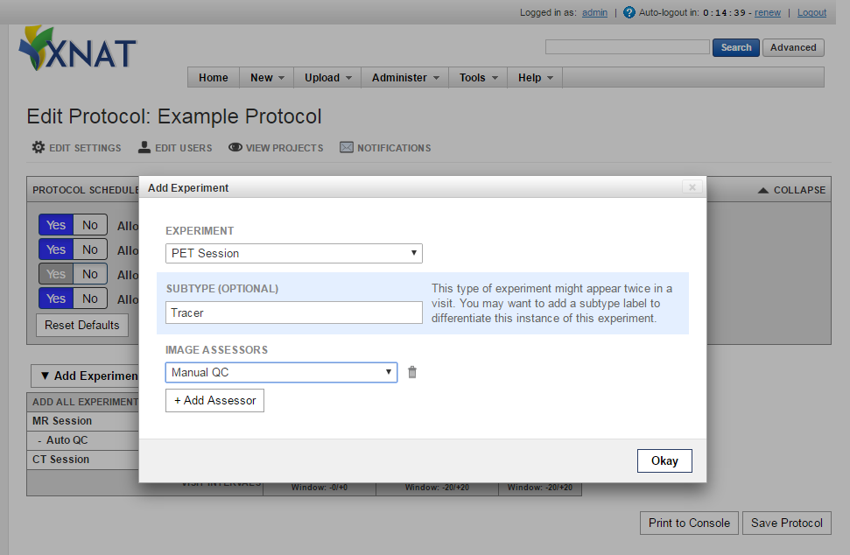
Introduction to the Protocol Editor
But let’s add a new experiment type

Slide 15
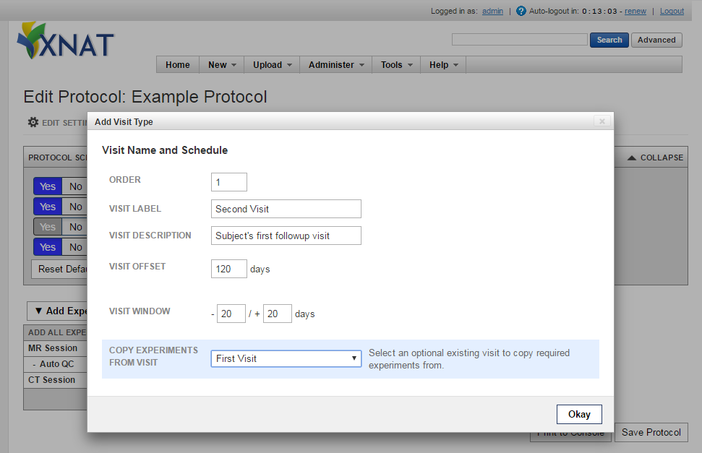
Introduction to the Protocol Editor
The second visit is more interesting

Slide 16
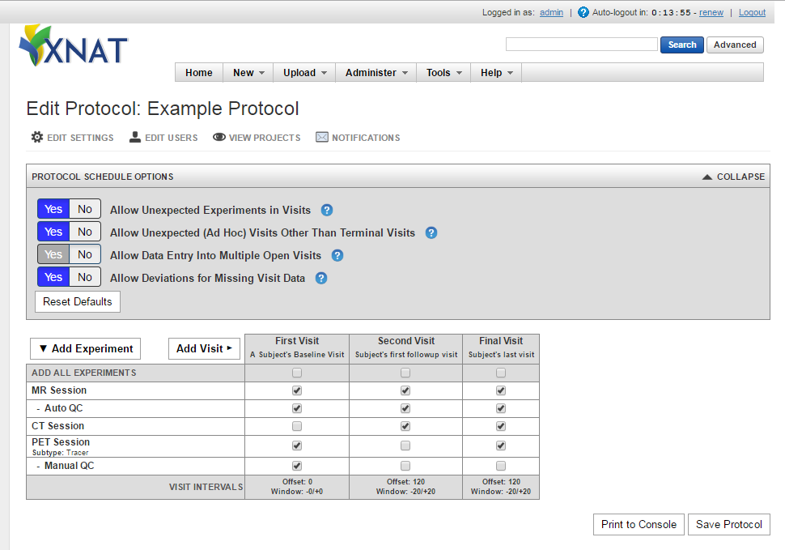
Introduction to the Protocol Editor
Continue to define your protocol by adding experiment rows and visit columns…

Slide 17
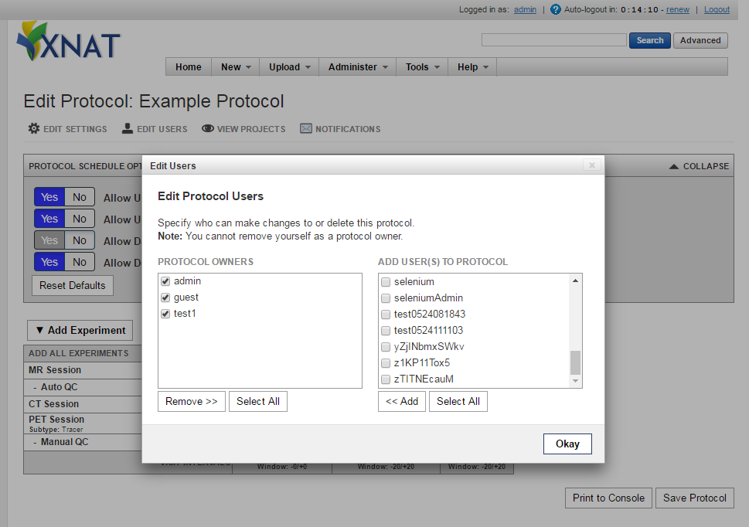
Introduction to the Protocol Editor Dialog Options
Specify who can manage this protocol

Slide 18
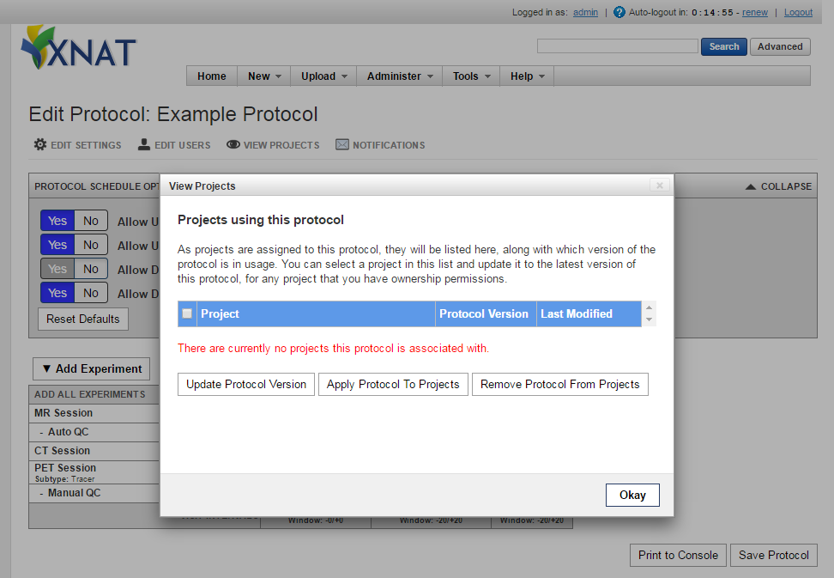
Introduction to the Protocol Editor Dialog Options
Associate this protocol with a project

Slide 19
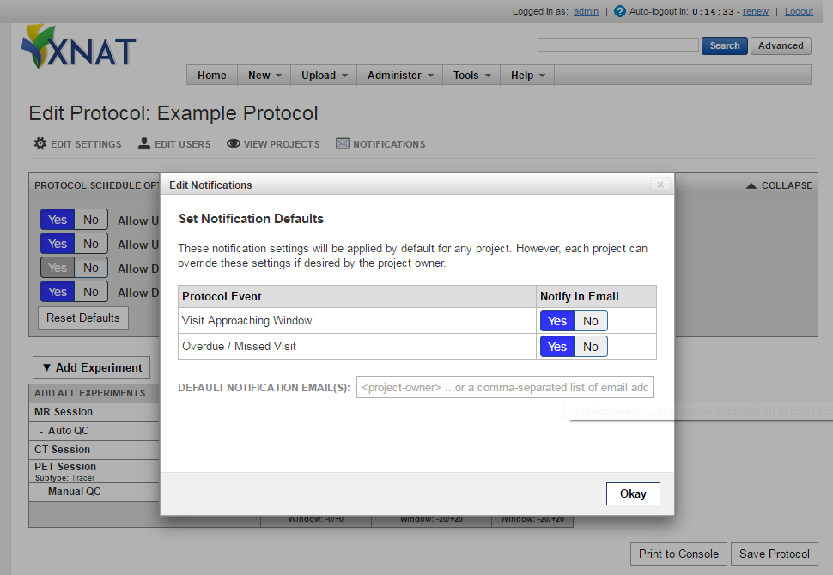
Introduction to the Protocol Editor Dialog Options
Setup notifications on the protocol

Slide 20
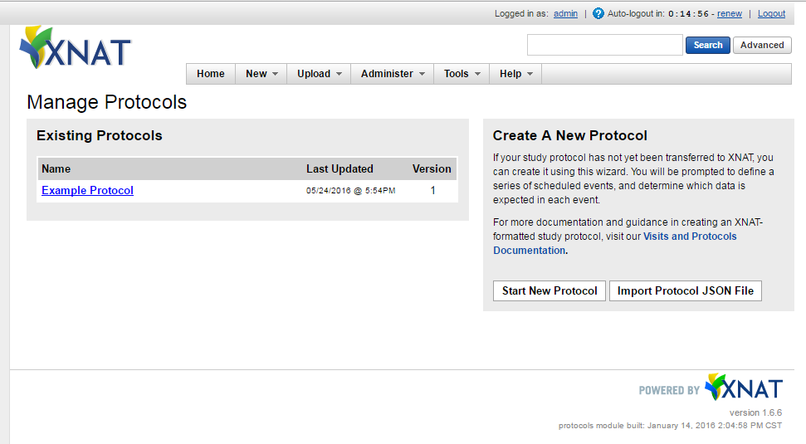
Introduction to the Protocol Editor
Save it!
…and note the version increment if you’re updating a protocol

Slide 21
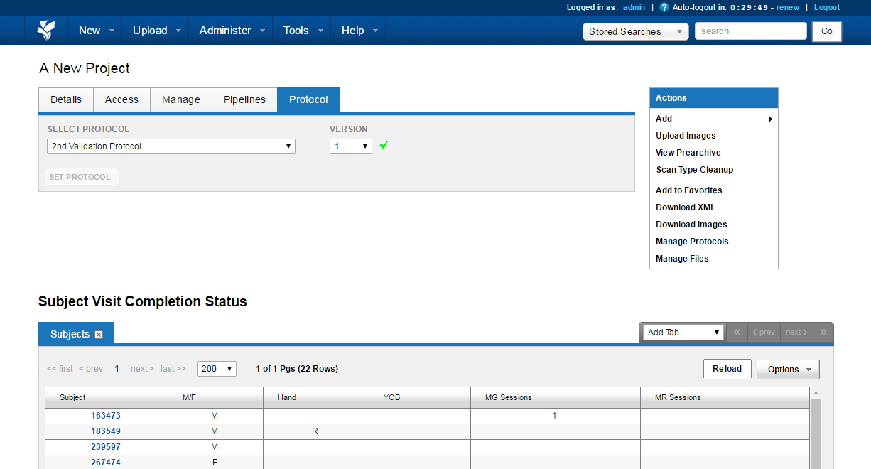
Apply your protocol to a project
Go to a project page.
If you’re an XNAT administrator or the project owner, you’ll find a “Protocols” tab

Slide 22
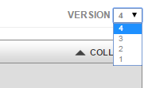
Back to the Protocol Editor for a moment…
As a side note, you can also manage project protocol associations and their versions from this dialog in bulk in the protocol editor.

Slide 23
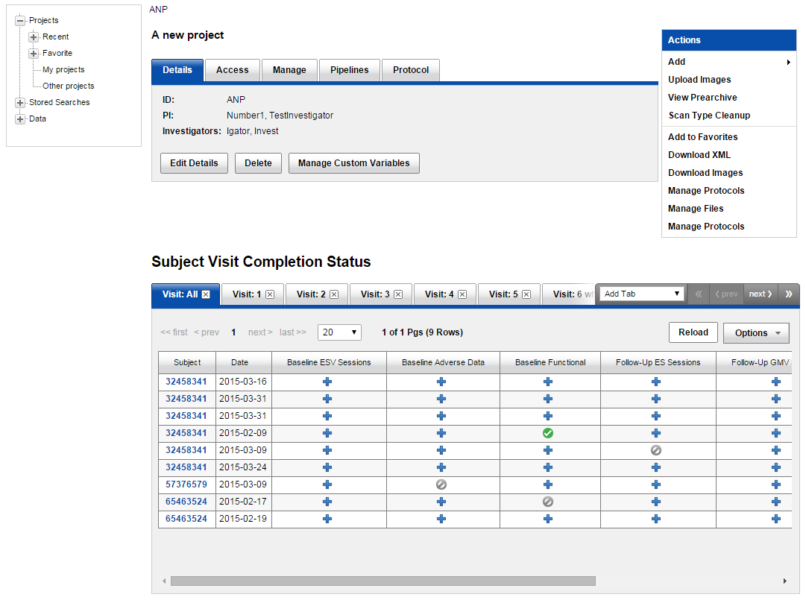
Project Dashboard
From the project page a research coordinator can quickly see which subjects have completed specified experiments , which need to be performed and which have had protocol deviations entered .

Slide 24
Project Dashboard
Visits are also broken down by tabs

Slide 25
Subject Visits
With a protocol in place, the Subject Details page now displays a Protocol Schedule by default.
The subject’s first expected baseline visit is waiting to be “opened”
The familiar experiment list is still accessible
If unexpected visits have been enabled on your protocol, you’ll have the option of creating an ad hoc visit

Slide 26
Subject Visits
So, let’s open the first visit!

Slide 27
Subject Visits
We now have our first empty visit.
…and a preview of the upcoming expected second visit
In this case our protocol doesn’t allow multiple open visits, so it won’t let you open the second visit until the first one is closed.

Slide 28
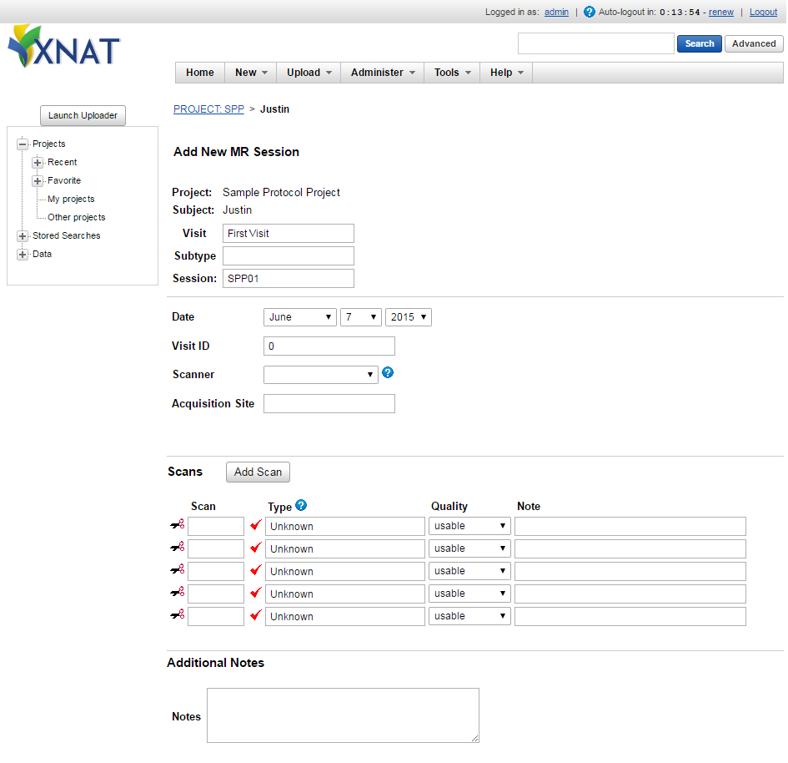
Subject Visits
Add the required experiments

Slide 29
Subject Visits
We’ve added the required experiments
And we’re now allowed to close the experiment
So we do.
And then we wait four months…

Slide 30
Subject Visits
The subject returns for a second visit, gets their MRI scan, but…
Disaster strikes!
We must enter a deviation ☹

Slide 31
Subject Visits
That allows us to close the visit
…which allows us to open the final visit… BUT we realize looking at the date on the final expected visit that there’s a problem with the protocol!
Uh oh! It’s expecting the subject to come in on the SAME DAY as their second visit.
That’s just silly! Let’s fix it!

Slide 32
Back to the Protocol Editor
We meant to add 120 days to the final visit’s offset.
Simple!
Hover over the final visit column’s header
Click on the pencil

Slide 33
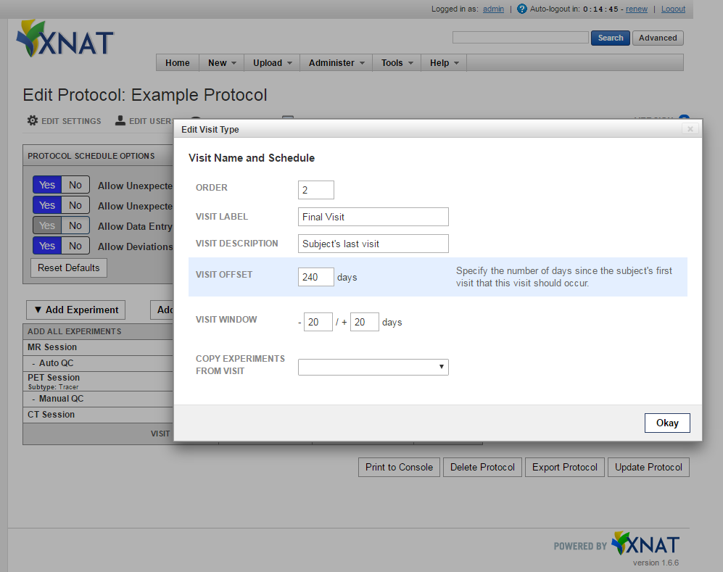
Back to the Protocol Editor
Fixed!
Save the protocol.

Slide 34
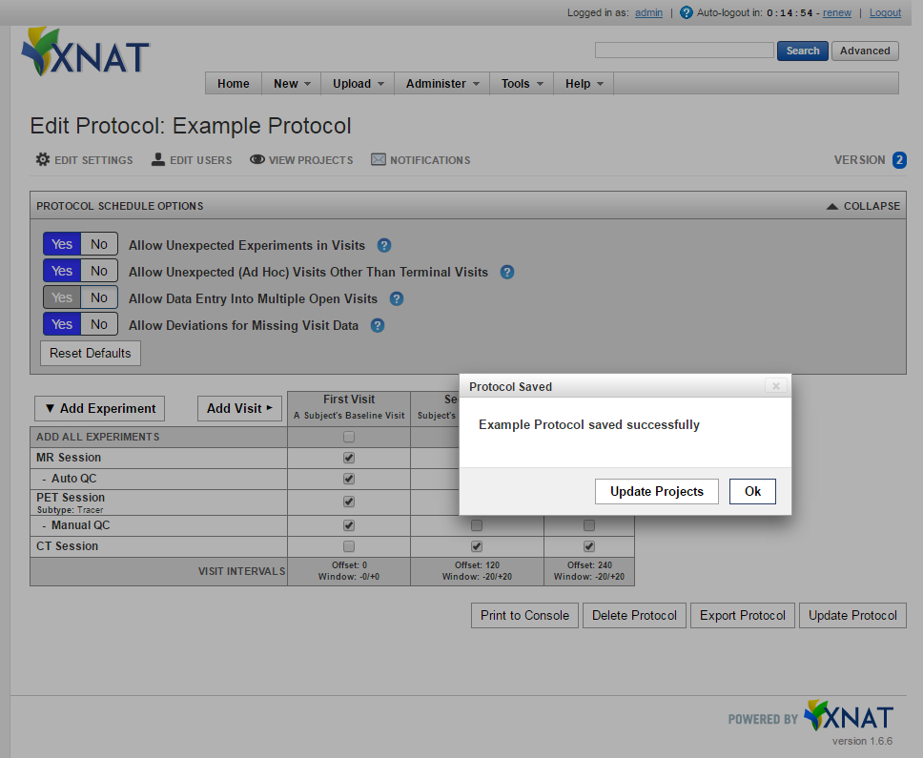
Back to the Protocol Editor
Note the reminder there that you’ll probably want to “Update Projects” with the new version of the protocol.

Slide 35
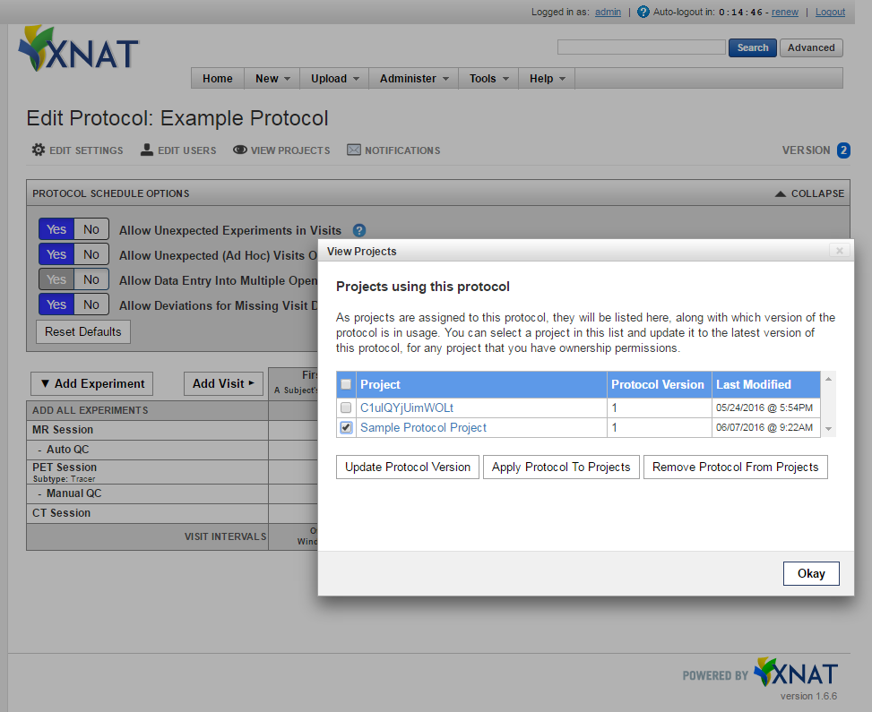
Back to the Protocol Editor
If you have multiple projects using this protocol, you can even do it in bulk.
Check their boxes and click “Update Protocol Version”
Note the version change on the project page.

Slide 36
Returning to Subject Visits
That looks better!
Let’s open the final visit

Slide 37
Back to the Protocol Editor
Note that this will be designated a “Terminal Visit”

Slide 38
Returning to Subject Visits
Lastly, another case in which you might enter a “Terminal Visit” is if a subject drops out of the study or dies.
Which is essentially equivalent to an Ad Hoc Visit.

Slide 39
Potential Future Visits & Protocols Plugin Features
Multi-ARM protocol support
Greater event notification options
REDCap schedule integration
More protocol report dashboards
Integrated core XNAT theme support
Spring controller based REST services with Swagger docs
Refactoring of Visits functionality in AngularJS
Full internationalization and localization support

Slide 40
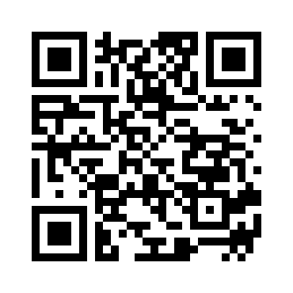
Wrapping Up
Some links:
http://marketplace.xnat.org/plugin/visits-protocols-module-beta-xnat-1-6-5/
http://marketplace.xnat.org/plugin/visits-protocols-plugin-alpha-xnat-1-7/
Source Repository:
1.6.5 Module
https://bitbucket.org/xnatx/protocols
1.7 Plugin
https://bitbucket.org/jcleve01/protocols-plugin
Updated documentation for this coming soon!
Questions?
My email: clevelandj@wustl.edu

