Slide 1
XNAT IT Planning
Chip Schweiss
June 7, 2016

Slide 2
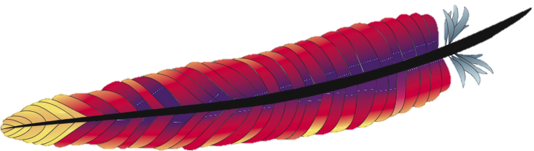

Basic Requirements
HTTPS proxy + Tomcat

Slide 3

Basic Requirements
HTTPS proxy + Tomcat
PostgreSQL

Slide 4
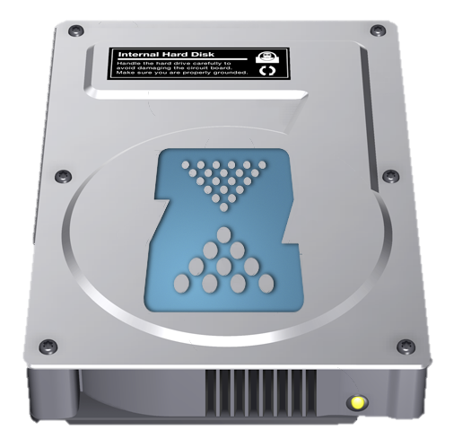
Basic Requirements
HTTPS proxy + Tomcat
PostgreSQL
Durable file storage

Slide 5
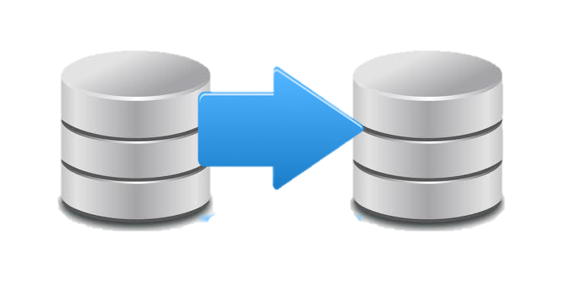
Basic Requirements
HTTPS proxy + Tomcat
PostgreSQL
Durable file storage
Backup

Slide 6
XNAT Hardware
Deciding factors
Amount of data
Data pipeline requirements
Number of simultaneous users
Budget

Slide 7

Virtualization vs. Bare Metal
Development life cycle advantages
Ease of scaling performance
NRG’s vSphere cluster
  VMware Academic Alliance
  https://labs.vmware.com/academic/licensing-overview

Slide 8
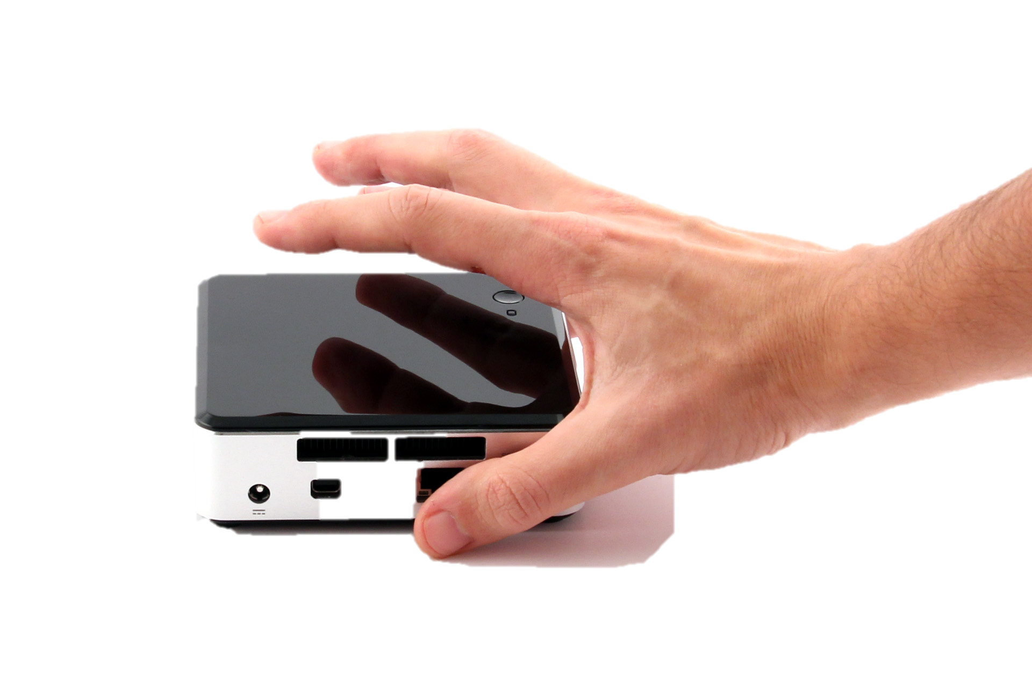
Example Hardware Configurations
Micro Scale (< 2 TB)
Intel NUC (Next Unit of Computing)
  Intel Core i5
  32 GB RAM
  250 GB SSD
  2 TB Disk
Ubuntu 15.10 or newer
  ZFS file system
CrashPlan backup (http://code42.com/crashplan)

Slide 9
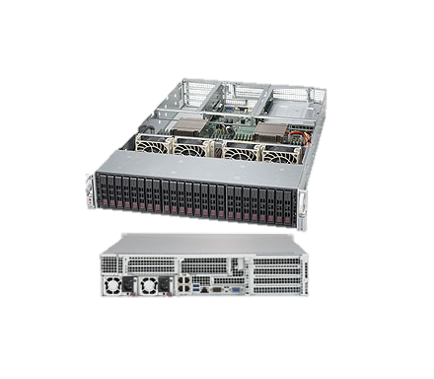
Example Hardware Configurations
Small Scale to Medium Scale (< 20TB)
Single server
  Single/Dual CPU
  64GB – 512GB RAM
  8-20 NL-SAS Disks
  1-3 SSDs
Ubuntu 15.10 or newer
  ZFS file system
Local backup or Replicated system

Slide 10

Example Hardware Configurations
Large Scale (100+ TBs)
Dedicated NAS Storage
  ZFS ($$$, ~$150/TB)
    Build or buy
    High Availability
    White paper: http://xnat.org/blog/wp-content/uploads/2016/05/ZFS-for-Research-Data-Storage-White-Paper-1.0.pdf
  Traditional enterprise solutions ($$$$$, ~$1K, TB)
Live DR copy ($$, ~$100/TB)
vSphere cluster ($$)
  3+ ESXi Hosts
  Typically $7K-$10K per host
  20-50 Virtual Machines per host
10Gb+ Network ($$)
High Performance Computing ($$$)

Slide 11


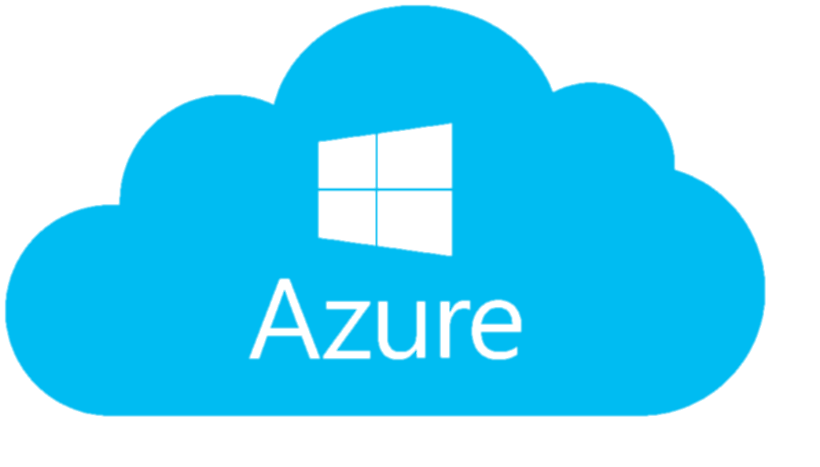
Example Hardware Configurations
Any Scale
AWS
Azure
Many others
HIPAA concerns

Slide 12
Automation / DevOps
Puppet
  https://bitbucket.org/NRGpuppet/puppet_module_xnat
  https://bitbucket.org/NRGpuppet/puppet_control_public
Chef
Vagrant
Docker
Scalr
AWS Cloud Formation

