Slide 1
XNAT Administration
Jenny Gurney, CNDA Operations
JUNE 7, 2016

Slide 2
Goal: Discuss the administration of some core XNAT features
DICOM Management
Project Administration
Large Study Management

Slide 3
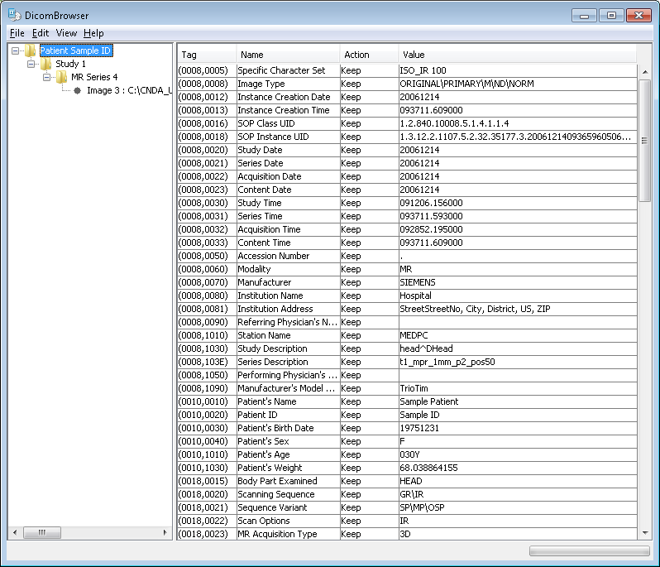
In Review: DICOM 101

Slide 4
DICOM Management
DICOM Upload Methods in XNAT
DICOM SCP Receiver and Project Routing
DICOM Anonymization
DICOM Series Import Filter

Slide 5
DICOM Management: Project routing
First Pass
Patient Comments (0010,4000)
Project:Project_ID (or Project Alias), Subject:Subject_ID, Session:Session_ID
Second Pass
Study Comments (0032,4000)
Project:Project_ID (or Project Alias), Subject:Subject_ID, Session:Session_ID

Slide 6
DICOM Management: Project routing
Third Pass
Study Description (0008,1030)
Project ID
Patient Name (0010,0010)
Subject Label
Patient ID (0010,0020)
Session Label

Slide 7
DICOM Management: Project routing
Fourth Pass
Accession Number (0008,0050)
Project ID

Slide 8
DICOM Management: Anonymization
Site wide
Project level

Slide 9
DICOM Management: Anonymization
Anonymization applied before upload
  Uploader applet
  Uploader application
Anonymization applied upon archive
  DICOM SCP receiver
  Compressed uploader
Anonymization applied when session moved to new project

Slide 10
DICOM Management: Anonymization
DICOM Edit Basic Syntax (http://nrg.wustl.edu/software/dicomedit/dicomedit-reference/)
Language elements
Comments //
String literals “1.3.12.2.1107.5.2.3.32.35177.1”, ”DEMO_Proj”, “”
Identifiers format, uppercase, project, subject, session
Tags (0010,0010)
Operators
  Symbolic assignment := , equivalence == , attribute deletion - , conditional :
  Word echo, describe

Slide 11
DICOM Management: Anonymization
Assignment (0008,0080) := "Washington University School of Medicine“
Delete attribute -(0010,1030) // delete Patient Weight
Conditional (0020,0011) = "1" : (0008,103E) := "Series One“
Regular expr (0020,0010) ~ "\d" : (0008,1030) := format["One digit study {0}", (0020,0010)]
Set operation (0020,0011) ~ "[1-5]" : -(0080,103E)
Delete tag block -(60XX,4000)
Delete private tags -(XXX#,XXXX)
http://nrg.wustl.edu/software/dicomedit/dicomedit-reference

Slide 12
DICOM Management: Anonymization
User-defined variables patientID := (0010,0020)
Match function visit := match[session,".*_(v[0-9]+)_.*",1]
Format function studyDesc := format["{0}_{1}_{2}", (0010,0020), visit, (0008,0060)]
URL encode function urlEncode[(0010,0020)]
Get URL function visit := getURL[visurl]
Hash UID (0028,1199) := hashUID[(0028,1199)]
new UID (0020,000D) := new UID

Slide 13
DICOM Management: Series Import Filter
Site wide
Project level
All filters applied before archive

Slide 14
Project Administration
Custom variables
Manage Groups
Create Project Resources
PET Tracers
DICOM Configuration
Scan Type Mapping
Protocol Validation

Slide 15
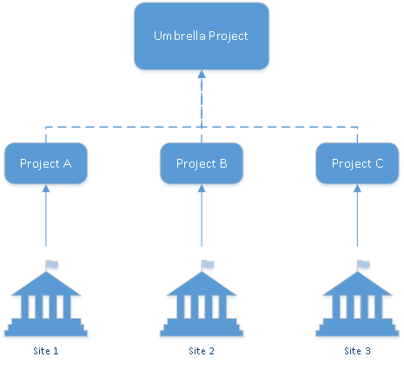
Large Study Management: Multicenter studies

Slide 16
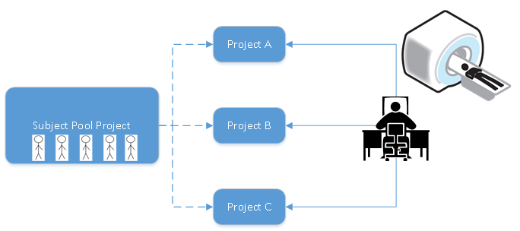
Large Study Management: Subject enrollment pools

