Slide 1
XNAT at Scale: CNDA
Jenny Gurney gkgurney@wustl.edu
CNDA Operations
JUNE 7, 2016

Slide 2
XNAT at Scale: CNDA
CNDA Environment
Continuous Integration
Identifying SQL Issues

Slide 3

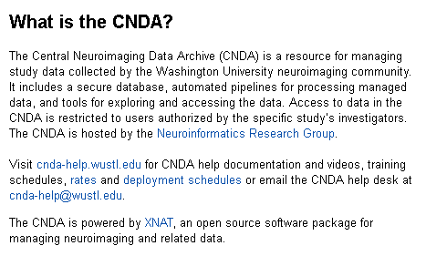

Just a little about CNDA
Old timey CNDA XNAT modules https://bitbucket.org/nrg_customizations

Slide 4
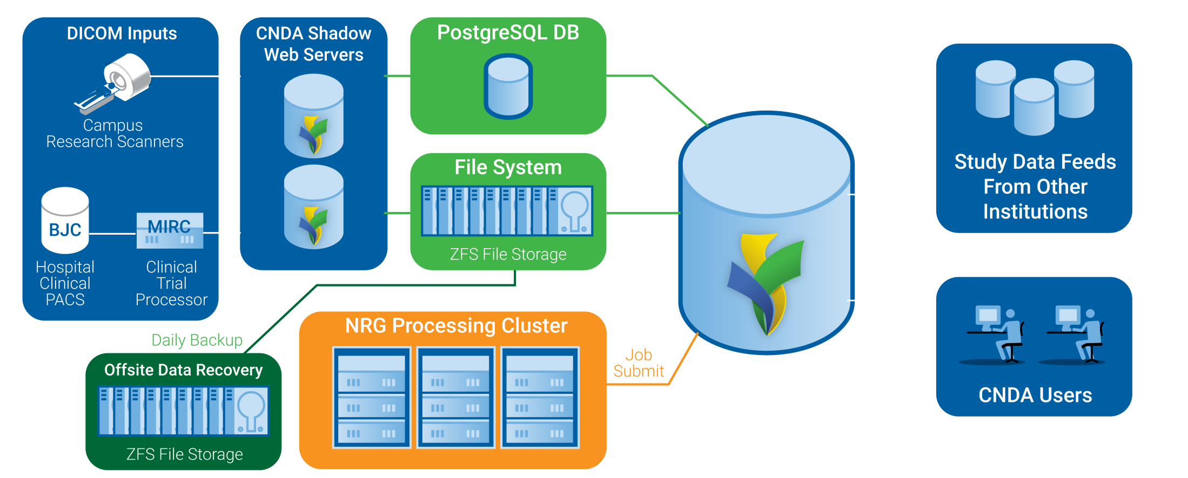
CNDA Environment

Slide 5
CNDA Environment: Production

Slide 6
CNDA Environment: CNDA Users

Slide 7
CNDA Environment: CNDA Users
GUI heavy XNAT
350 users, disabled after 6 months inactivity
REST API from users scripts
CTP Client users – similar to Uploader Applet
Park Reeves Study users come in via HTTPS to CTP

Slide 8
CNDA Environment: PostgreSQL DB

Slide 9
CNDA Environment: File System

Slide 10
CNDA Environment: Processing Cluster

Slide 11
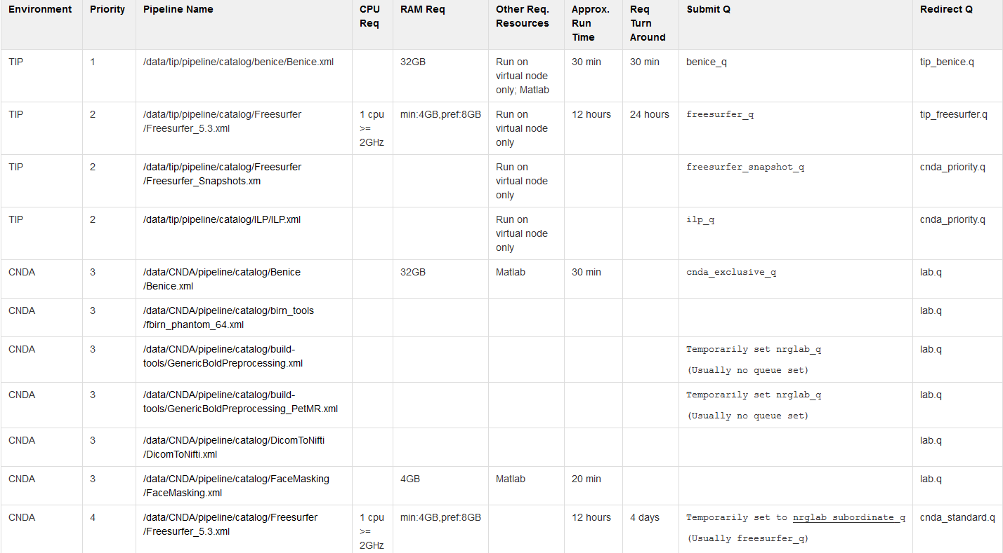
CNDA Environment: Processing Cluster

Slide 12

CNDA Environment: DICOM from Campus Scanners
CTP

Slide 13
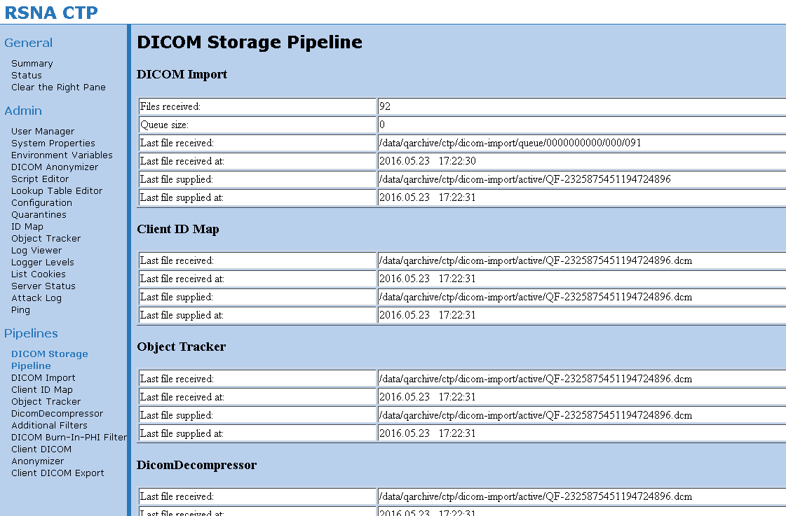
CNDA Environment: CTP

Slide 14
CNDA Environment: DICOM from Campus Scanners
Clinical/Research Scan Facility
Technician operate scanners
Somewhat rigid in procedure
Pass project ids in DICOM
CTP used to fork session to separate DICOM routers
List mode files saved to USB then transferred on cron from a mini PC

Slide 15
CNDA Environment: DICOM from Campus Scanners
Research-Only Scan Facility
Researchers and team run scanner
More flexibility in what is allowed
Research Imaging Information System provides routing
Scanner autosends to CTP
CTP used mostly as a buffer as a secondary back-up
CTP sends to DICOM receiver enabled for RIIS info

Slide 16
CNDA Environment: DICOM from Campus Scanners
Shadow Servers
Point to production file system and database
Receive DICOM traffic

Slide 17
CNDA Environment: PACS Query Retrieves

Slide 18
CNDA Environment: PACS Query Retrieves
Uses
  Retrospective studies
  Additional data for research study participants
JAAT http://nrg.wustl.edu/software/jaat/
JAAT generates a lookup.properties for CTP, then CMOVE
CTP deidentifies (limited PHI data set)
CTP forwards to CNDA via DICOM
Restricted time frame for pulls

Slide 19

CNDA Environment: DIAN Data Feed

Slide 20
CNDA Environment: DIAN Data Feed
Dominantly Inherited Alzheimer Network
7 of 10 years, 450 participants
10 sites to 22 sites collecting data, 5 continents
Data: Clinical, Psych, Biomarkers, Genetics, Imaging
ADCS pull every four hours
Mayo pushes MR QC nightly
Annual DIAN data freeze

Slide 21

CNDA Environment: MEDEX Data Feed
CTP

Slide 22
CNDA Environment: MEDEX Data Feed
Mindfulness, Health Education and Exercise
2 of 5 years, 450 participants
2 sites: Washington University and UCSD
CTP installed on mini PC at UCSD
CTP receives DICOM and transfers it via HTTPS to CNDA
GE multi-echo BOLD extracted by cron in CNDA

Slide 23
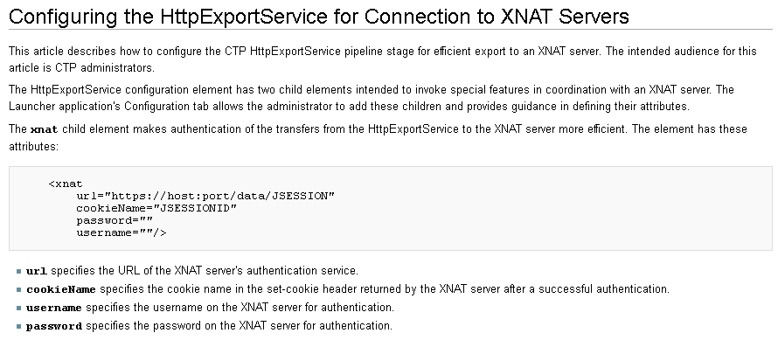
RSNA Clinical Trial Processor: HTTP XNAT integration
http://mircwiki.rsna.org/index.php?title=Configuring_the_HttpExportService_for_Connection_to_XNAT_Servers
http://mircwiki.rsna.org/index.php?title=MIRC_CTP

Slide 24
DevOps: Continuous Integration
Generate a virtual machine copy of yesterday production
Trigger Jenkins task for build of all latest check-ins
Trigger Jenkins task to run automated Selenium pipeline tests

Slide 25
Identifying SQL Issues, aka DB Tweaking
Queries troubles?
You try to pull up a listing and it never returns
Things keep slowing down on your XNAT
First step:
Identify slow queries or tables

Slide 26
Identifying SQL Issues, aka DB Tweaking
But how?
Postgres logs
In postgres.conf (on your vagrant in /etc/postgresql/9.5/main)
# Log queries longer than 30 seconds
log_min_duration_statement = 30000

Slide 27
Identifying SQL Issues, aka DB Tweaking
XNAT sql.log: if query never finishes, under standard production log4j settings, will never appear.
To log all queries, explode your ROOT.war and add a log4j.properties in ROOT/WEB-INF/conf with the following:

Slide 28
Identifying SQL Issues, aka DB Tweaking
# SETTING PoolDBUtils Log to DEBUG will log all SQL QUERIES
log4j.category.org.nrg.xft.db.PoolDBUtils = DEBUG, sql
log4j.additivity.org.nrg.xft.db.PoolDBUtils = false
#
# QUERY LOG
#
log4j.appender.sql = org.apache.log4j.DailyRollingFileAppender
log4j.appender.sql.file = /home/logs/tomcat/xnat-21/sql.log
log4j.appender.sql.ImmediateFlush=true
log4j.appender.sql.DatePattern='.'yyyy-MM-dd
log4j.appender.sql.append = true
log4j.appender.sql.layout = org.apache.log4j.PatternLayout
log4j.appender.sql.layout.conversionPattern = %d - %m%n

Slide 29
Identifying SQL Issues, aka DB Tweaking
Postgres resources
On your vagrant server: “top”
If you see processes run by the postgres user with almost 100% of the CPU and running for hours, that’s an issue
If you have multiple servers like us, it's helpful to run
ps -ef | grep PID

Slide 30
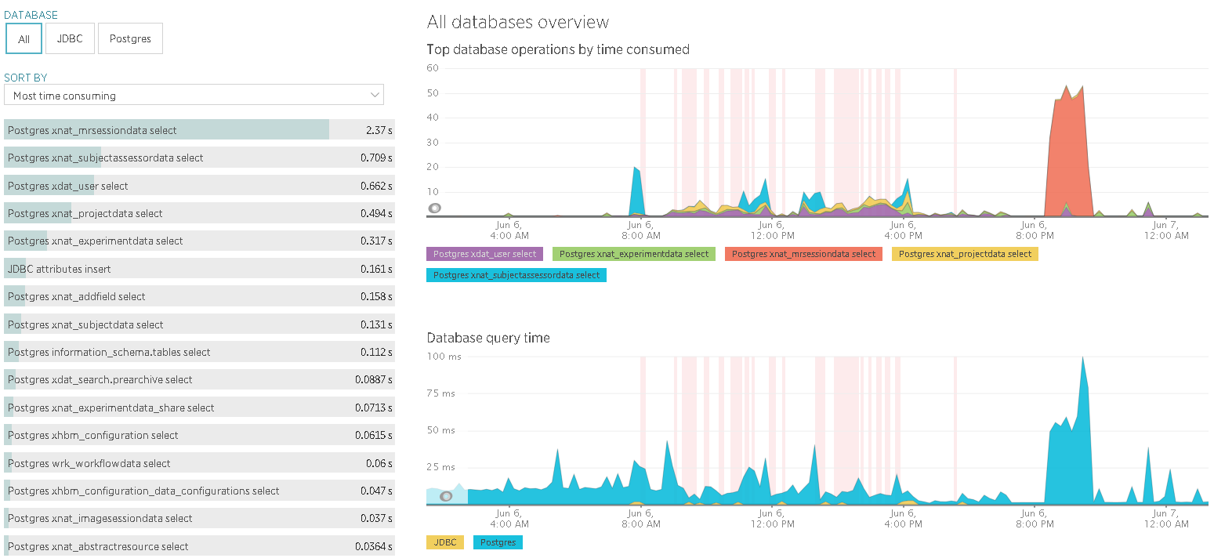
DB Tweaking: New Relic

Slide 31
Identifying SQL Issues, aka DB Tweaking
How do I fix my query troubles?
  You can index things that aren't already indexed.
  https://wiki.xnat.org/display/XW2/Possibly+Useful+Indexes+for+XNAT
  You can poke at the Postgres tuning. https://wiki.postgresql.org/wiki/Tuning_Your_PostgreSQL_Server
  Use PGAdmin III to run “explain analyze” on queries
  https://www.pgadmin.org

