Slide 1
Day 3: XNAT Processing with Docker
JUN 8, 2016

Slide 2
Outline
XNAT Processing
Docker
XNAT Processing with Docker

Slide 3
XNAT Processing
Data are inside XNAT
Users want to execute external applications on data, outside XNAT

Slide 4
XNAT Processing — General Steps
Gather data from XNAT
Launch executable
Get outputs back into XNAT (sometimes)

Slide 5
Manual Execution
Download data by hand (through GUI or REST API)
Stage files in proper place by hand
Launch executables by hand
Gather outputs for upload by to XNAT

Slide 6
Manual Execution
Benefits
Flexible
Problems
Time consuming
Error-prone
Person executing commands must be expert in XNAT and executable
Person executing commands must have access to compute machines

Slide 7
Scripting
An expert writes a script that automates…
Downloading from XNAT
Running executables
Gathering outputs
Non-expert runs script

Slide 8
Scripting
Benefits
Transfer of expertise
Automation reduces errors
100% flexible (in general)
Can use tools to abstract knowledge
Easy to share
Problems
Script writer must be expert in XNAT & executables
Script executor must log on to execution machines
Heterogeneous environments

Slide 9
XNAT Pipeline Engine
An expert writes a pipeline that automates…
Downloading from XNAT
Running executables
Gathering outputs
Non-expert runs pipeline

Slide 10
XNAT Pipeline Engine — Benefits
Pipelines are launched by XNAT
Launching user needs no access to compute nodes
Users can launch pipelines via UI, REST API, or automatically
Schemalink parameters have values provided by XNAT at launch time
Transfer of expertise (Pipeline writer to launching user)
Automation reduced errors
Resource descriptors for common tools can be reused

Slide 11
XNAT Pipeline Engine — Problems

Slide 12
XNAT Pipeline Engine — Problems
Writing pipelines has a steep learning curve
Structure of pipeline XML
How Engine executes pipeline XML
How XNAT reads/launches pipeline XML
Distinctions between Steps, Resource Descriptors, and executables
Setting up pipelines can be hard
Must manually place pipeline XML files on XNAT/compute machines
Must configure each pipeline on XNAT, and also on each project

Slide 13
XNAT Pipeline Engine — Problems
Pipeline UI
Default UI is not user-friendly
Custom UI is possible, but has its own problems
Pipeline writer must now also be a Java/HTML/JavaScript developer
Deploying custom Screen class requires shutting down, rebuilding XNAT
XNAT launches pipelines, and stores their state. Nothing else.
Cannot stop unwanted executions or restart failed executions.
Cannot pull any logs, on failure or success. Pipeline must push.
XNAT cannot handle data transfer. Pipeline must download/upload.

Slide 14
New Process Execution Infrastructure Goals
Deep XNAT integration
Launchable through XNAT (UI, API, and automatically)
Configurable through XNAT
Deployable through XNAT
XNAT understands how to launch, stop, restart, how to stage data, …
Flexible (Workflows, scripts, brand-new or off-the-shelf)
Easy to learn
Leverage known third-party code

Slide 15
What I Need
Remotely launch executables from XNAT
Ensure they are:
Portable
Deployable remotely
Consistent

Slide 16
Docker

Slide 17
Docker —Terms to Know
Docker (engine)
Docker server/host
Docker image
Docker container
Docker Hub (generic: Docker Registry)

Slide 18
Docker — How to get it
Native on Linux
Mac/Windows: Docker Toolbox (docker, docker-compose, docker-machine, etc.)
Mac: Homebrew
Mac/Windows: Native Docker currently in Beta

Slide 19
Docker
Demo: Pull a Docker Image

Slide 20
Docker
Demo: Build a Docker Image

Slide 21
Review
Processing XNAT data
Intro to Docker
Processing XNAT data with Docker…

Slide 22
XNAT + Docker
Caution: Pre-alpha! Code & concepts will change.

Slide 23
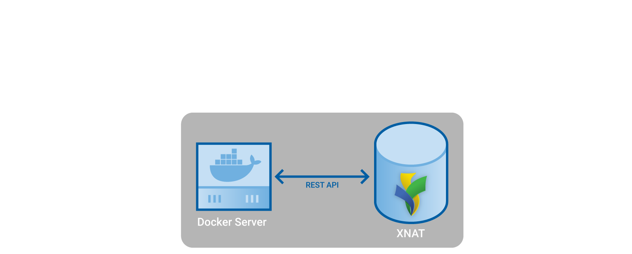
XNAT + Docker

Slide 24
XNAT + Docker
Manage images on Docker server (pull, delete)
Launch and manage containers
Stage data to and from Docker server (a.k.a. execution node)

Slide 25
XNAT + Docker — Steps to Execution
Pull a Docker image
Define the image within XNAT
Define a Command
Define an Action
Execute an ACE (Action/Context Execution)

Slide 26
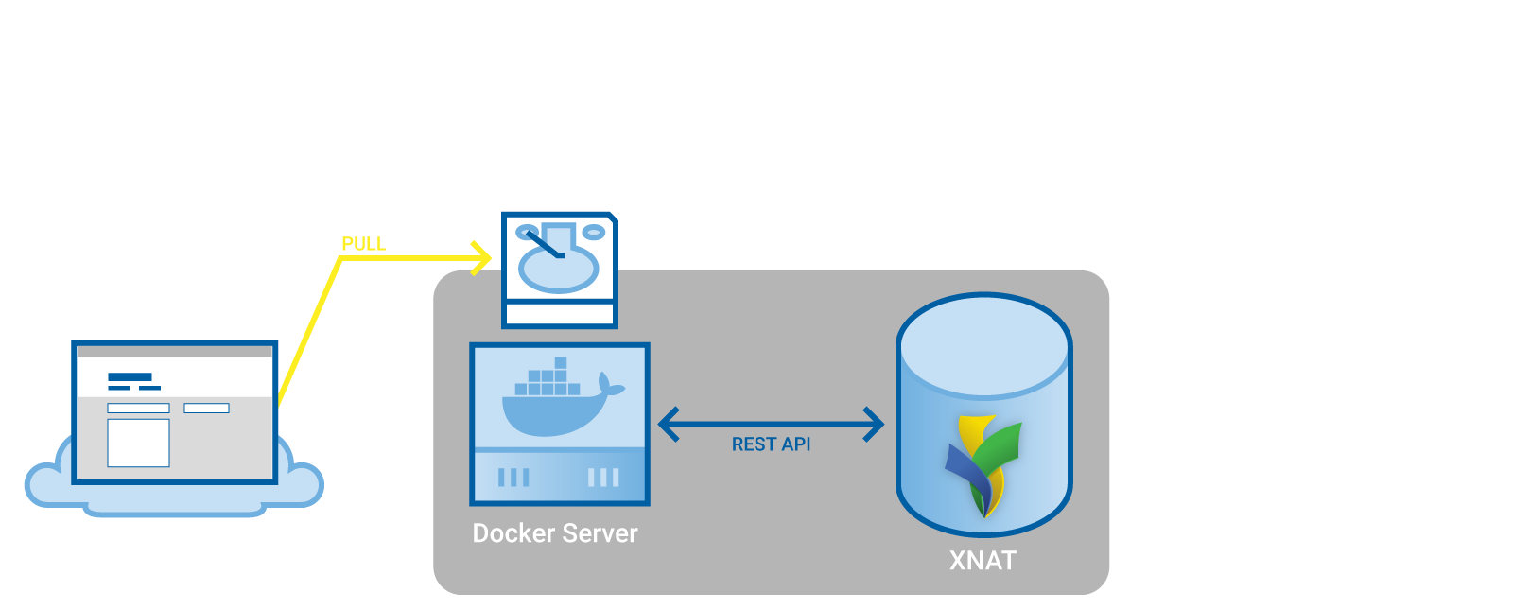
XNAT + Docker — Pull a Docker Image

Slide 27
XNAT + Docker — Docker Images
Must tell XNAT about Docker Image
Name
Docker Image ID
Labels
If we use XNAT to pull the image from a hub, we provide these image metadata at the same time

Slide 28
XNAT + Docker — Docker Images
Demo: xnat/dcm2niix

Slide 29
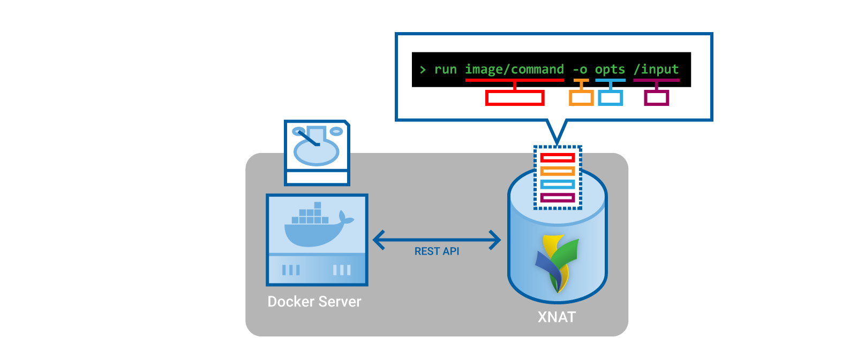
XNAT + Docker — Commands

Slide 30
XNAT + Docker — Commands
Defines how to run a command in a Docker image
“docker run” command
environment variables
mounts
Can define variables that will be filled in with values at runtime
No XNAT-specific information required (but you can provide hints to XNAT)

Slide 31
XNAT + Docker — Commands
Demo: dcm2niix command

Slide 32
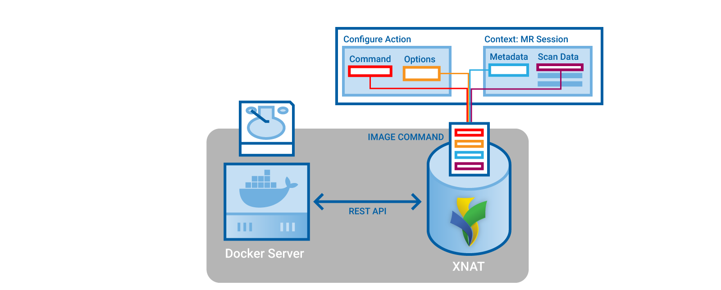
XNAT + Docker — Actions

Slide 33
XNAT + Docker — Action
Defines a root XNAT object on which it can be executed (the “Context”)
Defines how to fill in Command variables from root object
Defines the resources to be staged for the Command’s input mounts, and to be created from the Command’s output mounts

Slide 34
XNAT + Docker — Action
Demo: dcm2niix on a scan

Slide 35
XNAT + Docker — ACE
Action / Context Execution
Action is a template for how to run something
Context is a representation of where you are / what you’re looking at / what you want to execute an Action on.
ACE: fully resolves all template variables in Action and Command

Slide 36
XNAT + Docker — ACE
Demo: Execute dcm2niix Action

Slide 37
XNAT + Docker — UI
Demo: UI Wireframes with Will

Slide 38
Use Cases
XNAT User wants to run Freesurfer
XNAT Admin
Pulls Freesurfer Docker Image (or builds a new one)
Configures Command to launch the Image: Ex. “recon-all [subject dir]…”
XNAT User
Configures Action to execute Command from MR Sessions
Runs Freesurfer as an ACE by Executing the Action from an MR Session Context

Slide 39
Use Cases
XNAT User has a script that runs a few FSL commands
XNAT Admin
Builds a new Docker Image with FSL and the User’s script
Configures a Command to launch the Image
XNAT User
Configures an Action to execute the Command from MR Sessions
Runs their script as an ACE by Executing their Action from an MR Session Context

Slide 40
Use Cases
XNAT User has a script that runs a few FSL commands
XNAT Admin
Gathers information about script (language, requirements, etc.)
Pulls FSL Docker Image (or builds a new one)
Configures a new Script Environment
XNAT User
Adds their script to XNAT’s script repository
Configures Command
Configures Action
Executes ACE

Slide 41
Script Environment
Rather than a single-application Docker Image, can use a generic container (e.g. python, R, MATLAB, nipype, OpenMOLE, etc.)
Admin makes image available as Script Environment
Users can add scripts, configure them, and launch them as ACEs

Slide 42
Use Cases
Developer wants to make application available for XNAT users
Developer builds Docker Image with application + dependencies
XNAT Admin pulls Image, defines Command
XNAT Admin or User defines Action
User Executes ACE

Slide 43
Use Cases
Developer wants to make application available for XNAT users
Developer builds Docker Image with application + dependencies
Developer writes metadata into Docker Image that define Commands and Actions
XNAT Admin pulls Image
User Executes ACE

Slide 44
Future
Get feedback on design
Finish remaining major features
Resource importing
Monitoring
UI
Bulk execution on collections
Get a beta into your hands

Slide 45
Conclusion
Data are inside XNAT
Users want to execute external applications on data, outside XNAT

Slide 46
Conclusion
My focus
Make it as easy as possible to get data out of XNAT
Make it as easy as possible to run whatever you want from XNAT
Your focus
Think about how you can use this
Give me feedback

Slide 47
Contact me
jflavin@wustl.edu
xnat_discussion Google group
github.com/nrgxnat/container-service

