Slide 1
Presentation:
XNAT Under The Hood
June 8, 2016

Slide 2
Introduction
Projects, subjects, and experiments
REST APIs
Extending the XNAT UI
Search engine
Features and access control
Automation
Workflows
Honorable mentions

Slide 3
Projects, subjects, and experiments
Projects
Subjects
Experiments: Everything that’s not a project or a subject
Three types:
  Image sessions
  Image assessors
  Subject assessors

Slide 4
REST APIs
Discovery
New REST APIs should have Swagger documentation
Older REST APIs:
  Wiki documentation
  Review code especially XNATApplication class
  Setting the logging level to INFO and review restlet.log

Slide 5
Extending the XNAT UI
Velocity templates
JSP pages
Themes
UI extension points
Admin UI and Spawner

Slide 6
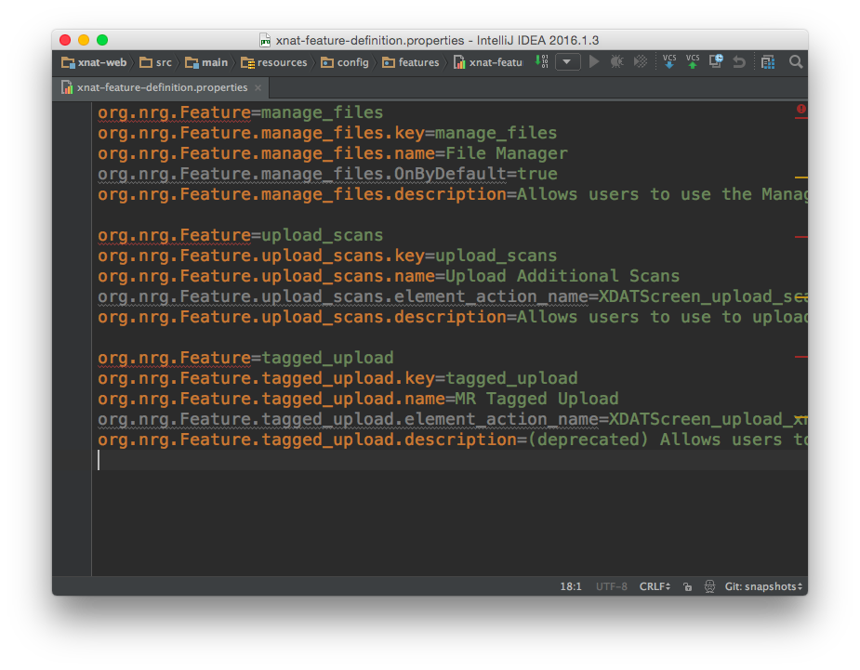
The Features Feature
Defining an XNAT feature
Controlling features
Using features to control and target user access

Slide 7
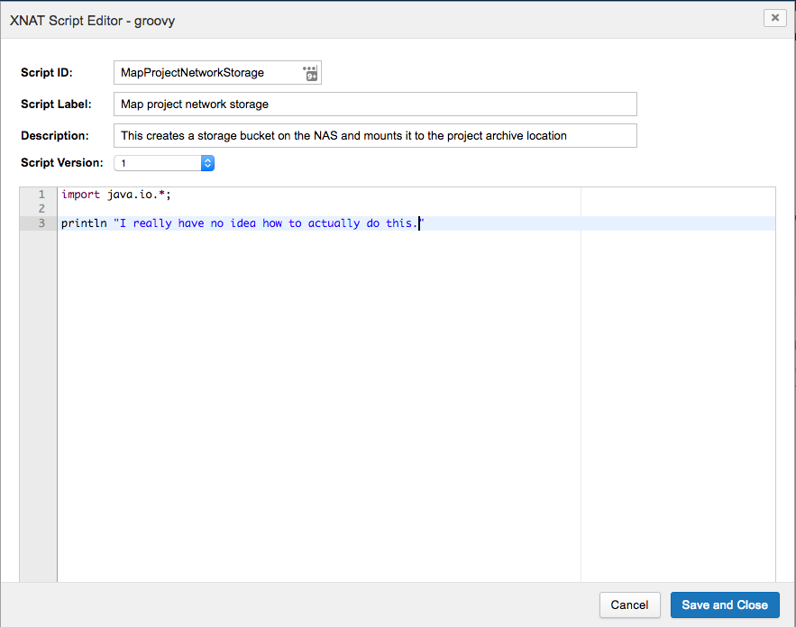
Automation
Internal automation scripting
Language support
Mapping of events to event handlers
Event handlers aren’t necessarily scripts
High degree of security risk

Slide 8
Events and Workflows
History in XNAT: where they started, where they’ve been, where they are
Where they’re going
Workflows WERE the event system in 1.6.5
Still interacts with event system, but serves more as log or audit trail
XNAT will have an actual workflow engine eventually, so terminology needs to change

Slide 9

Honorable mentions
XFT versus Hibernate:
Cage match battle royale
But they also get along:
  Shared database connection pooling
  Separation of responsibilities

Slide 10
Honorable mentions
Spring vs Turbine
War of attrition:
  Spring introduced in limited areas of even 1.4
  Authentication migrated to Spring in 1.5
  New metadata and infrastructure services implemented in Spring and Hibernate through 1.6
  In 1.7, application is migrated to Spring web application context structure

