Slide 1
Visits and Protocols
Jordan Woerndle 26 JUN 2012
XNAT Developer

Slide 2
Goal for Today
Demonstrate experimental features that enable native support for longitudinal studies and provide fine-grained validation to help manage data.
Next: story

Slide 3
Scenario – PI has a new Study
Study runs for 5 years
Subjects return for regular visits every 6 months
Baseline is a standard suite of tests and surveys
Subjects get a PET-FDG at every visit
If a subject shows signs of disease, they get a PET-PIB at each visit from then on
If a subject dies, they get a pathology report
Next: picture

Slide 4
2 Years of Visits Illustrated
Baseline 6 Mo 1 Yr 1.5 Yr 2 Y . . .
Chris
Pat
Sam
Terry
Baseline
Standard
Standard
Standard
Standard
Baseline
Standard
Disease
Disease
Disease
Baseline
Standard
Standard
Pathology
Baseline
Standard
Standard
Standard
Disease
Next: pi’s needs

Slide 5
PI Says
I’m tragically disorganized. Help me…
  Report missed visits
  Know if data is missing from a visit
  See if someone with disease didn’t get the second PET
  “Close” a visit once all data is there so we don’t accidentally add more to it
  Remember not to call someone back if they have a pathology report
Next: breakdown

Slide 6
Let’s Break This Down
Visits
  Longitudinal Study
  Each subject is seen 2x’s a year for 5 years
  Total of 10 Visits
Visit Types
  Baseline visit is a standard suite of tests
  Each visit after could be of one of the following:
    Standard Follow-Up
    Follow-Up with Disease
    Pathology
Next: VN vs VT pic

Slide 7
Visit Names vs. Visit Types
VISIT NAME
Baseline 6 Mo 1 Yr 1.5 Yr 2 Y . . .
Chris
Pat
Sam
Terry
Baseline
Standard
Standard
Standard
Standard
Baseline
Standard
Disease
Disease
Disease
Baseline
Standard
Standard
Pathology
Baseline
Standard
Standard
Standard
Disease
VISIT TYPE
Next: XNAT support

Slide 8
The Protocol Framework Module:
Native support for longitudinal studies within projects via Visits
Strict definition of Visits
  When a visit is expected (baseline, 6 mo, 1 yr) (delta)
  What type of visit is allowed (No Disease / Disease)
  Within each type, what kind of data is expected/required
Enhanced User Interfaces
Reporting and Acknowledgement
Next: screenshot

Slide 9
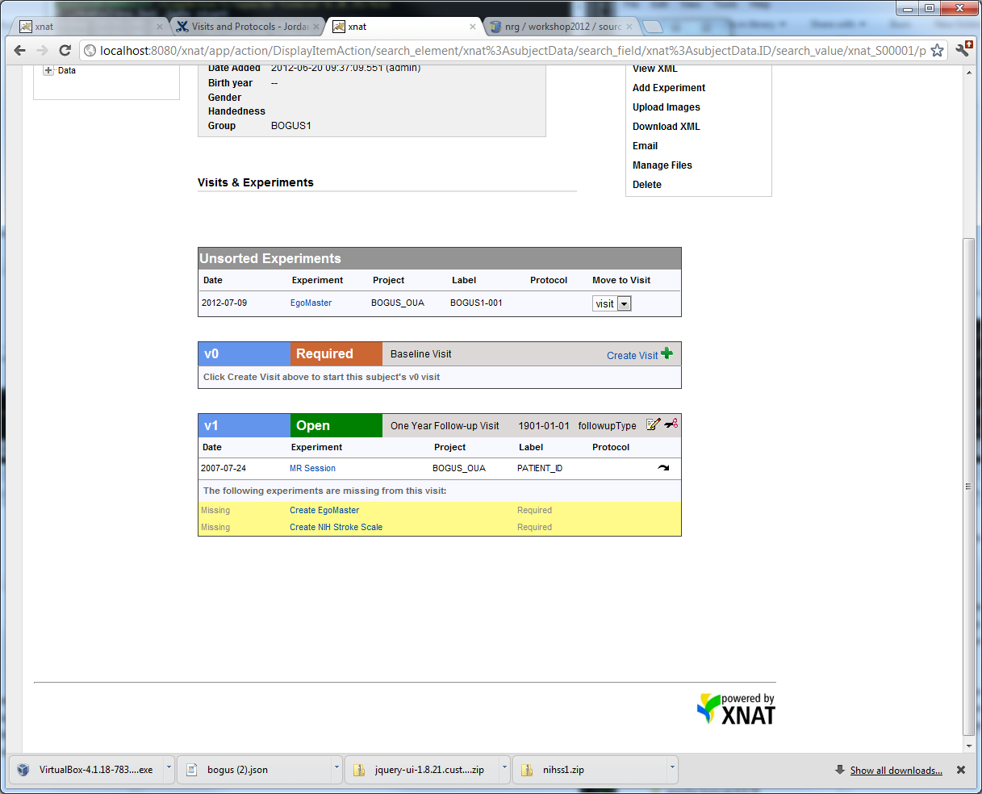
UI Example – Subject Details
Next: Visit Detail

Slide 10
UI Example – Subject Details
A Subject’s V0 (baseline) Visit
Open/Closed
Date
Type
Edit and
Delete
Visit
Required Experiment?
Missing Experiments List
(click to create if user creatable)
Valid Experiments List
(click the link to view/edit)
Remove Experiment from Visit
Next: Unsorted Detail

Slide 11
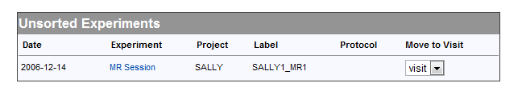
UI Example – Subject Details
A Subject’s Unsorted Experiments
Use this to assign an experiment to a Visit
Next: Create Detail

Slide 12
UI Example – Subject Details
A Visit That doesn’t yet exist
Click here to create a “V0” Visit
Next: details

Slide 13
Details
Visit Name Definition (intervals)
  Required
  Delta
  What visit types are valid for this time point
Visit Type Definition
  List of valid experiment types
  Which experiments are required/optional
  How those experiments are entered in the system
  Ability to distinguish between identical experiment types that within a visit (PET-PIB / PET-FDG)
Next: features

Slide 14
Features
Open/Close a Visit (data entry)
Ability to modify the Protocol as things change
Able to deal with data that is outside the protocol (invalid visits, experiments that don’t quite fit)
Next: Future

Slide 15
Planned Features
“Spreadsheet” type reporting to get a project-wide view of your project’s progress
Warnings when data is outside protocol
Issue tracking and Acknowledgement to indicate why something is outside protocol (suppresses future warnings)
Fine-grained rules engine to support things like out-of-order visit types and pretty much anything you can imagine (scheduling?)
Directed Path to simplify data creation
Next: how-to

Slide 16
How to Use Protocols/Visits
Install the Module
Define Protocol and code it in JSON
Upload the Protocol to the Project
Use XNAT
Change Protocol and Upload it again…
Next: BOGUS ex.

Slide 17
BOGUS Example
Baseline Visit
  3T MR
  PET-FDG
  EGO Master 3.7
  NIH Stroke Scale
One Year Follow-Up
  3T MR
  EGO Master 3.7
  NIH Stroke Scale
2 Visit Types
2 Visits
Simple Protocol, Let’s define it
Next: define VT’s

Slide 18
Visit Type Parameters
Name
Description
List of Expected Experiments
  Type
    XNAT Type for example, xnat:mrSessiondata
  Protocol
    poorly named… used to distinguish between experiments of the same type. In our first example, this is how you distinguish between PET-FDG and PET-PIB within one visit.
  User Entered?
  Create/Edit/Delete Link Template
  Required?
  Sort Order
Next: Visit Type Example

Slide 19
Visit Type Definition #1 – Full Visit
Name: Full Visit
Description: Full Visit with PET
Experiments List:
  3T MR
    Type: xnat:Mrsessiondata
    Protocol: null
    Required: true
    Sort order: 1
    User entered: false
  PET- FDG
    Type: xnat:petsessiondata
    Protocol: null
    Required: true
    Sort order: 2
    User entered: false
  EGO Master 3.7
    Type: bogus:egoMaster
    Protocol: null
    Required: true
    Sort order: 3
    User entered: false
  NIH Stroke Scale
    Type: xnatx:nihStrokeScaleData
    Protocol: null
    Required: true
    Sort order: 4
    User entered: true
Next: no PET def.

Slide 20
Visit Type Definition #2 – NO PET
Name: No Pet
Description: No PET visit
Experiments List:
  3T MR
    Type: xnat:Mrsessiondata
    Protocol: null
    Required: true
    Sort order: 1
    User entered: false
  EGO Master 3.7
    Type: bogus:egoMaster
    Protocol: null
    Required: true
    Sort order: 2
    User entered: false
  NIH Stroke Scale
    Type: xnatx:nihStrokeScaleData
    Protocol: null
    Required: true
    Sort order: 3
    User entered: true
Next: interval def.

Slide 21
Let’s Define BOGUS’
Visit Names (Intervals)
Name | Description | Delta | Allowed Visit Type List
V00 | Baseline Visit | 0 | [“Full Visit”]
V01 | Follow-up Visit | 365 | [“No Pet Visit”]
Next: BOGUS review

Slide 22
BOGUS Protocol Complete
Visit Types
  Full Visit
    List of experiments
  No PET
    List of experiments
Visit Names
  Baseline
    Only 1 allowed type – Full Visit
  1 Year Follow-Up
    Only 1 allowed type – No PET Visit
Next: JSON

Slide 23
BOGUS Protocol - JSON
JSON is a human & machine readable text file format used for data exchange. Used as a more compact alternative to XML.
{"projectID": "BOGUS_OUA",
"versionDescription”:"InitialProtocol",
"visitTypes": [
. . .
],
"visitNames": [
. . .
]
}
Experiment definitions for each type of visit go here
Standard Visit, Drug Visit
Intervals like Baseline and Follow-Up and what Visit Types are allowed go here
Ex. Baseline 6Mo 1Y
Next: json example

Slide 24
BOGUS Protocol – JSON Continued
”visitTypes": [
{
"name": "baselineType",
"description": "Baseline Visit Type",
"expectedExperiments": [
{
"type": "xnat:mrSessionData",
"protocol": null,
"createLink": null,
"deleteLink": null,
"editLink": null,
"required": true,
"sortOrder": 0,
"userEntered": false
},
{
"type": "xnat:petSessionData",
. . .
Next: upload

Slide 25
Upload the JSON
PUT to the REST API:
  /projects/BOGUS/protocols/protocol
  (JSON and Format is validated on PUT)
GET to view the JSON
DELETE to the same URI to delete protocol
PUT a new JSON file to update
  History is maintained and viewable using the Configuration REST API…
Next: Thank you

Slide 26
Any Questions?
Jordan Woerndle
XNAT Discussion Google Group
woerndlej@mir.wustl.edu
Let’s Demo!
http://wiki.xnat.org – search for “Visits and Protocols”
or go to:
https://wiki.xnat.org/display/Workshop2012Pub/Visits+and+Protocols+-+Jordan+Woerndle

