Slide 1
Getting the most from your time at Camp XNAT, or How not to be hung from the flagpole by your underwear
Dan Marcus
Camp Director
June 24, 2012

Slide 2
Lots to learn this week!
PI track (Today – Rm. 209):
  Learn about current capabilities.
  Lots of discussion about the XNAT roadmap.
Admin track (Today – Wed):
  Configure and customize.
  Get data into XNAT.
  Get data out of XNAT.
Developer track (Th – Fri):
  Make XNAT do new things.
Notes:
Who’s back from the 2010 workshop?
Who’s been using XNAT for a while?
Who’s a complete and utter novice?

Slide 3
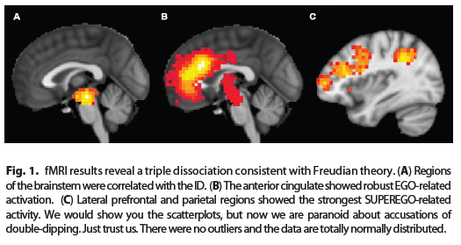
The BOGUS Study
Fisher and Student, 2012

Slide 4
The BOGUS Study
Hypothesis 1: The Ego, Id, and Superego triple dissociation is also present in anatomic structures and in the regional metabolic rate.
Hypothesis 2: Severe strokes dissolve the triple dissociation.

Slide 5
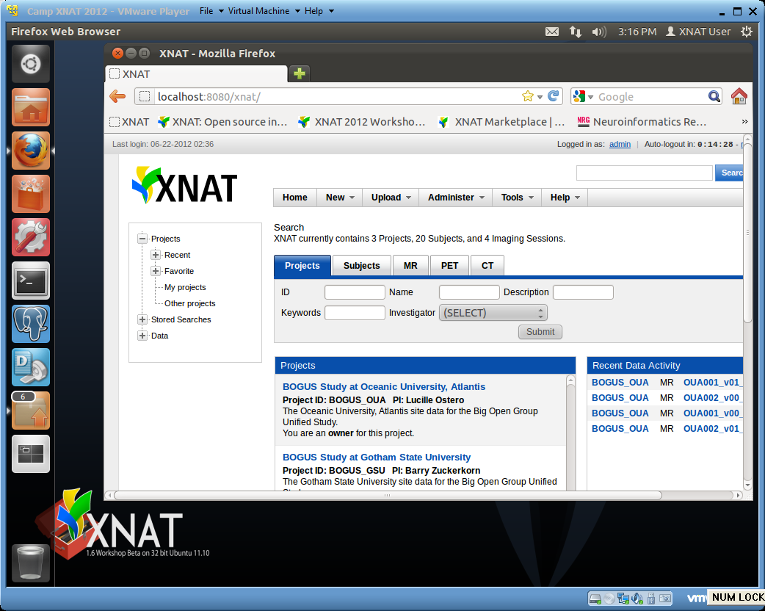
Workshop Virtual Machine

Slide 6
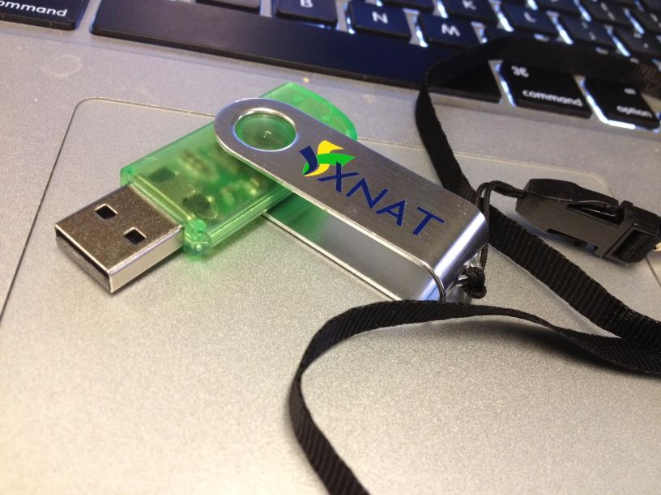
Workshop Virtual Machine

Slide 7

Activity 1 (Monday AM): Project intake
Objectives:
  Learn how to work with PIs to extract project requirements.
  Learn how to map project requirements to XNAT capabilities.
How:
  Break into small groups and interview the BOGUS study “PI”.
  Regroup to discuss XNAT capabilities.
Jenny

Slide 8

Lunch (Monday): Get your VMs ready
Objectives:
  Install the XNAT 1.6 RC 1 VM running on your laptop.
  Get familiar with VM.
How:
  Get USB drive with VM player and image.
  Follow install guide.
  Take a tour with Counselor Rick.
Rick

Slide 9

Activity 2 (Mon PM): Project setup
Objectives:
  Learn basic XNAT project configuration.
  Learn advanced configuration (anonymization, validation, protocols, sharing, …)
How:
  Configure the BOGUS project on your VM.
Tim

Slide 10
Activity 3 (Tues AM): Site setup
Objectives:
  Learn how to install existing modules.
  Learn how to create new modules.
How:
  Install a module from XNAT Marketplace for the BOGUS project on your VM.
  Create a new module for the BOGUS project on your VM.
Rick

Slide 11

Lunch (Tues): IT in the trenches
Objectives:
  Learn about IT requirements and solutions for XNAT.
How:
  Discuss IT approaches used by the CNDA support staff.
Chip

Slide 12

Activity 4 (Tues PM): Data upload
Objectives:
  Learn multiple ways to upload image data to XNAT.
  Learn multiple ways to upload non-image data to XNAT.
How:
  Upload BOGUS image data to your VM.
  Upload BOGUS clinical data to your VM.
Kevin

Slide 13

Activity 5 (Wed AM): Pipelines
Objectives:
  Learn how to create XNAT pipelines.
  Learn how to manage XNAT pipelines.
How:
  Review an existing pipeline for BOGUS.
  Write your own simple pipeline for BOGUS.
Mohana

Slide 14
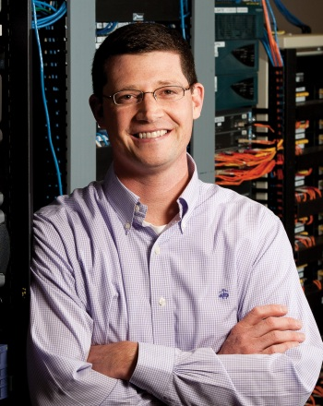
Lunch (Wed): XNAT beyond 1.6
Objectives:
  Learn about the XNAT Roadmap.
  Contribute your ideas to the Roadmap.
How:
  Dan will lead discussion.
Dan

Slide 15

Activity 6 (Wed PM): Reporting
Objectives:
  Learn how to build reports in XNAT.
  Learn how to import XNAT data into external reporting tools.
How:
  Build reports requested by the BOGUS PI.
Will

Slide 16
Developer days
Option 1: Bring your own data, data types, pipelines, configuration issues, etc.
Option 2: Work on new XNAT features
  Pick from the list on the wiki.
  Propose your own.

Slide 17
Developer days
A few talks:
  Thursday morning: XNAT internals
  Thursday afternoon: XNAT REST API
  Friday morning: XNAT’s new UI

Slide 18

Meet your camp counselors
Rick Herrick
Tim Olsen
Kevin Archie
Will Horton
Mohana
Chip Schweiss
Jordan Woerndle
Jenny Gurney

Slide 19







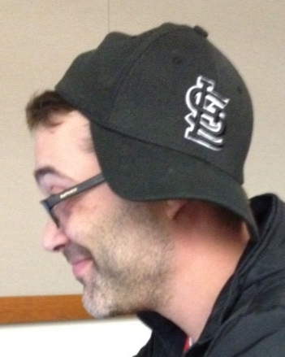
More camp staff
Jeanette Cline
Lauren Wallace
Joel Balestra
Mike McKay
Shamima Walton
James Ransford
Mark Florida
Cathy Gezella

Slide 20
Camp rules
Ask lots of questions.
For longer discussions, find a breakout spot/room. We have several reserved. Check the wiki for locations.
Use the wiki liberally – every session has a page, add comments/questions during the sessions.
Videos are being recorded for all admin sessions.

Slide 21
Camp rules
Sit toward the front.
  If you can’t read this, you’re going to miss a lot of the workshop.
You’re going to see a lot of XNAT this week – don’t get too intimidated.
XNAT 1.6 will feature prominently – please report bugs to issues@xnat.org.
Spend time with your counselors.
Feed frequently

Slide 22
Dinner tonight @ Wild Flower
Cocktails at 6:00 (cash bar)
Dinner at 7:00
Check wiki for directions (note use the side door entrance on Euclid!)
Blitz talks!

Slide 23
Happy hour tomorrow @ Brennan’s
Cocktails and light food at 5:30
Check wiki for directions (note use the side door entrance on Euclid!)
You don’t even have to give a talk!

Slide 24
Any questions?

Slide 25
XNAT 1.6
Modules
Protocols
Improved archive workflow (Merging!)
Automated anonymization
Configuration infrastructure
Multiple DICOM receivers
Security enhancements
Mail enhancements
Audit trail backend
No more mustard & bronze color theme!

Slide 26
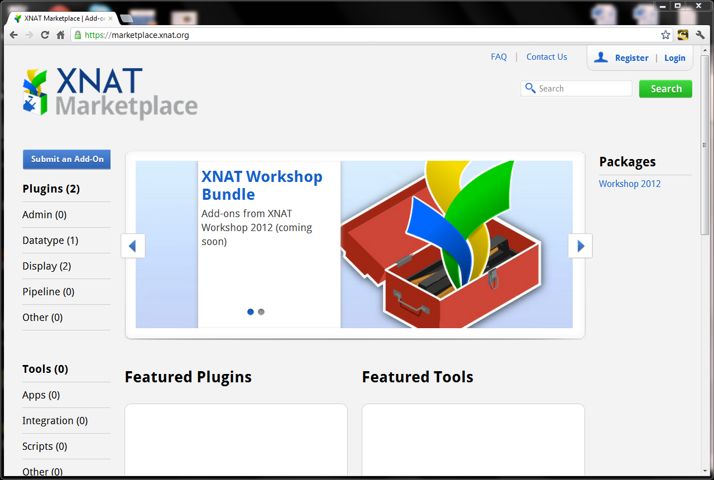
XNAT 1.6

Slide 27
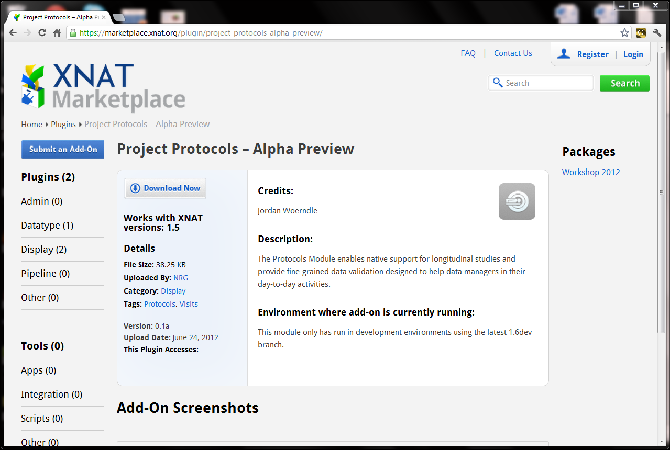
XNAT 1.6

Slide 28
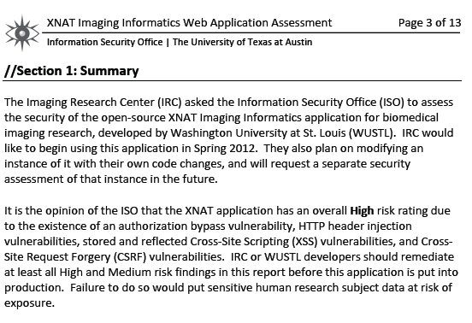
XNAT 1.6

Slide 29
XNAT 1.6

Slide 30
XNAT 1.6

Slide 31
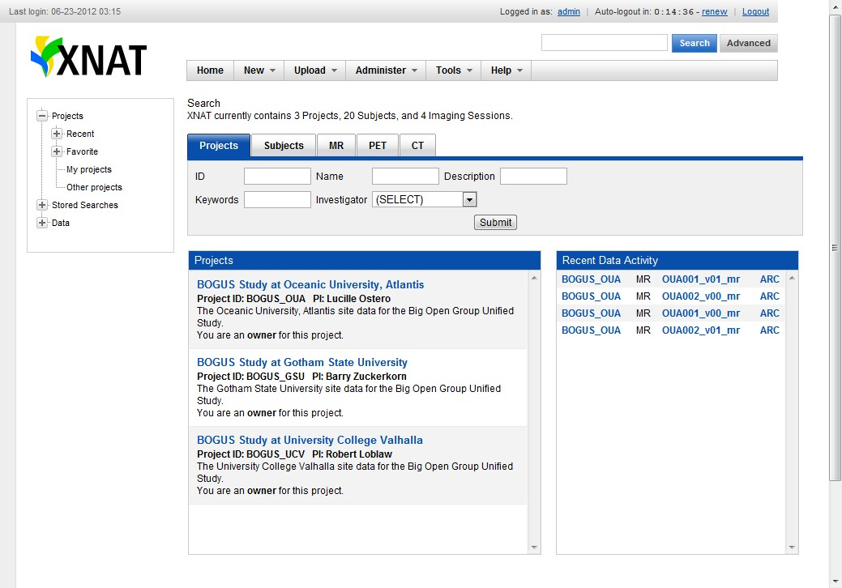
XNAT 1.6

Slide 32
XNAT 1.6

Slide 33
XNAT 1.6

Slide 34
XNAT 1.6

Slide 35
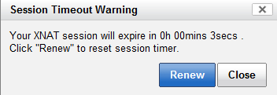
XNAT 1.6

Slide 36
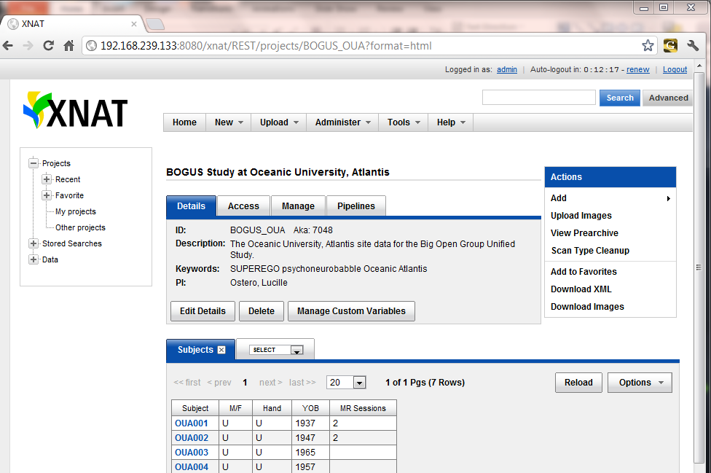
XNAT 1.6

Slide 37
XNAT 1.6

Slide 38
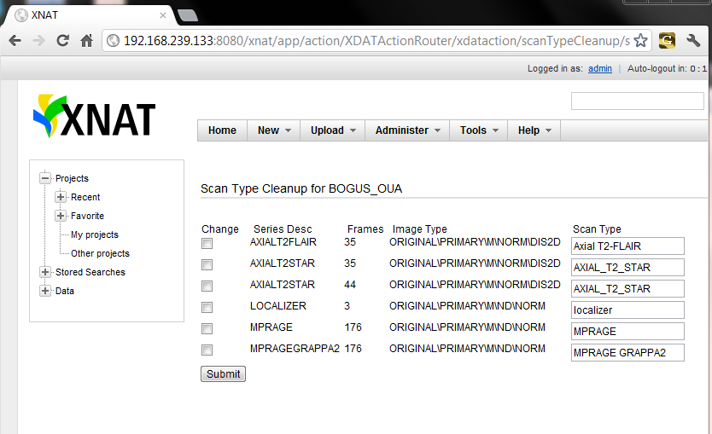
XNAT 1.6

Slide 39
XNAT 1.6

Slide 40
XNAT 1.6

Slide 41
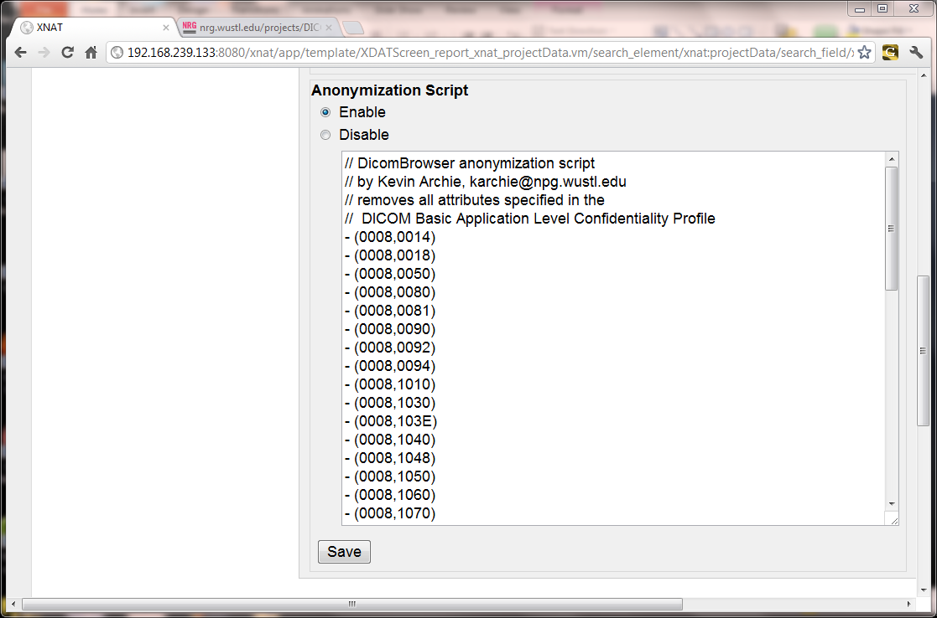
XNAT 1.6

Slide 42
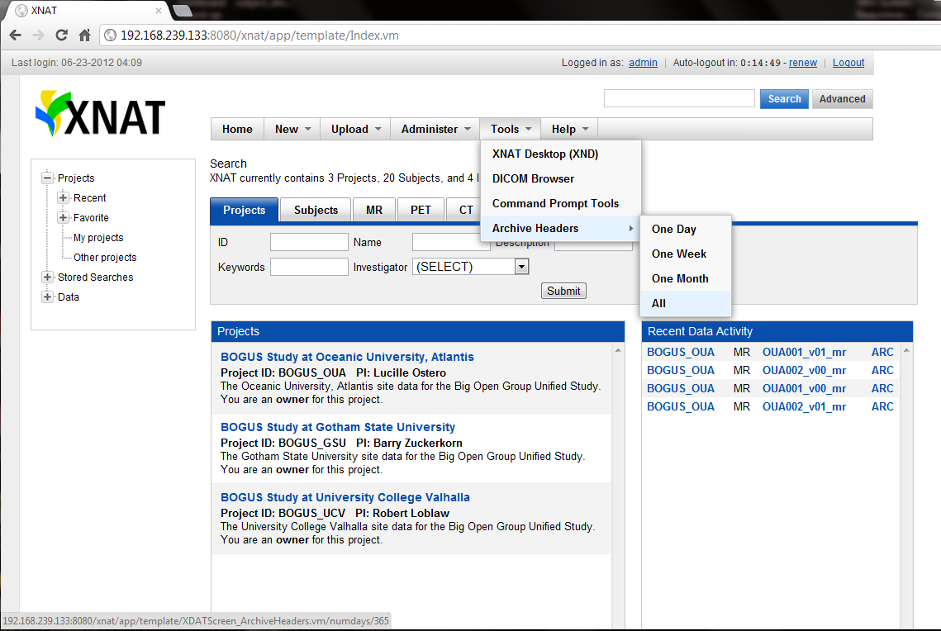
XNAT 1.6

Slide 43
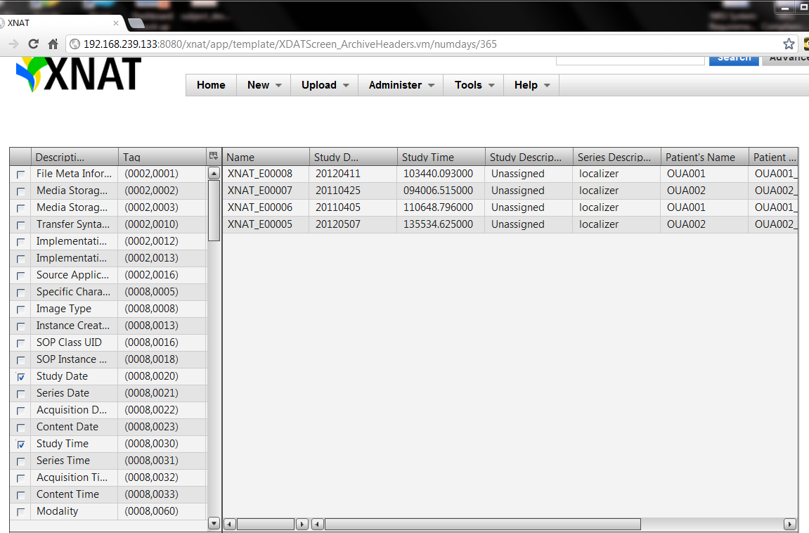
XNAT 1.6

Slide 44

Have fun, campers!

