Slide 1
Day 3:
XNAT Processing with Docker
JUN 8, 2016

Slide 2
Outline
XNAT Processing
Docker
XNAT Processing with Docker

Slide 3
XNAT Processing
Data are inside XNAT
Users want to execute external applications on data, outside XNAT

Slide 4
XNAT Processing — General Steps
Gather data from XNAT
Launch executable
Get outputs back into XNAT (sometimes)

Slide 5
Manual Execution
Download data by hand (through GUI or REST API)
Stage files in proper place by hand
Launch executables by hand
Gather outputs for upload by to XNAT

Slide 6
Manual Execution
Benefits
  Flexible
Problems
  Time consuming
  Error-prone
  Person executing commands must be expert in XNAT and executable
  Person executing commands must have access to compute machines

Slide 7
Scripting
An expert writes a script that automates…
  Downloading from XNAT
  Running executables
  Gathering outputs
Non-expert runs script

Slide 8
Scripting
Benefits
  Transfer of expertise
  Automation reduces errors
  100% flexible (in general)
  Can use tools to abstract knowledge
  Easy to share
Problems
  Script writer must be expert in XNAT & executables
  Script executor must log on to execution machines
  Heterogeneous environments

Slide 9
XNAT Pipeline Engine
An expert writes a pipeline that automates…
  Downloading from XNAT
  Running executables
  Gathering outputs
Non-expert runs pipeline

Slide 10
XNAT Pipeline Engine — Benefits
Pipelines are launched by XNAT
  Launching user needs no access to compute nodes
  Users can launch pipelines via UI, REST API, or automatically
  Schemalink parameters have values provided by XNAT at launch time
Transfer of expertise (Pipeline writer to launching user)
Automation reduced errors
Resource descriptors for common tools can be reused

Slide 11
XNAT Pipeline Engine — Problems

Slide 12
XNAT Pipeline Engine — Problems
Writing pipelines has a steep learning curve
  Structure of pipeline XML
  How Engine executes pipeline XML
  How XNAT reads/launches pipeline XML
  Distinctions between Steps, Resource Descriptors, and executables
Setting up pipelines can be hard
  Must manually place pipeline XML files on XNAT/compute machines
  Must configure each pipeline on XNAT, and also on each project

Slide 13
XNAT Pipeline Engine — Problems
Pipeline UI
  Default UI is not user-friendly
  Custom UI is possible, but has its own problems
    Pipeline writer must now also be a Java/HTML/JavaScript developer
    Deploying custom Screen class requires shutting down, rebuilding XNAT
XNAT launches pipelines, and stores their state. Nothing else.
  Cannot stop unwanted executions or restart failed executions.
  Cannot pull any logs, on failure or success. Pipeline must push.
  XNAT cannot handle data transfer. Pipeline must download/upload.

Slide 14
New Process Execution Infrastructure Goals
Deep XNAT integration
  Launchable through XNAT (UI, API, and automatically)
  Configurable through XNAT
  Deployable through XNAT
  XNAT understands how to launch, stop, restart, how to stage data, …
Flexible (Workflows, scripts, brand-new or off-the-shelf)
Easy to learn
Leverage known third-party code

Slide 15
What I Need
Remotely launch executables from XNAT
Ensure they are:
  Portable
  Deployable remotely
  Consistent

Slide 16
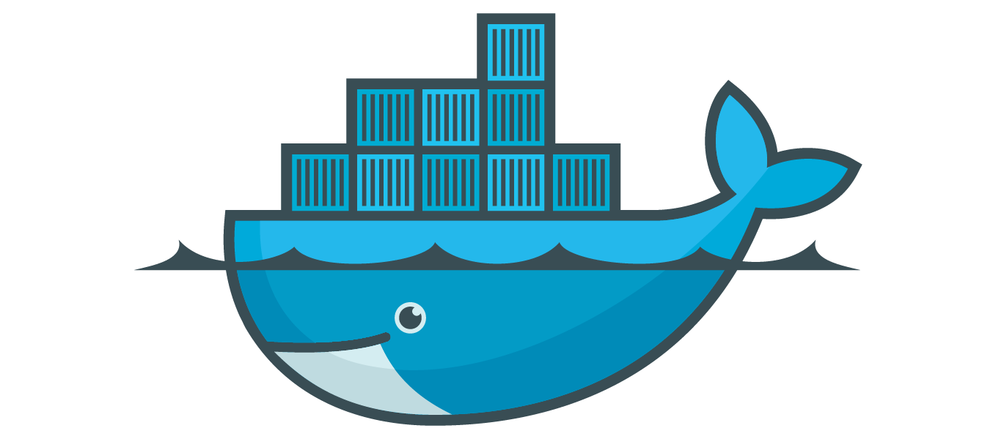
Docker

Slide 17
Docker —Terms to Know
Docker (engine)
Docker server/host
Docker image
Docker container
Docker Hub (generic: Docker Registry)

Slide 18
Docker — How to get it
Native on Linux
Mac/Windows: Docker Toolbox (docker, docker-compose, docker-machine, etc.)
Mac: Homebrew
Mac/Windows: Native Docker currently in Beta

Slide 19
Docker
Demo: Pull a Docker Image

Slide 20
Docker
Demo: Build a Docker Image

Slide 21
Review
Processing XNAT data
Intro to Docker
Processing XNAT data with Docker…

Slide 22
XNAT + Docker
Caution: Pre-alpha! Code & concepts will change.

Slide 23
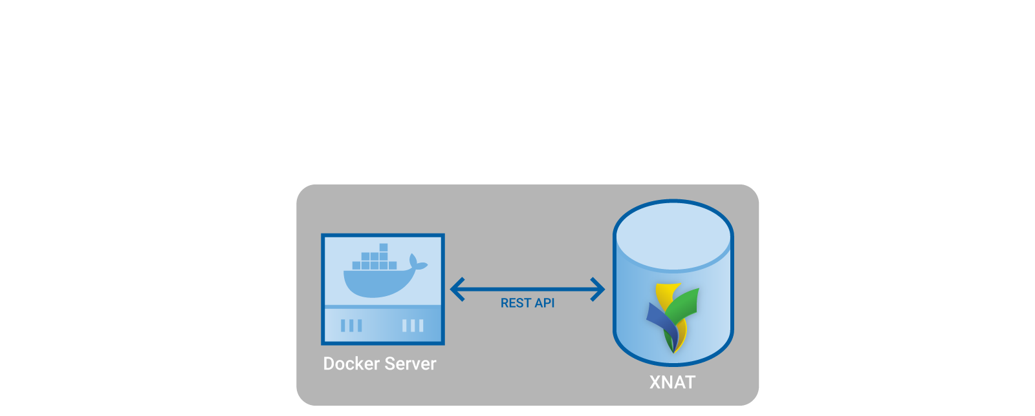
XNAT + Docker

Slide 24
XNAT + Docker
Manage images on Docker server (pull, delete)
Launch and manage containers
Stage data to and from Docker server (a.k.a. execution node)

Slide 25
XNAT + Docker — Steps to Execution
Pull a Docker image
Define the image within XNAT
Define a Command
Define an Action
Execute an ACE (Action/Context Execution)

Slide 26
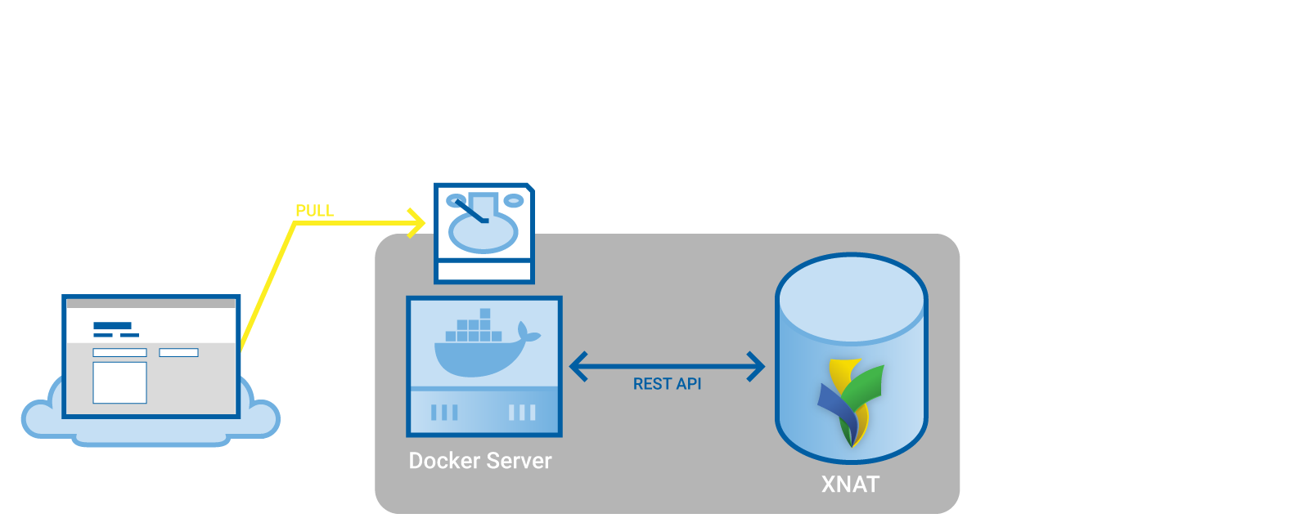
XNAT + Docker — Pull a Docker Image

Slide 27
XNAT + Docker — Docker Images
Must tell XNAT about Docker Image
  Name
  Docker Image ID
  Labels
If we use XNAT to pull the image from a hub, we provide these image metadata at the same time

Slide 28
XNAT + Docker — Docker Images
Demo: xnat/dcm2niix

Slide 29
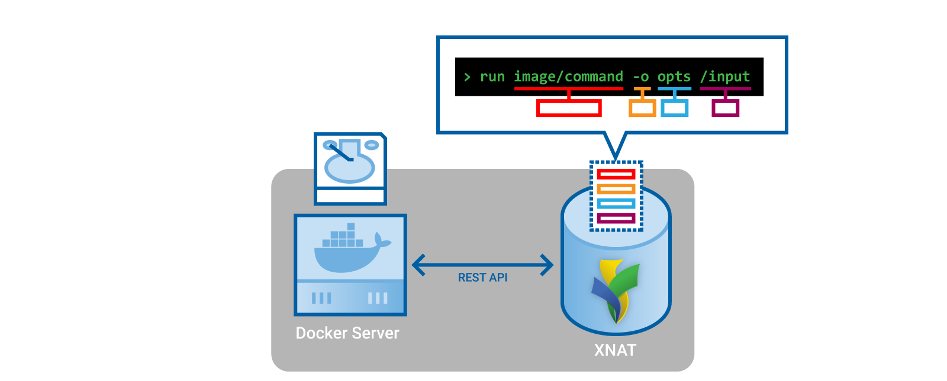
XNAT + Docker — Commands

Slide 30
XNAT + Docker — Commands
Defines how to run a command in a Docker image
  “docker run” command
  environment variables
  mounts
Can define variables that will be filled in with values at runtime
No XNAT-specific information required
(but you can provide hints to XNAT)

Slide 31
XNAT + Docker — Commands
Demo: dcm2niix command

Slide 32
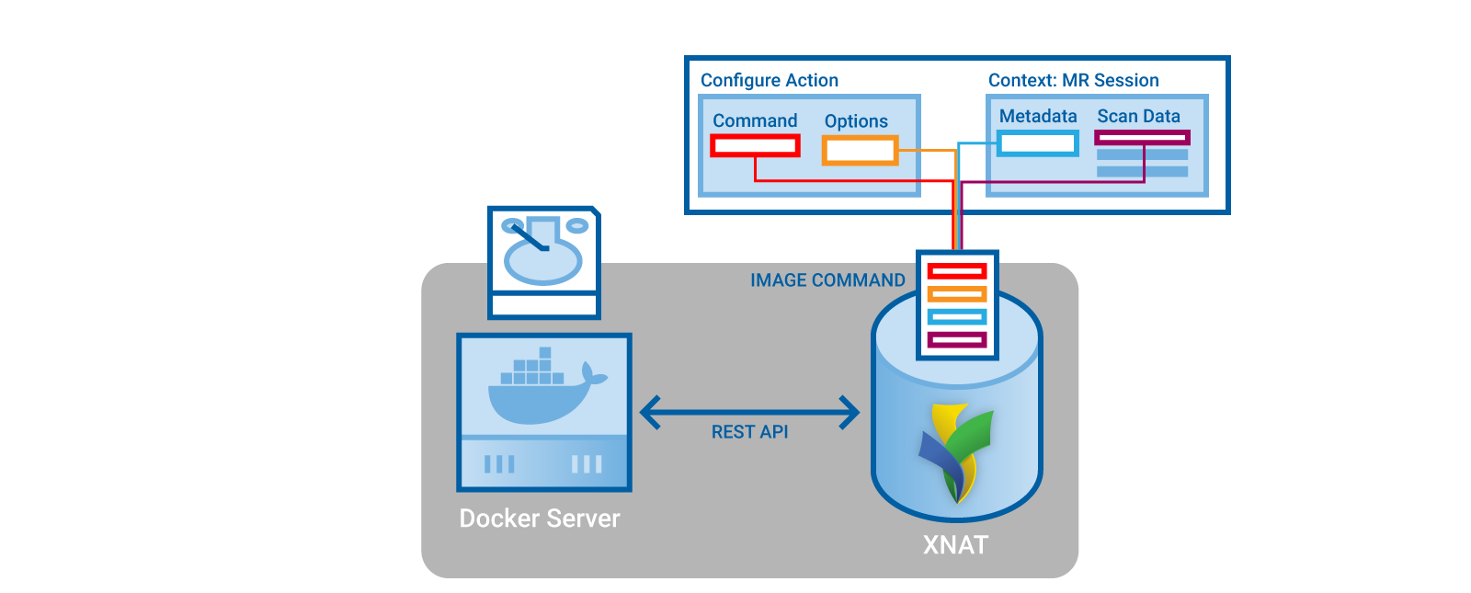
XNAT + Docker — Actions

Slide 33
XNAT + Docker — Action
Defines a root XNAT object on which it can be executed
(the “Context”)
Defines how to fill in Command variables from root object
Defines the resources to be staged for the Command’s input mounts, and to be created from the Command’s output mounts

Slide 34
XNAT + Docker — Action
Demo: dcm2niix on a scan

Slide 35
XNAT + Docker — ACE
Action / Context Execution
Action is a template for how to run something
Context is a representation of where you are / what you’re looking at / what you want to execute an Action on.
ACE: fully resolves all template variables in Action and Command

Slide 36
XNAT + Docker — ACE
Demo: Execute dcm2niix Action

Slide 37
XNAT + Docker — UI
Demo: UI Wireframes with Will

Slide 38
Use Cases
XNAT User wants to run Freesurfer
XNAT Admin
  Pulls Freesurfer Docker Image (or builds a new one)
  Configures Command to launch the Image: Ex. “recon-all [subject dir]…”
XNAT User
  Configures Action to execute Command from MR Sessions
  Runs Freesurfer as an ACE by Executing the Action from an MR Session Context

Slide 39
Use Cases
XNAT User has a script that runs a few FSL commands
XNAT Admin
  Builds a new Docker Image with FSL and the User’s script
  Configures a Command to launch the Image
XNAT User
  Configures an Action to execute the Command from MR Sessions
  Runs their script as an ACE by Executing their Action from an MR Session Context

Slide 40
Use Cases
XNAT User has a script that runs a few FSL commands
XNAT Admin
  Gathers information about script (language, requirements, etc.)
  Pulls FSL Docker Image (or builds a new one)
  Configures a new Script Environment
XNAT User
  Adds their script to XNAT’s script repository
  Configures Command
  Configures Action
  Executes ACE

Slide 41
Script Environment
Rather than a single-application Docker Image, can use a generic container (e.g. python, R, MATLAB, nipype, OpenMOLE, etc.)
Admin makes image available as Script Environment
Users can add scripts, configure them, and launch them as ACEs

Slide 42
Use Cases
Developer wants to make application available for XNAT users
Developer builds Docker Image with application + dependencies
XNAT Admin pulls Image, defines Command
XNAT Admin or User defines Action
User Executes ACE

Slide 43
Use Cases
Developer wants to make application available for XNAT users
Developer builds Docker Image with application + dependencies
Developer writes metadata into Docker Image that define Commands and Actions
XNAT Admin pulls Image
User Executes ACE

Slide 44
Future
Get feedback on design
Finish remaining major features
  Resource importing
  Monitoring
  UI
  Bulk execution on collections
Get a beta into your hands

Slide 45
Conclusion
Data are inside XNAT
Users want to execute external applications on data, outside XNAT

Slide 46
Conclusion
My focus
  Make it as easy as possible to get data out of XNAT
  Make it as easy as possible to run whatever you want from XNAT
Your focus
  Think about how you can use this
  Give me feedback

Slide 47
Contact me
jflavin@wustl.edu
xnat_discussion Google group
github.com/nrgxnat/container-service

Slide 48


