Slide 1
Automated XNAT Testing with Selenium and JIRA
Charlie Moore, June 7, 2016

Slide 2
Outline
Brief Introduction to Selenium
XNAT-themed tests based around Selenium and testNG:
  CNDA Pipeline Tests
Brief overview of test integration with JIRA and Zephyr

Slide 3
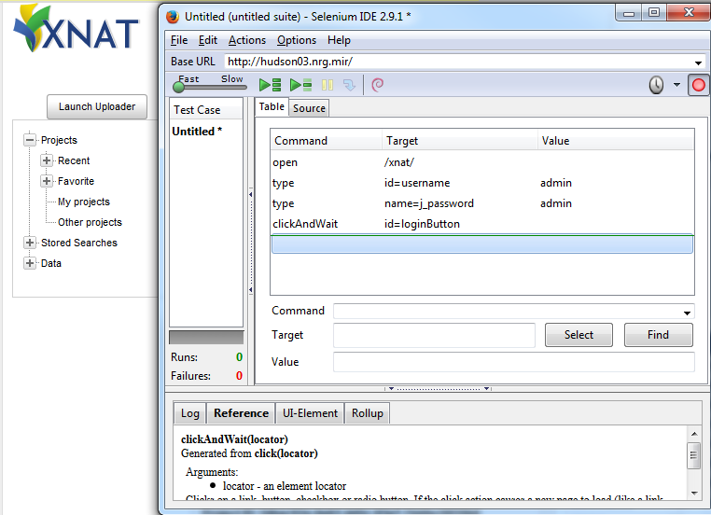
Getting Set up with Selenium
Selenium “IDE”
  Pros:
    Easy
    Recording
    Lightweight
  Cons:
    Scalability
    Frailty
    (Un)portability
    Lightweight

Slide 4
Getting Set up with Selenium
Selenium WebDriver
  Robust
  Multiplatform/browser
  Maintainable
  Available at:
    http://www.seleniumhq.org/download/, or
    Java library available with maven:
<dependency>
<groupId>org.seleniumhq.selenium</groupId>
<artifactId>selenium-java</artifactId>
<version>2.53.0</version>
</dependency>

Slide 5
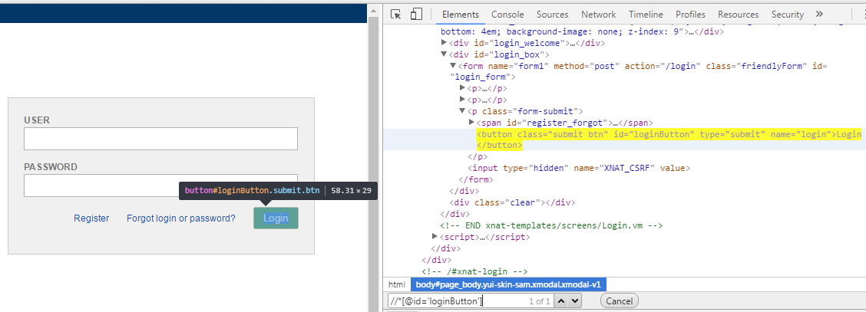
Getting Started with Selenium
Identifying elements of interest:
  Gold standard: element ids
  Plan B: More advanced locating
  strategies like XPath
Working with WebElements:
  Predefined methods for clicks, filling fields, etc.
driver.findElement(By.id("loginButton")).click();

Slide 6
CNDA Selenium Pipeline Tests
Base NRG Selenium Package:
  Source of the engine to actually run the tests.
  Extra Crispy 1.7 version: https://bitbucket.org/xnatdev/nrg_selenium
  Legacy 1.6 version: https://bitbucket.org/xnatdev/nrg_selenium_1_6
  CNDA pipeline tests use 1.6 since CNDA is running XNAT 1.6
CNDA Pipeline Test Package:
  Contains specific CNDA pipeline tests.
  Available at: https://bitbucket.org/xnatdev/cnda_selenium_pipeline_tests

Slide 7
Pipeline Test Schematic (testNG annotations)
@BeforeSuite:
  Check to ensure that the selenium user account is setup correctly on CNDA
@Test phase:
  Launch all pipelines, each launch corresponding to 1 @Test
  For each pipeline that passed the launch phase, run various customized checks on the session to ensure correct pipeline execution. The checks for each session correspond to 1 @Test and include:
    Creation of assessors
    Files created under parent session resources/scans, files created under assessor
    Values displayed in created assessors, checked to match specified criteria such as exact equality, within 1% error, etc.

Slide 8
Pipeline Launch Test
Entire test can be constructed as a List of simple elements describing basic core operations (click, fill text, select dropdown option, etc.)
@Test()
public void testLaunchFS_PUP() {
config.add(new TestStepElement(By.id("start"), XNATLocators.BUTTON_ADVANCE));
config.add(new SelectElement(By.name("pet_scan_id"), "5: DIAN PIB 336mtx (AC)"));
config.add(new TestStepElement(By.id("start"), XNATLocators.BUTTON_ADVANCE));
config.add(new ClickElement(By.xpath("//input[@value='freesurfer']")));
config.add(new TestStepElement(By.id("start"), XNATLocators.BUTTON_ADVANCE));
config.add(BUTTON_ADVANCE_CLICK_ELEMENT);
config.add(new TestStepElement(By.id("start"), XNATLocators.BUTTON_ADVANCE));
config.add(new ClickElement(By.xpath("//input[@data-mrlabel='PUP_FS_MR']")));
config.add(new TestStepElement(By.id("start"), XNATLocators.BUTTON_ADVANCE));
config.add(BUTTON_ADVANCE_CLICK_ELEMENT);
config.add(new TestStepElement(By.id("start"), XNATLocators.BUTTON_ADVANCE));
config.add(new FillElement(By.name("refroistr"), "Cerebellum-Cortex"));
config.add(new TestStepElement(By.id("start"), XNATLocators.BUTTON_ADVANCE));
config.add(BUTTON_ADVANCE_CLICK_ELEMENT);
config.add(new TestStepElement(By.id("start"), XNATLocators.BUTTON_ADVANCE));
config.add(new SimpleClickElement(XNATLocators.BUTTON_ADVANCE));
config.add(new AlertElement("Build pipeline with these parameters?"));
config.add(new TestStepElement(By.xpath("//*[contains(text(), 'The build process was successfully launched')]"), By.xpath("//td[@valign='bottom']")));
config.add(new SimpleClickElement(By.xpath("//input[@value='CLOSE']")));
performPipelineTest(PUP_FS_SESSION, "PETUnifiedPipeline", PUP_HISTORY_NAME);
}

Slide 9
Pipeline Check Test
Standardized steps pass through checkPipelineTest method. Customized operations are added after checkPipelineTest() method is called.
@Test()
public void testCheckFS_PUP() {
checkPipelineTest(PUP_FS_SESSION, Collections.singleton("PUP Timecourse"), null, 600, 60 * 60 * 4, PUP_HISTORY_NAME);
seleniumUtils.exceptionSafeClick(By.linkText("PUP Timecourse"));
captureStep(XNATLocators.H2_TAG, XNATLocators.DELETE_LINK);
compareTable(importValuesFromCSV("PUP_FS_values.csv", PUP_FS_SESSION), "FS PUP Summary values",
XNATLocators.SHORT_SUMMARY_TABLE, XNATLocators.QC_RESULTS_TABLE);
driver.findElement(By.linkText("View Full Results")).click();
seleniumUtils.captureTable(FULL_TABLE, 16);
compareTable(importValuesFromCSV("PUP_FS_values_page_2.csv", PUP_FS_SESSION), "FS PUP Full values");
logLogout();
checkVerificationErrors();
}

Slide 10
Now what?
Great, I have these Selenium tests, but…
What happens when something goes wrong?
Alternatively, what if I want a record of my tests?
Both concerns are alieviated by integrating Selenium tests with JIRA (more specifically, the Zephyr and ZAPI JIRA plugins).
  Provided by nrg_selenium packages mentioned earlier

Slide 11
JIRA Integration Schematic (testNG annotations)
@BeforeSuite phase:
  Create a new Test Cycle under the specified JIRA project and version.
  Add an execution for each test to be run under this cycle.
@Test phase:
  As each @Test begins, corresponding execution is updated from unexecuted to WIP (Work in Progress)
  Steps are updated in JIRA as @Test reaches key points.
  Upon successful @Test completion or failure, corresponding execution is updated appropriately.

Slide 12
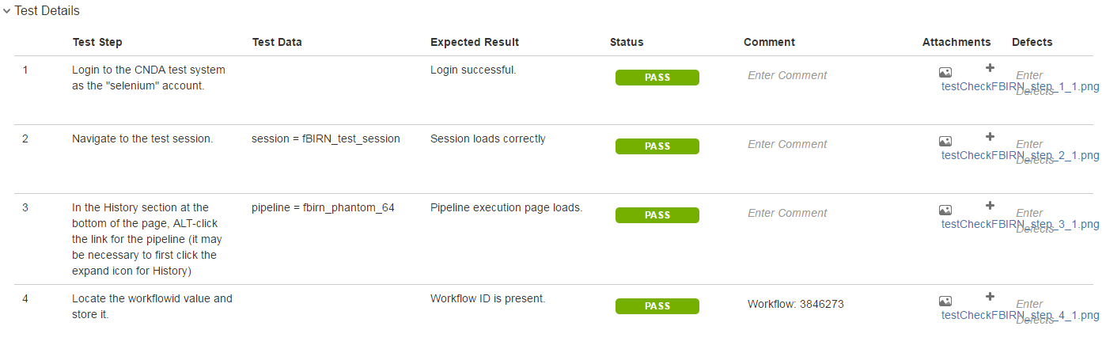
Final Product
A portion of a test execution in JIRA:

Slide 13
Wrapping Up
List of all links in presentation:
  http://www.seleniumhq.org/download/
  https://bitbucket.org/xnatdev/nrg_selenium
  https://bitbucket.org/xnatdev/nrg_selenium_1_6
  https://bitbucket.org/xnatdev/cnda_selenium_pipeline_tests
Questions?
  You can also email me later: moore.c@wustl.edu

