Slide 1
XNAT 1.7:
Getting Started
6 June, 2016

Slide 2
Introduction
In this presentation we’ll discuss:
Features and functions in XNAT 1.7
Requirements
Installing
Configuring
Upgrading

Slide 3
What’s new in XNAT 1.7
Lots of stuff:
Ease of installation
Integrated configuration
Easy to customize and extend:
  Plugin architecture
  REST APIs
  System events
  Powerful scripting functions
Notes:
Emphasize new stuff,

Slide 4
What’s new in XNAT 1.7
Installation:
A single installation file means no more builder or scripts!
No source code or folders to keep track of
Minimal system configuration required
Easy installation makes it easier to upgrade later
Notes:
Pre-install requirements still include setting up directories writable by the Tomcat owner and also the home folders: config, logs, plugins, and work.

Slide 5
What’s new in XNAT 1.7
Configuration:
All configuration is persisted in the database,* so…
No configuration files embedded in the application!
Easy to extend system configuration properties
Database configuration simplifies back-up and restoral
* OK, the database properties are in a file. But not inside the application!

Slide 6
What’s new in XNAT 1.7
Integration:
All new REST APIs are documented inline (Swagger)
Event framework
Scripting
Container service

Slide 7
What’s new in XNAT 1.7
Extending and customizing XNAT:
@XnatPlugin functionality (framework configuration)
Existing data types still work, but are more easily integrated
A real plugin architecture: extensions are now separate projects
Preferences framework
Custom REST APIs
Scheduled tasks
Application-wide event handling framework

Slide 8
Installation requirements
Linux platforms preferred, OS X and Windows supported
Java 7 or 8
Tomcat 7 (optional front-end proxy)
PostgreSQL 9.4 or later
Notes:
For front-end proxy set up, if you want to do load balancing you have to have a front-end proxy. SSL configuration is much easier to do with nginx as well.

Slide 9
Installing XNAT 1.7
XNAT 1.7 still requires some system configuration:
Integrate front-end proxy (nginx, apache) with Tomcat (optional)
Configure Tomcat and PostgreSQL
Create required folders and set ownership and permissions
Configure XNAT home and database configuration

Slide 10
No but actually installing XNAT 1.7
OK fine!
Copy XNAT war file into the webapps folder
…
And...
...
I’m waiting...

Slide 11
And that’s it!
But…
The builder process is gone, replaced by:
  A Gradle plugin that generates code from data-type schema files
  Database schema generation and updates managed on the fly
The XNAT war file contains the complete application
Because nothing is configured through properties files in the web app, there’s no need to set those in the builder folder nor to change them within the application itself
Notes:
This will only make sense if you’ve installed a previous version of XNAT, but for people who will be installing XNAT for the first time with version 1.7, it’s a good time to start!

Slide 12
Other installation options…
Downloading and installing the war is the easiest, but you can also:
”Explode” the war
Use the development code:
  Clone the XNAT code repository
  Build using the included gradlew
  Run the exploded code
Run from a development tool like IntelliJ or Eclipse

Slide 13
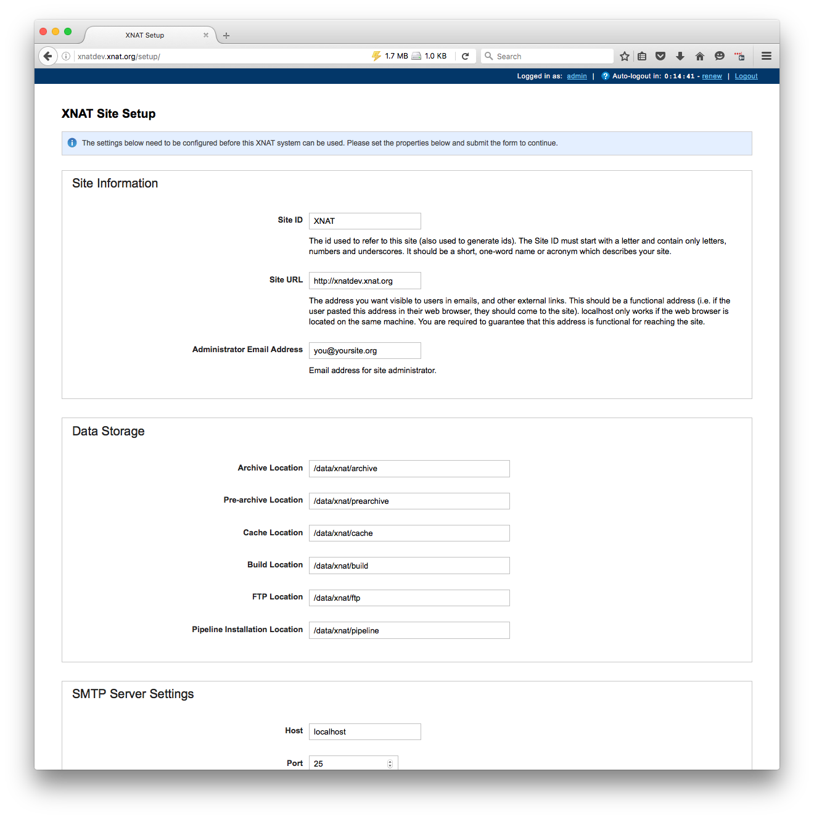
Configuring XNAT 1.7
Minimal configuration outside of the application:
Set the location of xnat.home in the Tomcat configuration
Create xnat-conf.properties file in ${xnat.home}/configs
Configure your new XNATwith the setup page

Slide 14
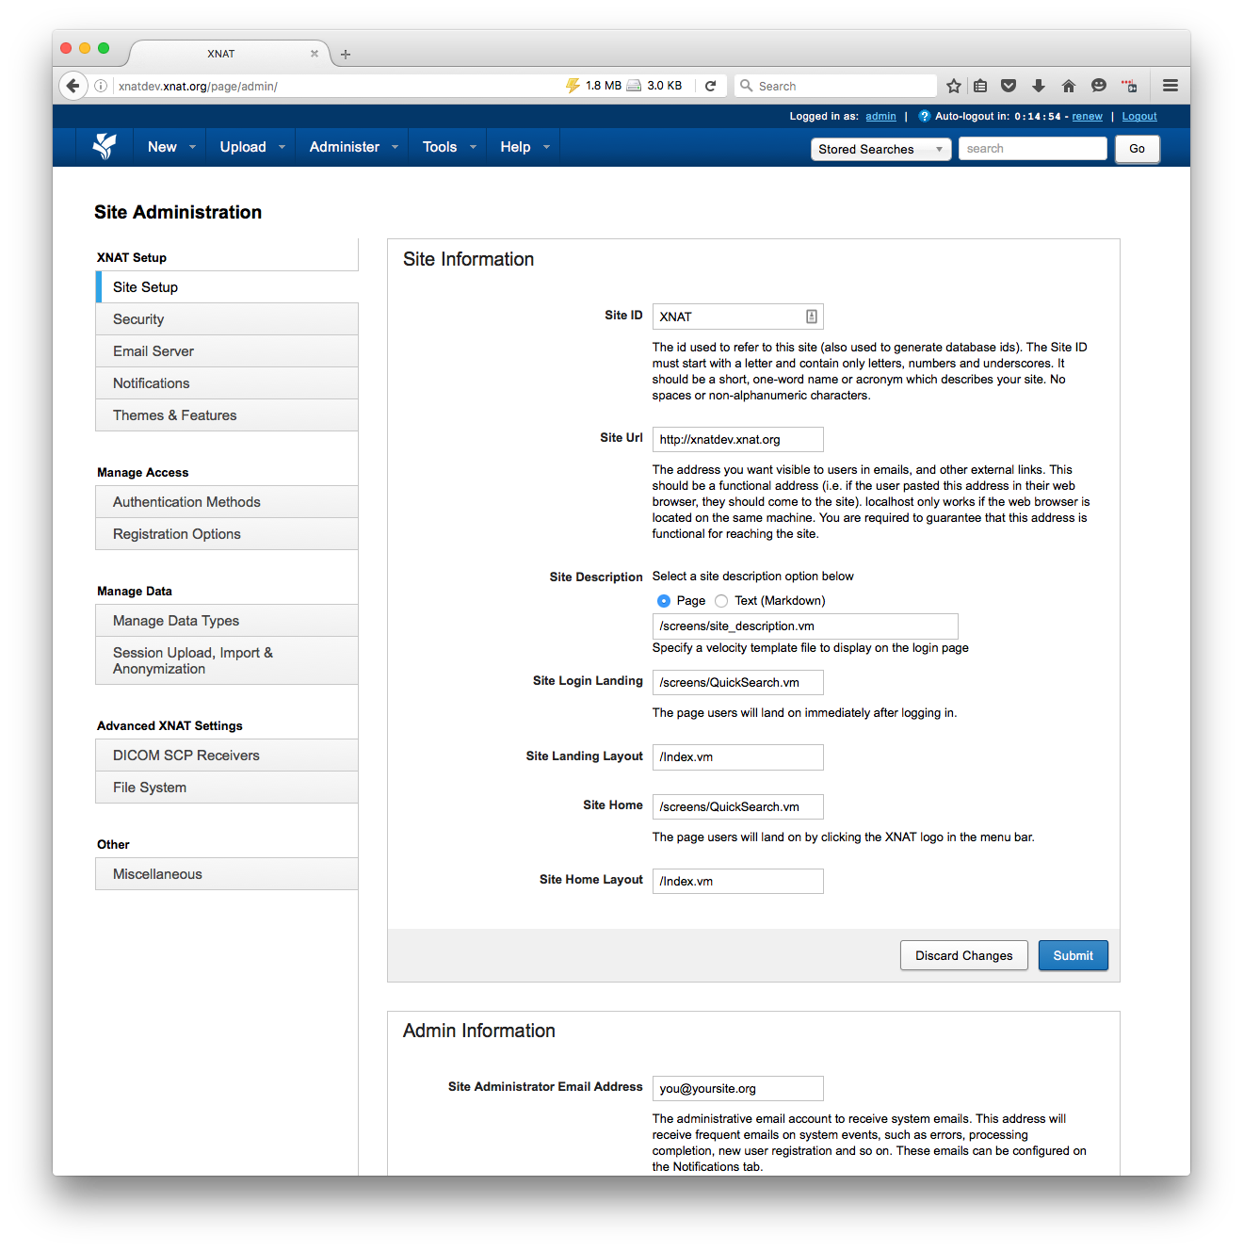
Configuring XNAT 1.7
Once the initial set up is completed, all system configuration is managed through the application
Custom properties can be set on the site configuration
Custom UI elements can be configured through the Spawner
Plugins provide their own configuration interfaces

Slide 15
Upgrading to XNAT 1.7
The underlying architecture for 1.7 is mostly the same as 1.6:
All of the data types are the same
Security and user data are the same
Most existing configuration data will migrate quietly

Slide 16
Upgrading to XNAT 1.7
Take steps to test the migration and preserve your data:
If possible, test on a development server first!
Back up your XNAT database, data archive, and application
Because XNAT 1.7 doesn’t use the builder, you don’t have to worry about conflicts with files in your existing build structure
Any custom code or modules will need to be migrated to the XNAT 1.7 plugin structure.

Slide 17
XNAT 1.7 Walkthrough
Provisioning
Installing
Configuring

Slide 18
Q&A
More info on extending XNAT and custom configuration options in Programming XNAT

