Slide 1
PyXNAT
PyXNAT 101 : Introduction to pyxnat.
David J. Just

Slide 2
Agenda
What is pyXNAT
Connecting to a server
Accessing Objects
Creating Objects
Reading/Writing attributes
Uploading/Downloading Files

Slide 3
What is pyXNAT
PyXNAT is a python interface to XNAT’s REST API
Simplifys writing data interactions with xnat by giving you a local programmable interface to XNAT’s data.
Supplies methods of searching, object access, and file upload/download.
Getting started: http://pythonhosted.org/pyxnat/

Slide 4
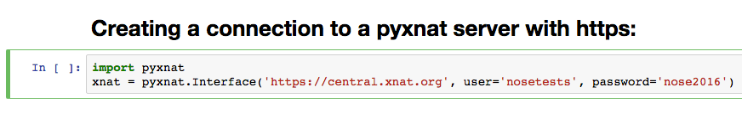
Connecting to XNAT

Slide 5
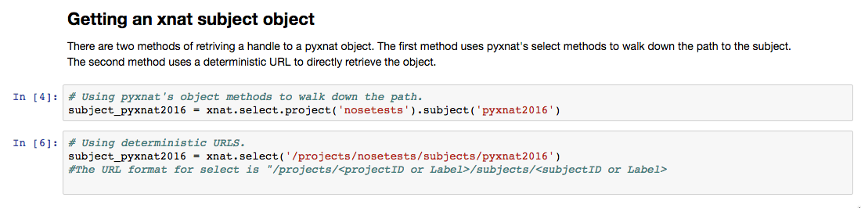
Accessing an Object:

Slide 6
Accessing objects : Paths.
XNAT Paths are deterministic. It is possible to generate the valid path to any object by knowing it’s label and it’s parents labels. If you want a list of all objects at any given level, leave off the last label.
/projects : list of all projects.
/projects/myproject : handle to project <myproject>
/projects/myproject/subjects/mysubject/experiments/theExperiment/scans/scanOne
  This is a direct reference to scan with label “scanOne” under experiment “theExperiment” subject “mysubject” and project “myProject”

Slide 7
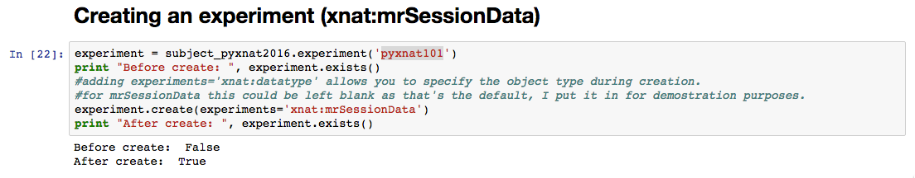
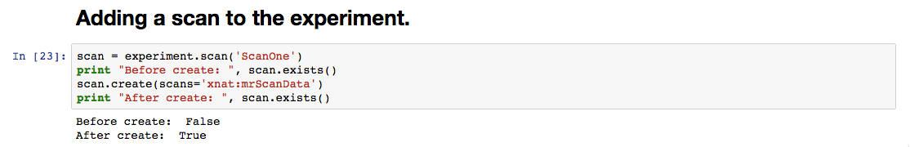
Creating Objects

Slide 8
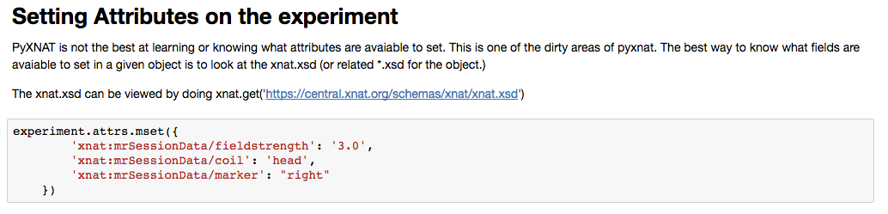
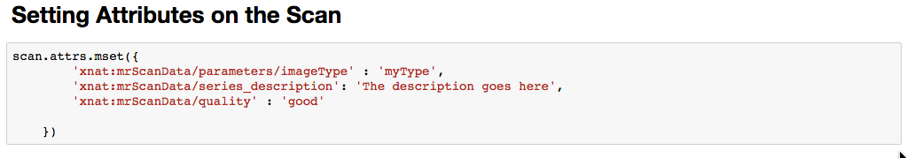
Setting Attributes

Slide 9
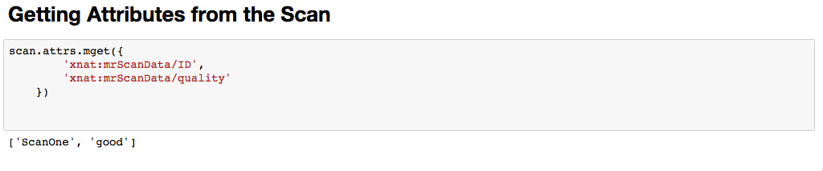
Getting Attributes

Slide 10
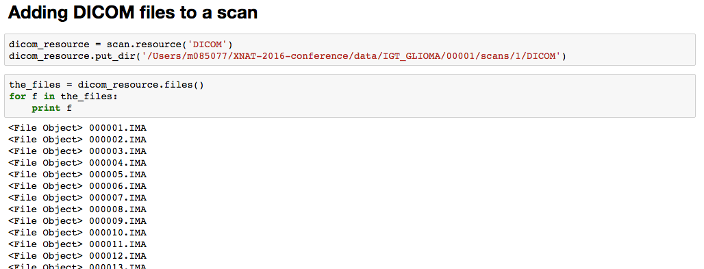
Uploading Files (DICOM)

Slide 11
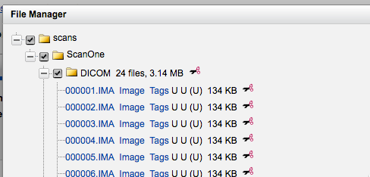
Uploading Files (DICOM)

Slide 12
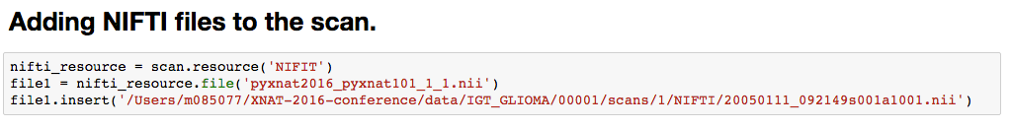
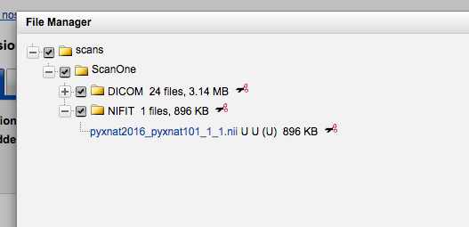
Uploading files (Not DICOM)
PyXNAT is not limited to dicom files. You can upload any type of file you want to any resource you want.

Slide 13
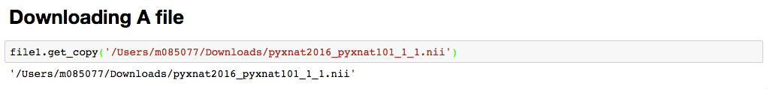
Downloading a File
Get_copy pulls a copy of the file off of xnat and saves it to the full path specified. When using get_copy it is required to specify the file name along with the path.

Slide 14
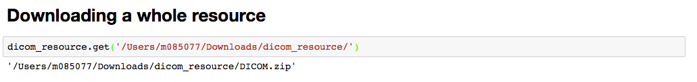
Downloading a whole resource
When downloading a whole resource it downloads as a zip file by default. The path that you give must exist before calling get.
You can specify ‘extract=true’ if you want pyxnat to extract the zip file for you.
If left as a zip, the zip will contain the same data structure format as the resource did on XNAT.

